Slide 2

Meteorology for the Amateur Astronomer
Presented by Jim Lawrence
Jim Lawrence joined WAVY in June, 1991 as a fill-in weathercaster. In October of 1995, he became a full-time weathercaster for WAVY and for the Local Weather Station.
He is a member and seal holder of both the American Meteorological Society and the National Weather Association. Long-time residents of Hampton Roads can remember that Jim spent nearly 20 years as a personality for one of the area's best radio stations.
Jim is a native of Louisville and is a graduate of Old Dominion University with an emphasis in science. In 1995, Jim graduated from the Mississippi State Broadcast Meteorology Program. He is an avid astronomer whose collection of telescopes includes 12 and 16-inch reflectors and a Celestron 14.
He and his wife Jacqueline reside in Virginia Beach.

Slide 3
Just what is “seeing”
Just what is “seeing”?
  The pool analogy…
What is Relative Humidity and why do we care?

Slide 4
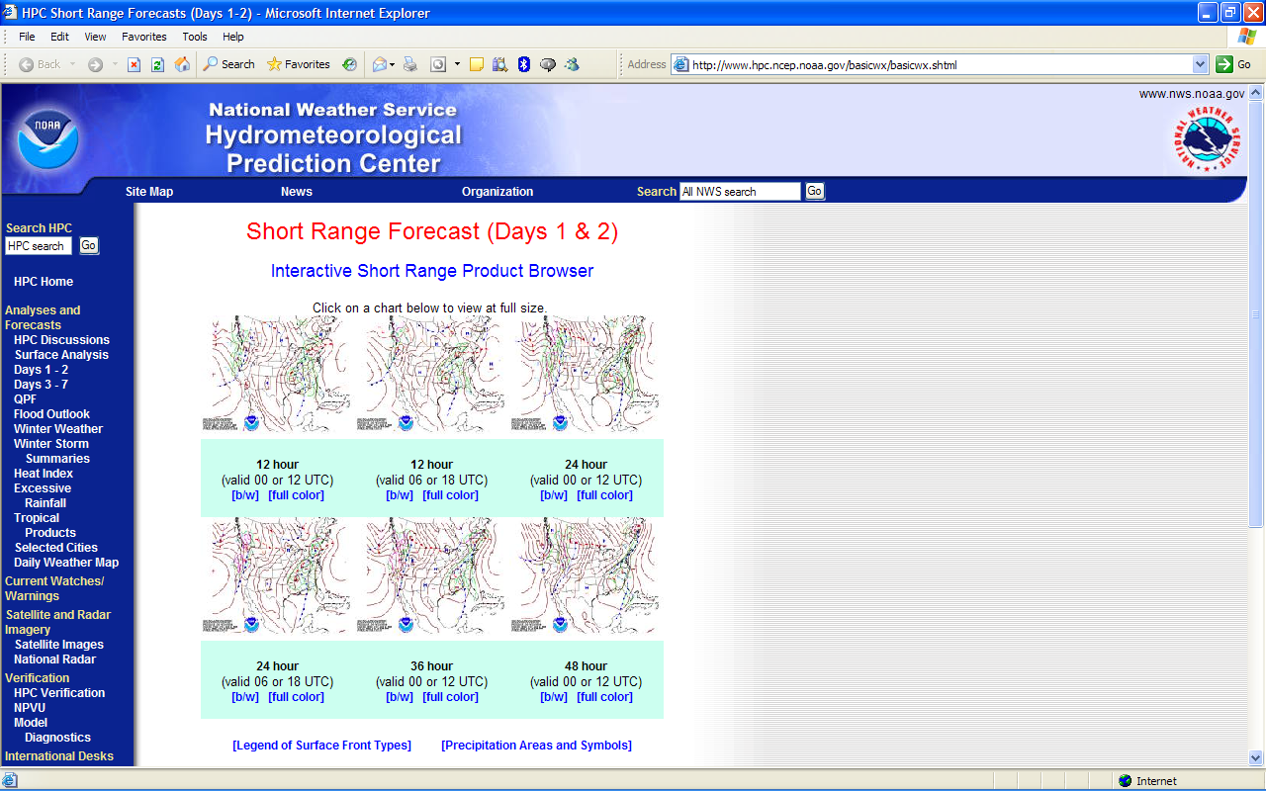
Hydrometeorological Prediction Center http://www.hpc.ncep.noaa.gov/basicwx/basicwx.shtml

Slide 5
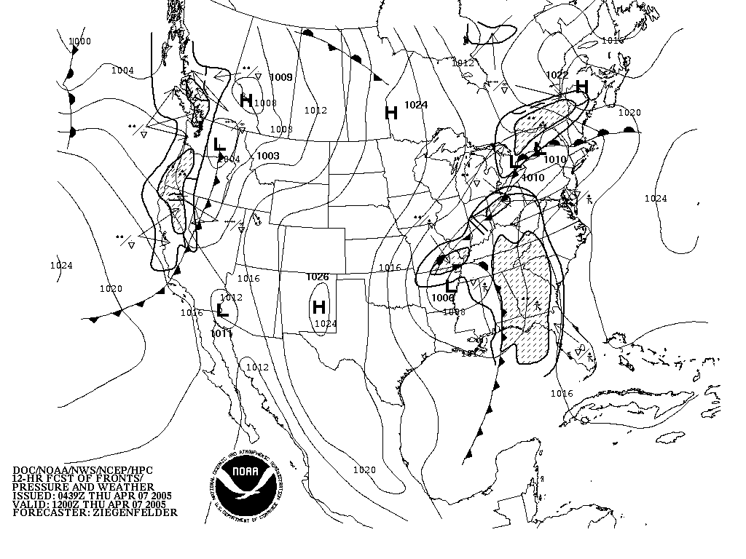
Hydrometeorological Prediction Center http://www.hpc.ncep.noaa.gov/basicwx/92fbw.gif

Slide 6
Hydrometeorological Prediction Center http://www.hpc.ncep.noaa.gov/basicwx/basicwx.shtml

Slide 7
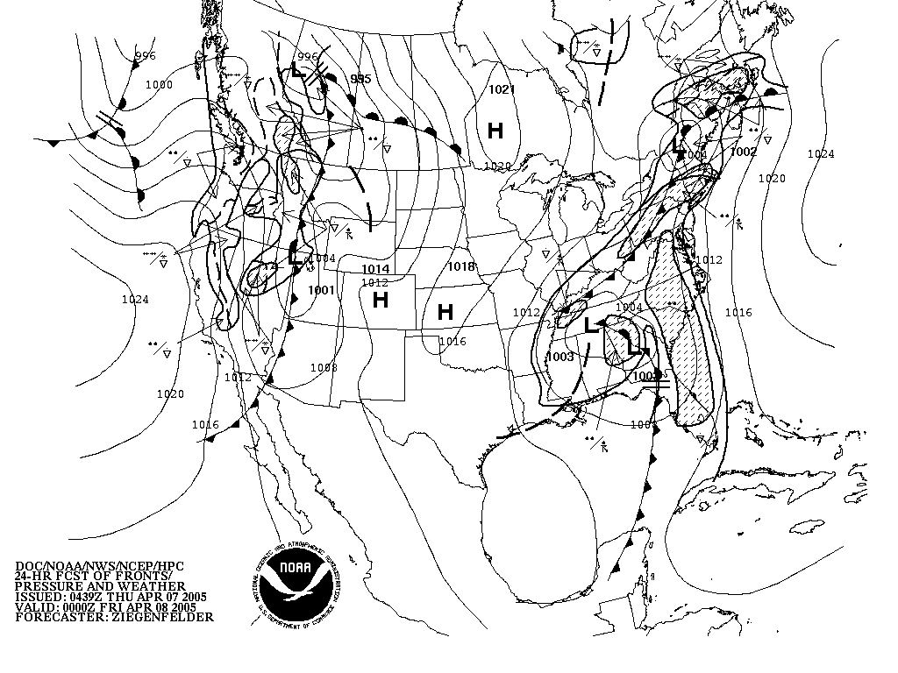
Hydrometeorological Prediction Center http://www.hpc.ncep.noaa.gov/basicwx/94fbw.gif

Slide 8
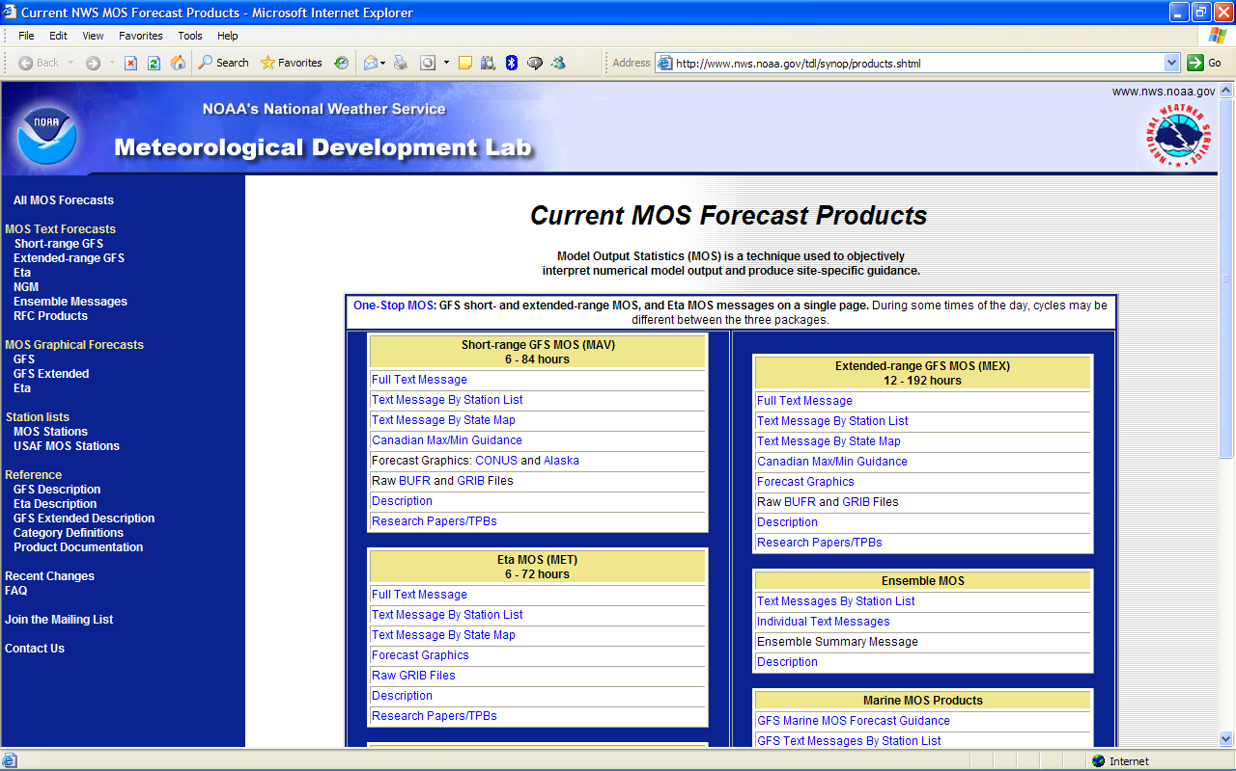
Meteorological Development Laboratory http://www.nws.noaa.gov/tdl/synop/products.shtml

Slide 9
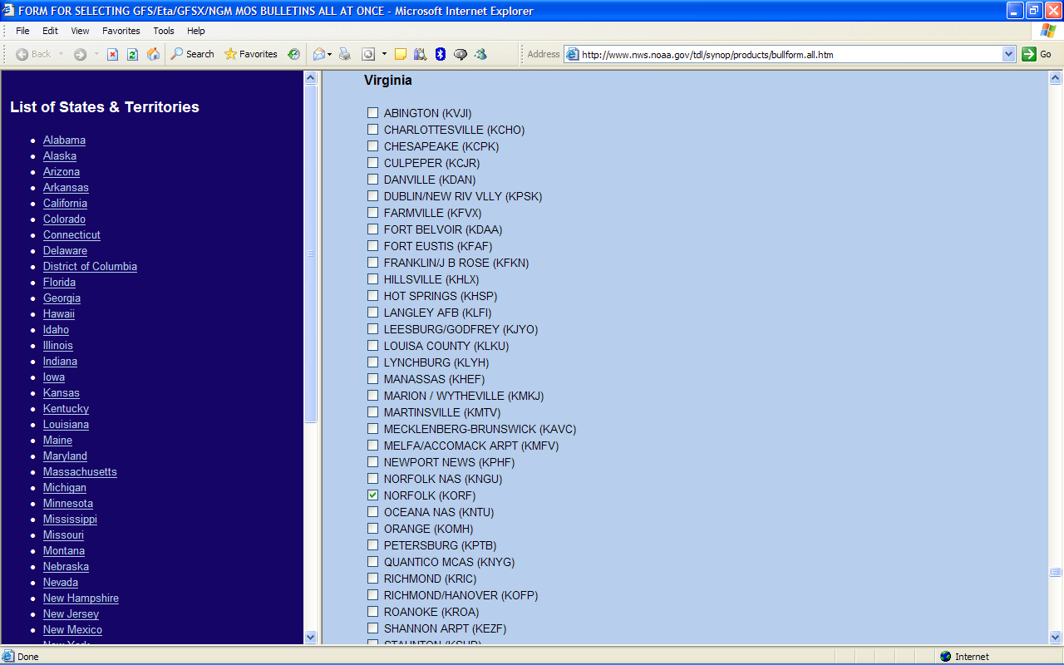
Meteorological Development Laboratory http://www.nws.noaa.gov/tdl/synop/products/bullform.all.htm

Slide 10
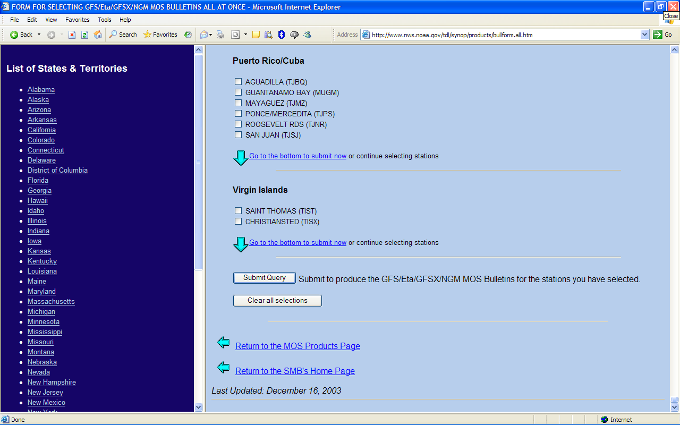
Meteorological Development Laboratory http://www.nws.noaa.gov/tdl/synop/products/bullform.all.htm

Slide 11
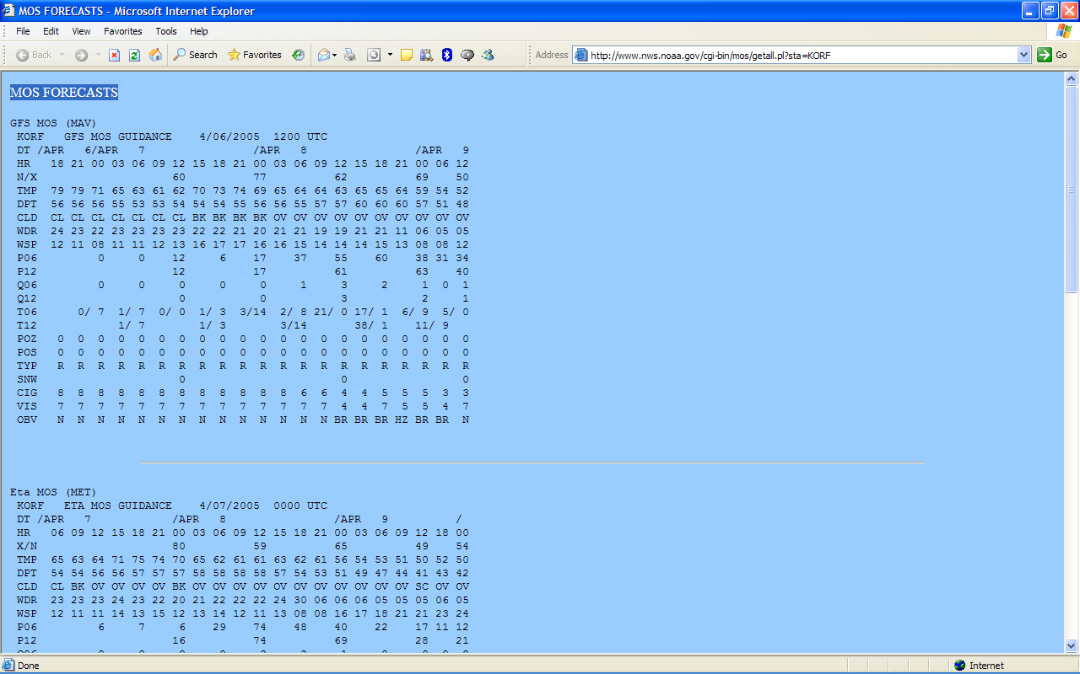
MOS FORECASTS http://www.nws.noaa.gov/cgi-bin/mos/getall.pl?sta=KORF

Slide 12
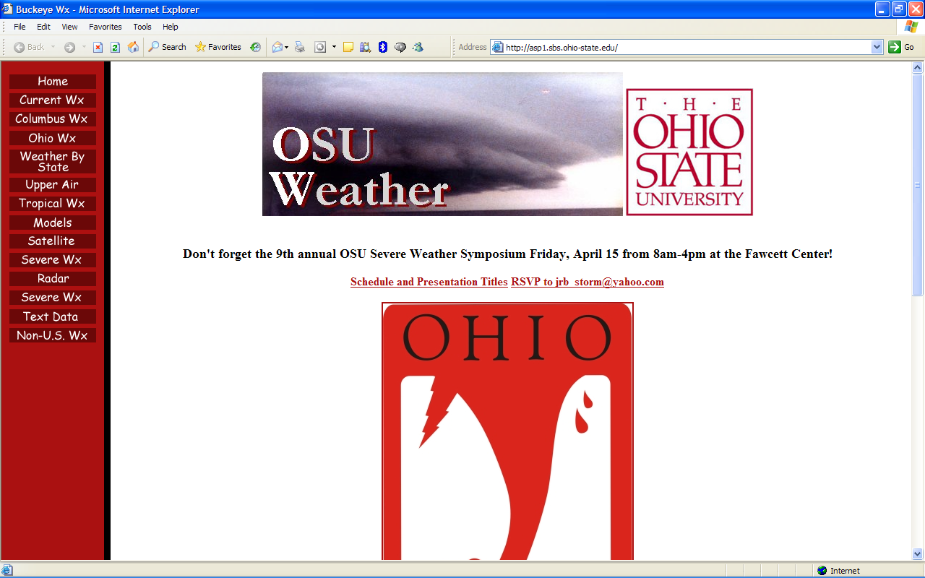
Ohio State University WWW weather server http://asp1.sbs.ohio-state.edu/

Slide 13
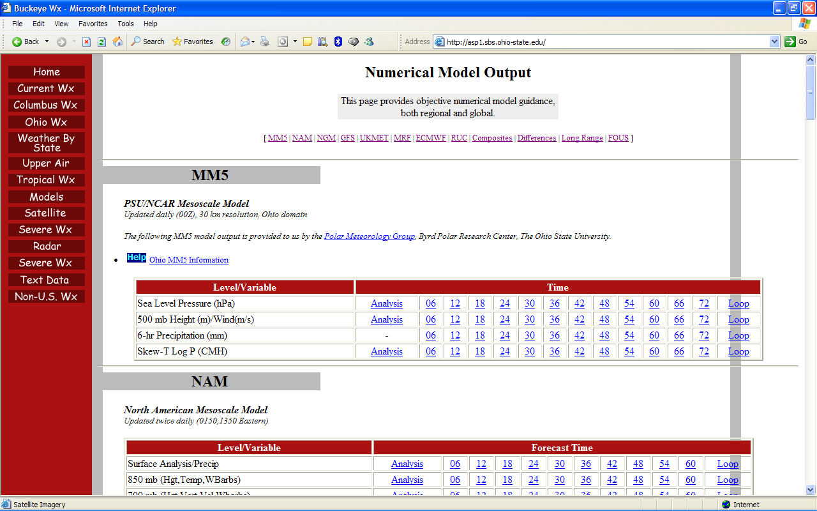
Ohio State University WWW weather server http://asp1.sbs.ohio-state.edu/

Slide 14
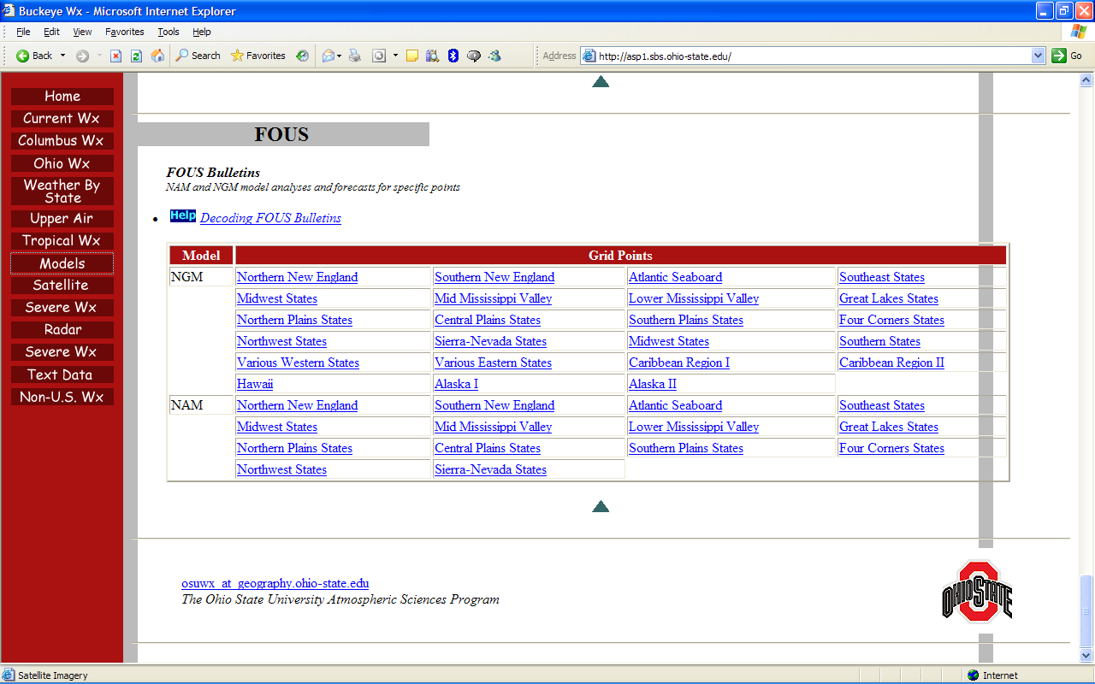
Ohio State University WWW weather server http://asp1.sbs.ohio-state.edu/

Slide 15
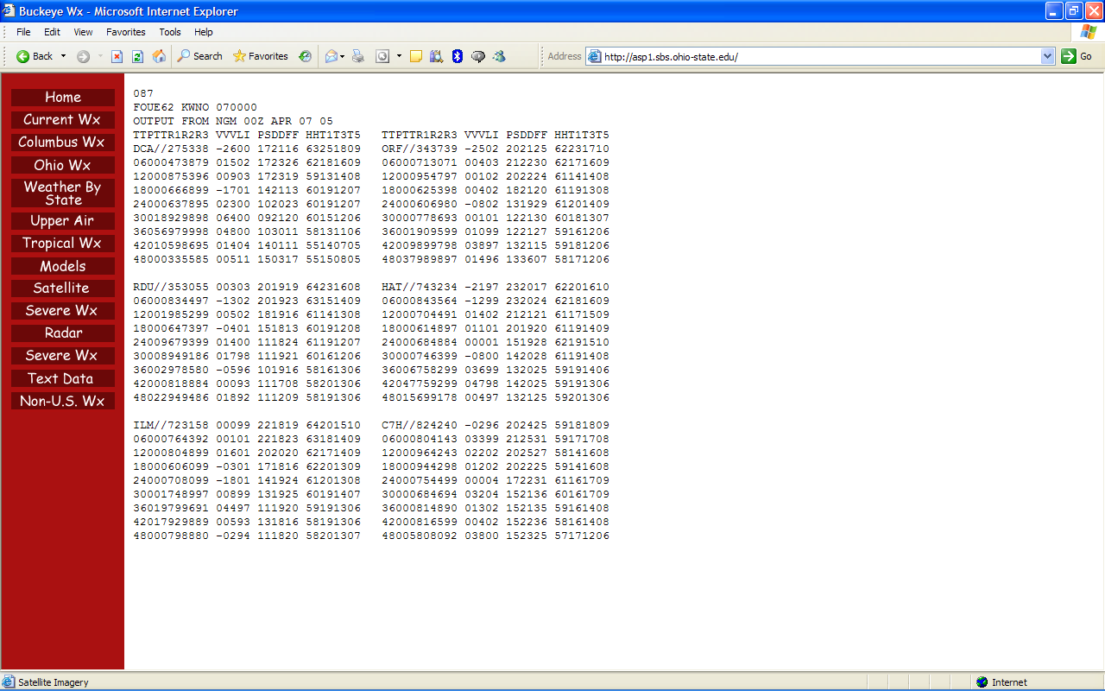
Ohio State University WWW weather server http://asp1.sbs.ohio-state.edu/

Slide 16
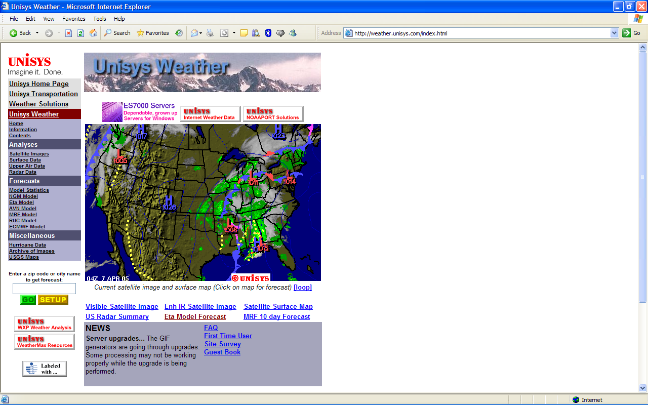
Unisys Weather http://weather.unisys.com/index.html

Slide 17
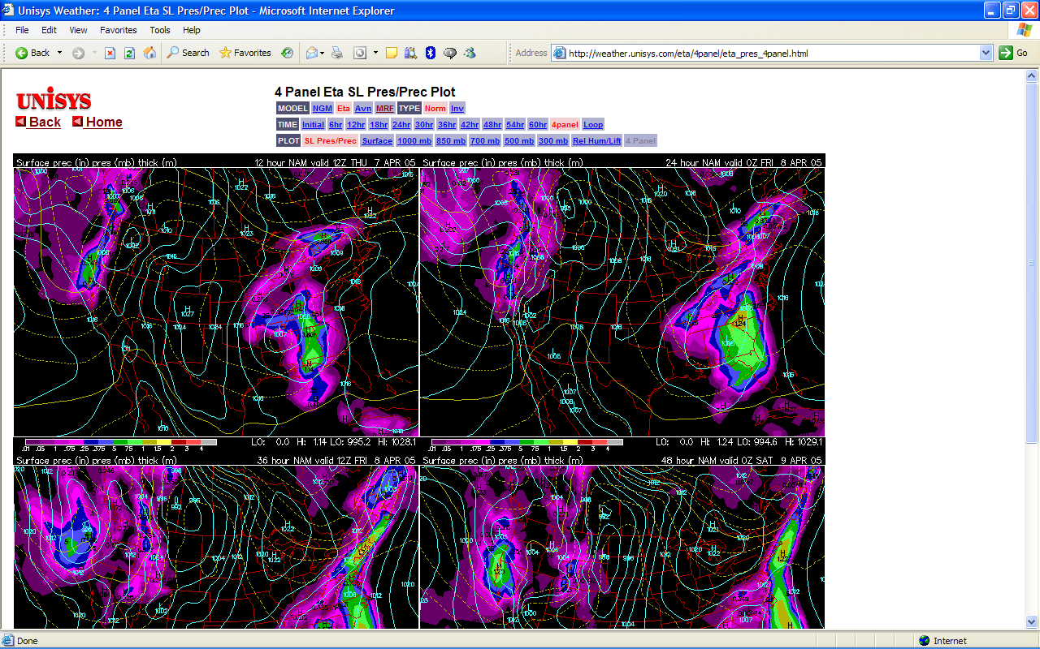
Unisys Weather http://weather.unisys.com/eta/4panel/eta_pres_4panel.html

Slide 18
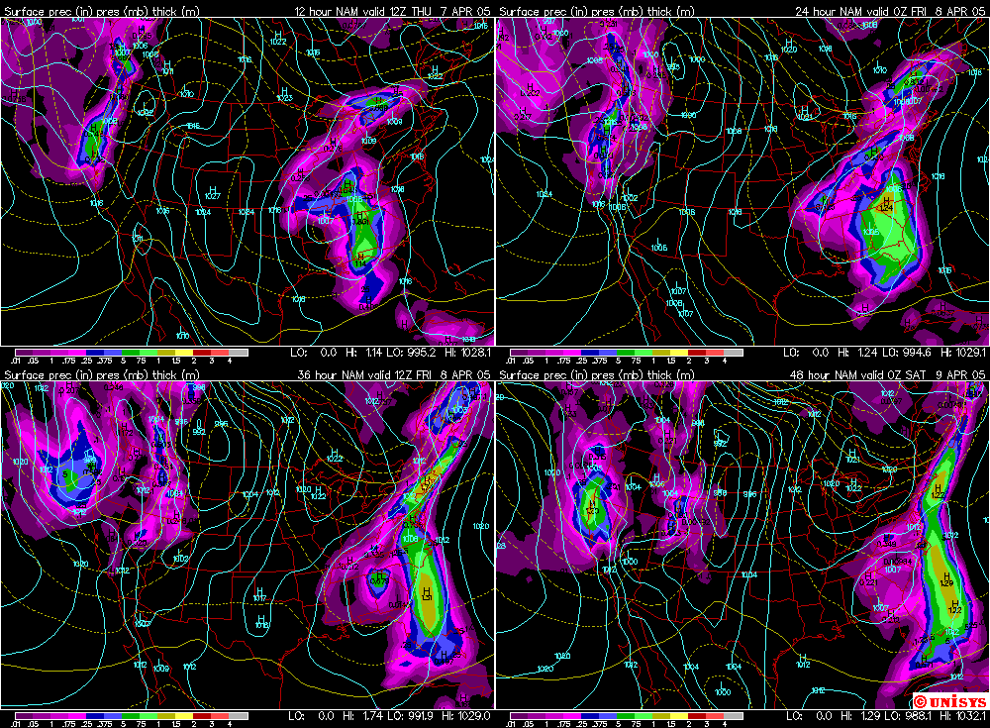

Slide 19
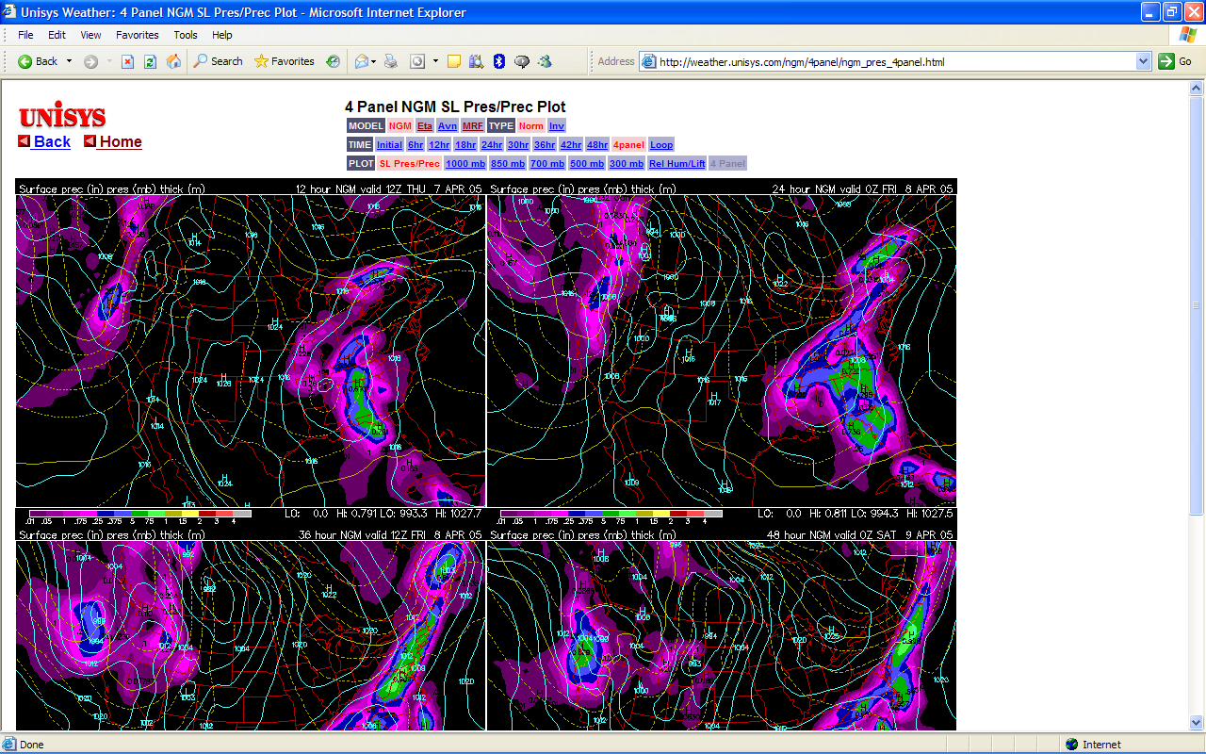
Unisys Weather http://weather.unisys.com/ngm/4panel/ngm_pres_4panel.html

Slide 20
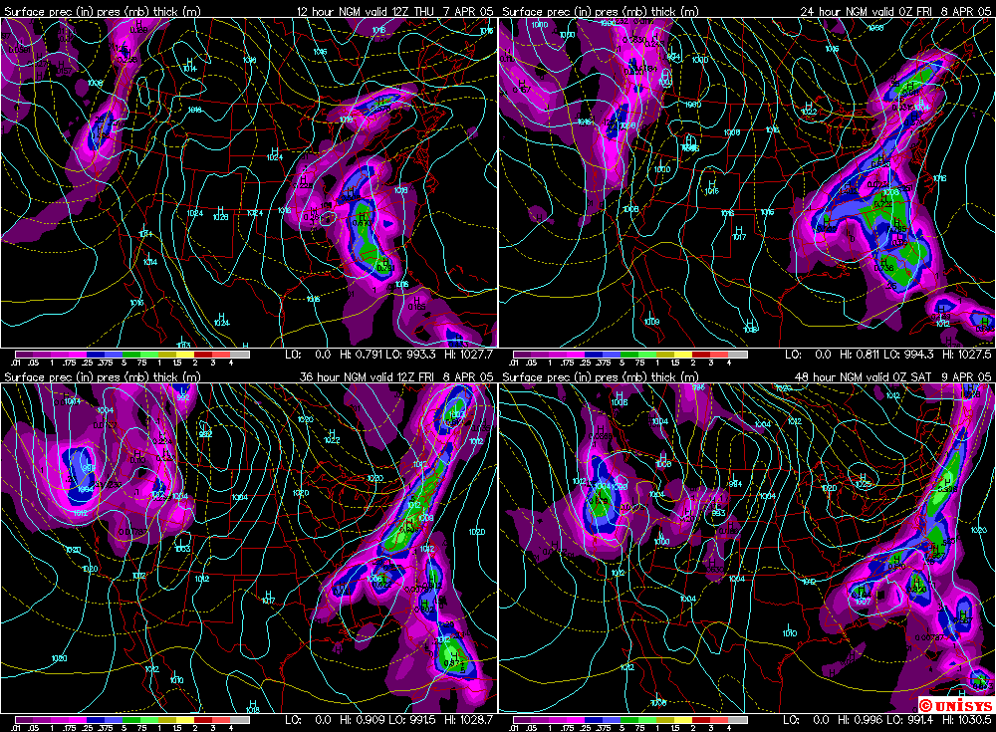

Slide 21
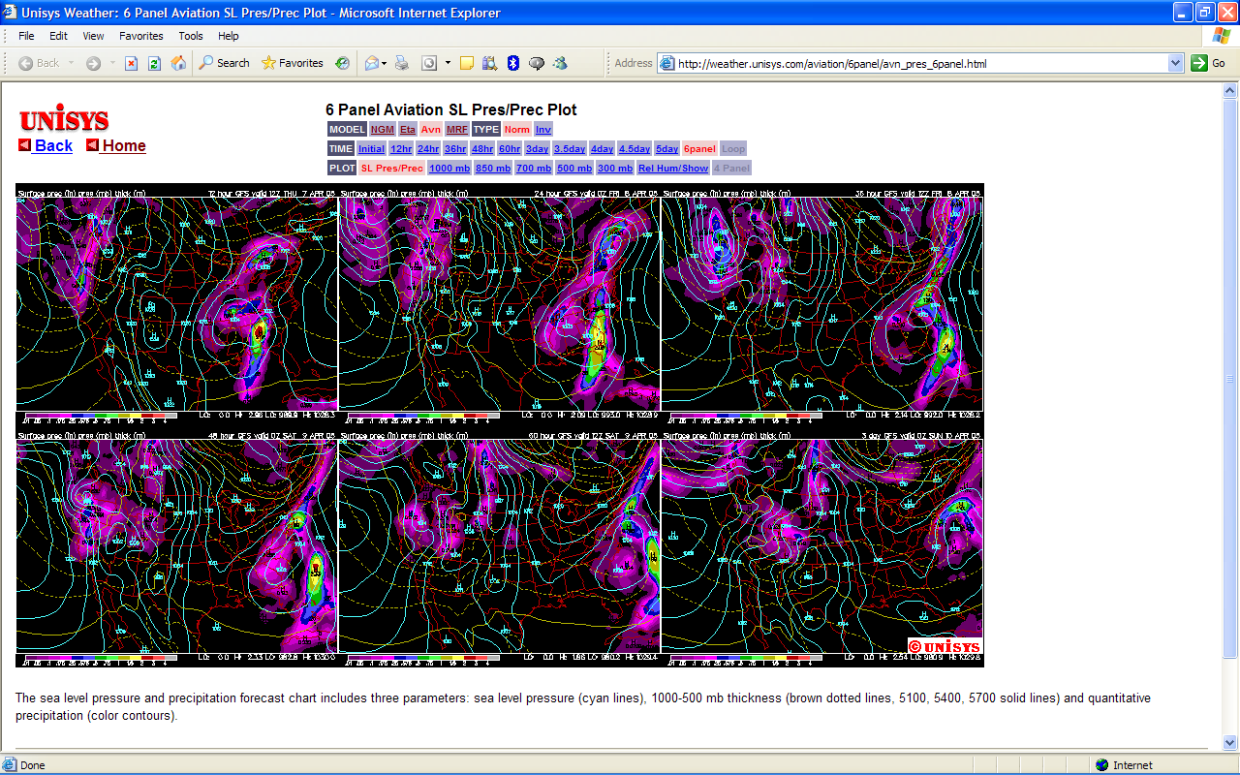
Unisys Weather http://weather.unisys.com/aviation/6panel/avn_pres_6panel.html

Slide 22
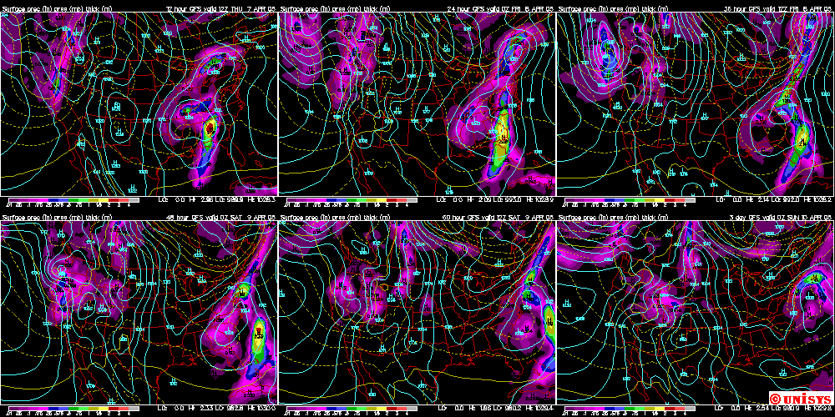

Slide 23
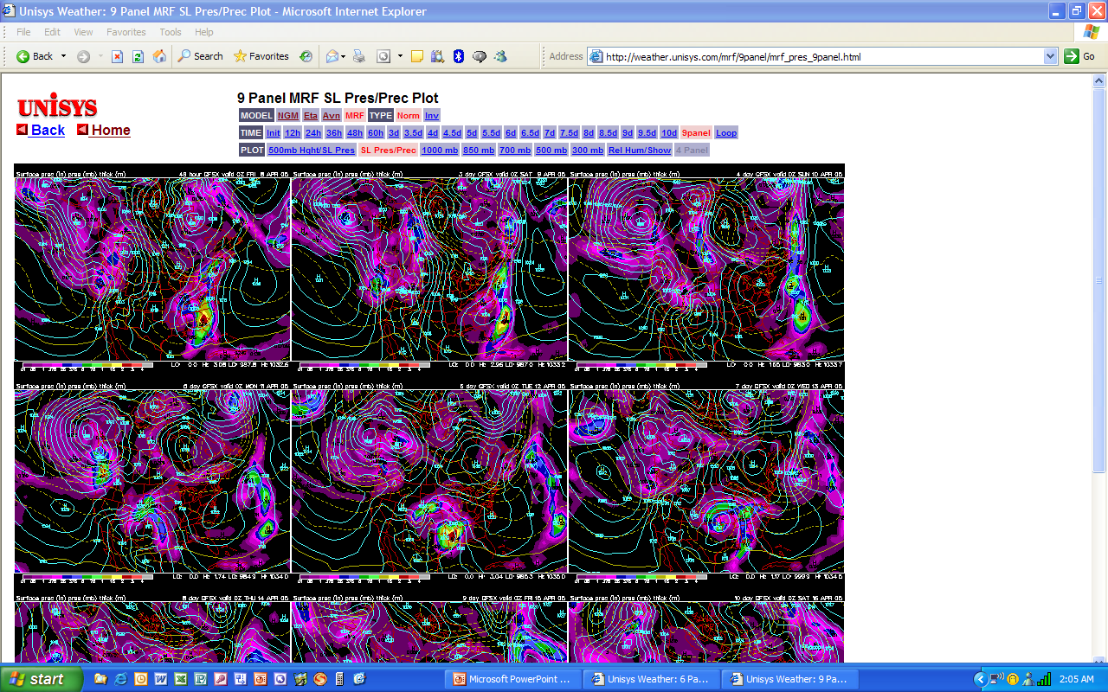
Unisys Weather http://weather.unisys.com/aviation/6panel/avn_pres_6panel.html

Slide 24
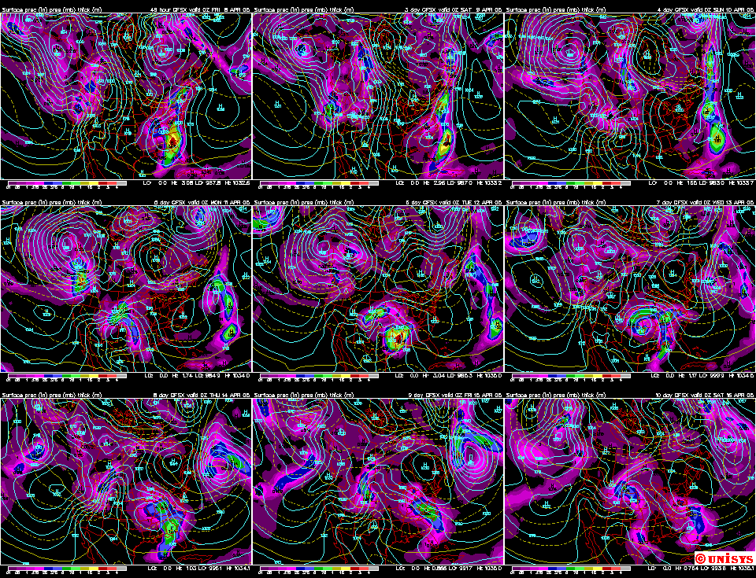

Slide 25
Meteorology for the Amateur Astronomer
?

