Slide 1
Please take your seat

Slide 2
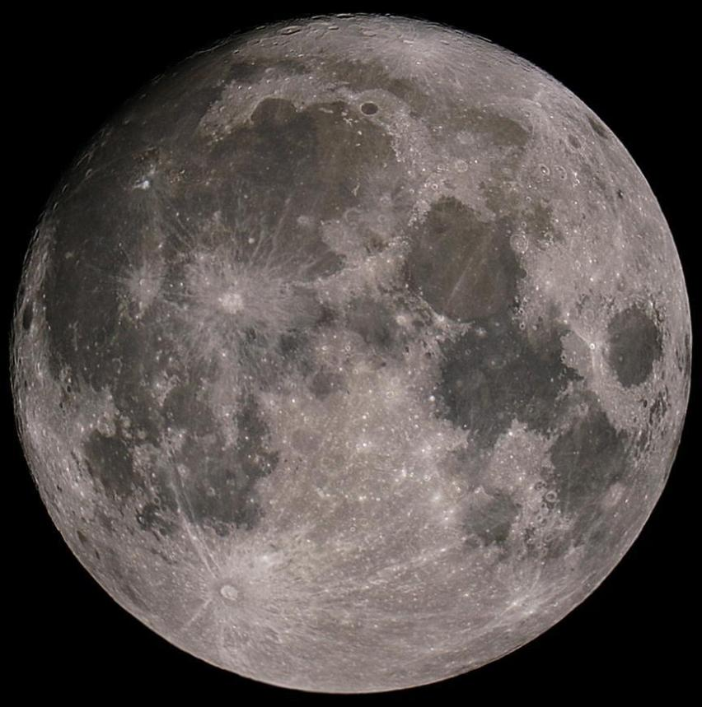
MOONS
Many
Presented to
Lunar Festival at Greenbrier Middle School
May 22, 2007

Slide 3

The Back Bay Amateur Astronomers
Bringing Astronomy to the People of Hampton Roads
The Back Bay Amateur Astronomers
PO Box 9877
Virginia Beach, VA 23450

Slide 4

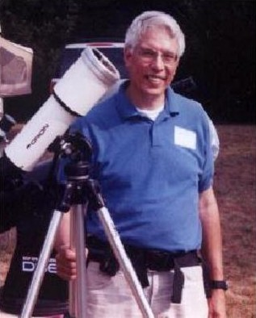
Your “Solar System Ambassador”
George Reynolds

Slide 5
“Solar System Ambassador”
George Reynolds
Assisted by BBAA members…
Ted Forte
Georgie June
James Kresky
Matt McLaughlin
Chuck Jagow
Kevin Weiner
Barb Weiner

Slide 6
A MOON…
What is it?…
Does every planet have one?.
Can we see them?
Let’s find out!
Let’s find out!

Slide 7
Planets with moons in our
Solar System
8 “official” Planets
Mercury 0 Jupiter 63
Venus 0 Saturn 37
Earth 1 Uranus 23
Mars 2 Neptune 12
3 “Dwarf” Planets
Pluto 3 Eris ?
Ceres ?

Slide 8
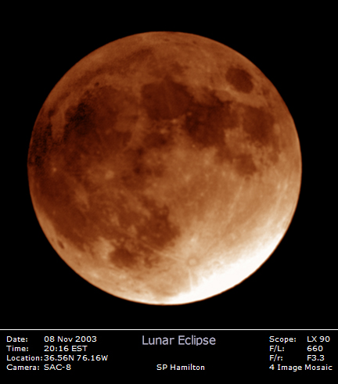
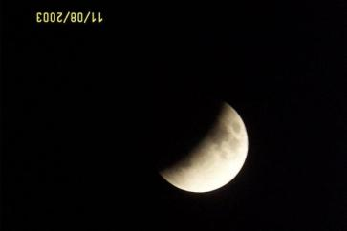
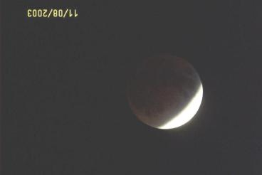
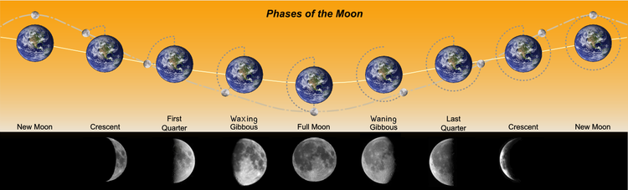
Our Moon, Luna
Phases
Lunar Eclipse

Slide 9

The Moon – The Whole Thing!
Can you see…
The Man in the Moon?
The Woman in the Moon?
The Rabbit in the Moon?
The cow jumping over the Moon?

Slide 10
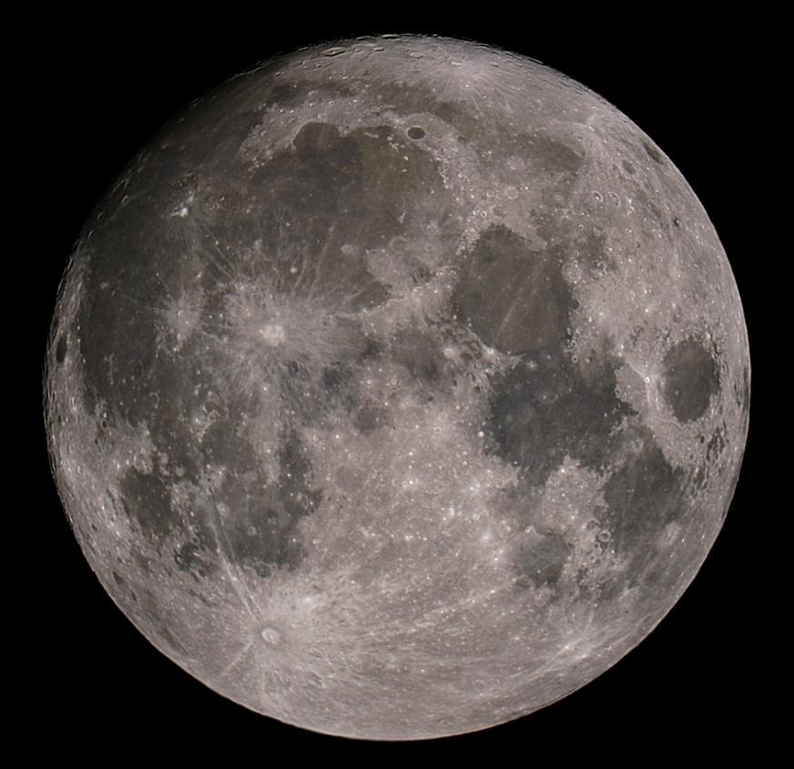
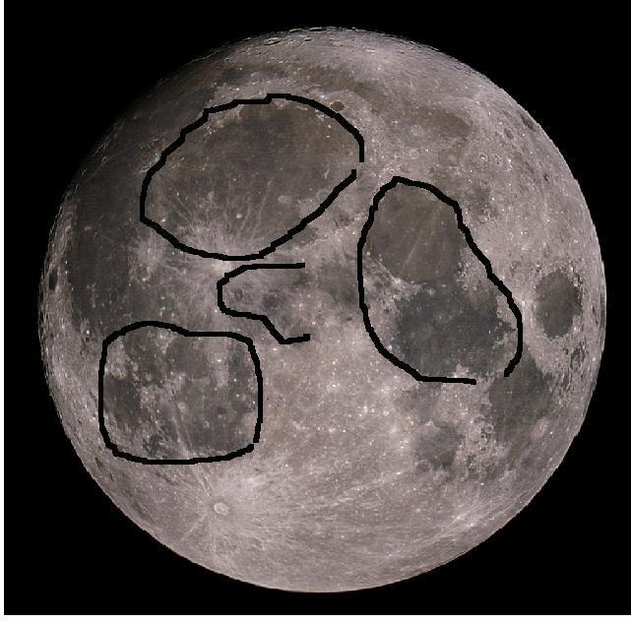
The Man in the Moon

Slide 11
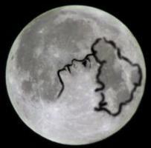
The Woman in the Moon

Slide 12
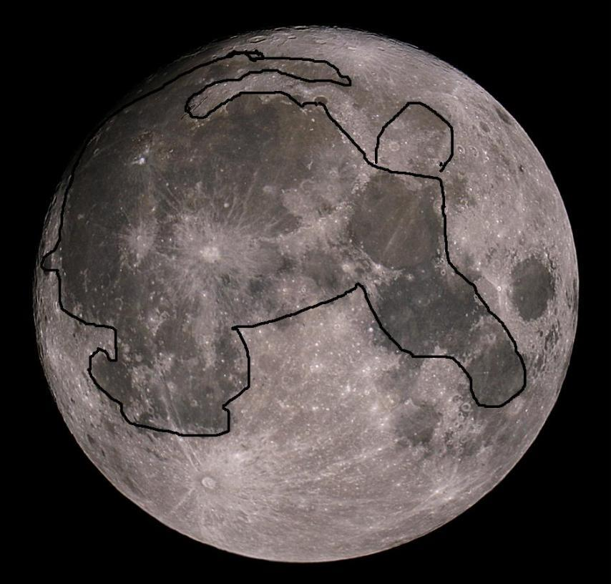
The Rabbit in the Moon

Slide 13
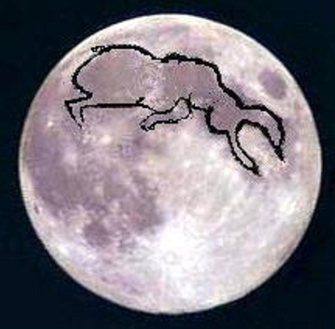
The Cow Jumping Over the Moon

Slide 14
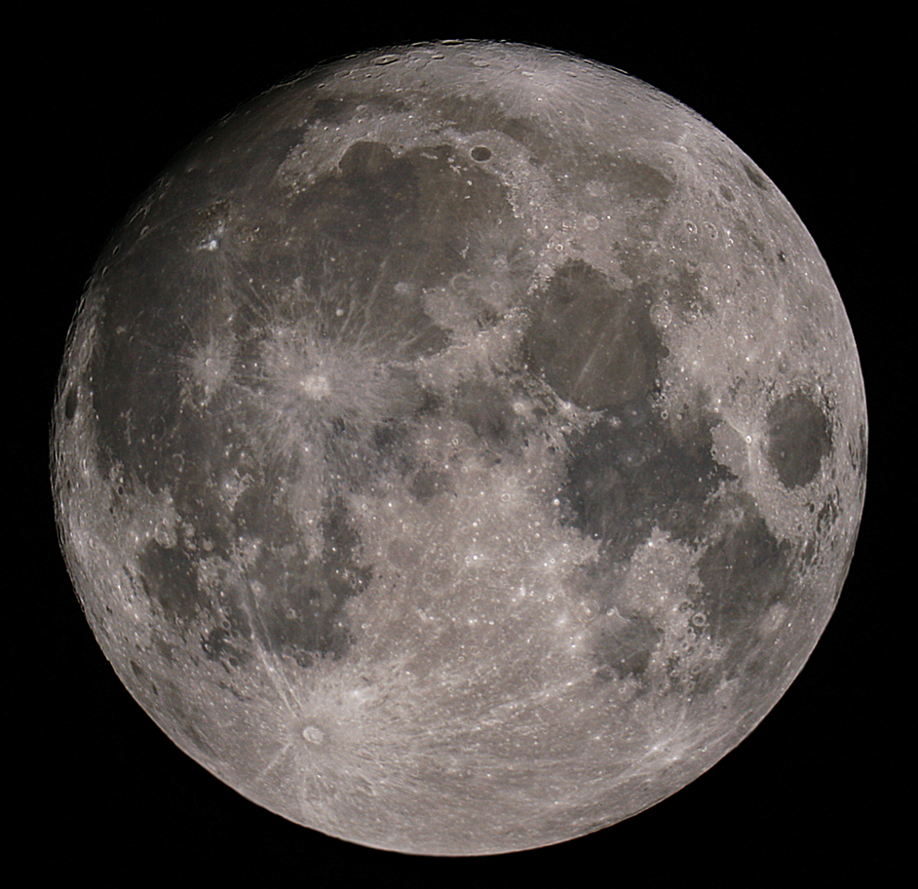
The Moon – The Whole Thing!
The Big Craters with Bright “Rays” are
Copernicus
and
Tycho

Slide 15
The Moon – Dry “Seas”,
Or “Maria”
Oceanus Procellarum
Mare Imbrium
Mare Nubium
Mare Serenitatus
Mare Tranquillitatus
Mare Crisium, “Sea of Crises”

Slide 16
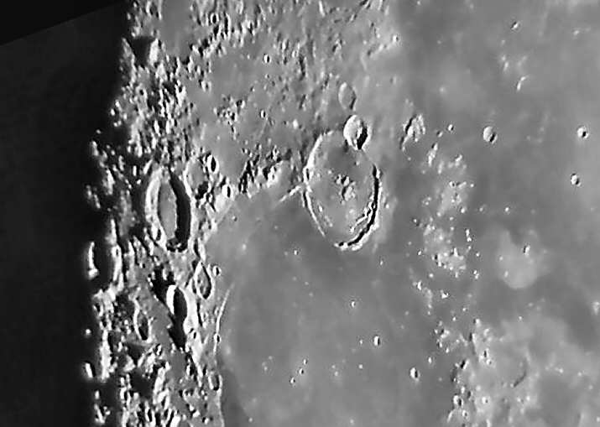
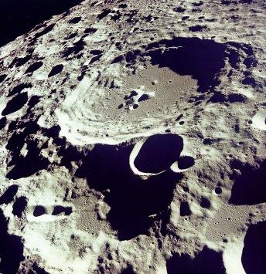
More “Moon Shots”
Craters on the Far Side of the Moon
Gassendi Crater

Slide 17
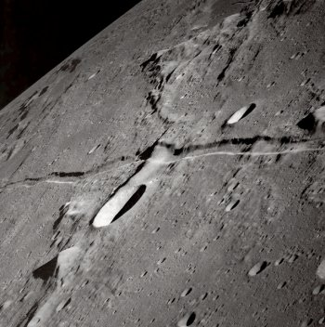
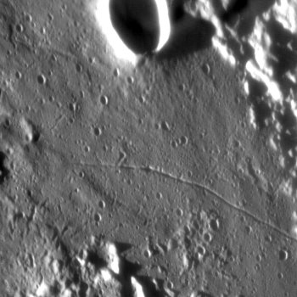
More “Moon Shots”
Craters and Rilles, Peaks and Valleys

Slide 18
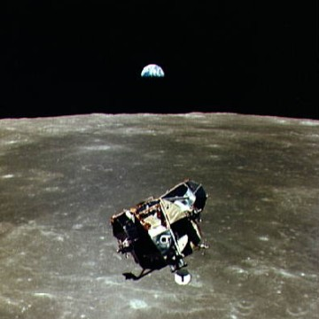
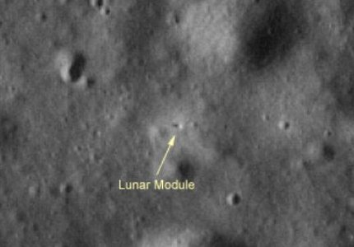
Moon Exploration
Apollo 17 Lunar Module – Telescopic View from Earth
Apollo 11 Lunar Module
View from Command Module

Slide 19
But our Moon, Luna, is just one of many moons in our solar system
There are at least 140 moons orbiting planets (and dwarf planets)
Some have been discovered by earth-bound telescopes
Some have been seen by the Hubble Space Telescope
Many have been discovered by spacecraft, exploring the heavens

Slide 20
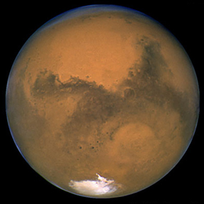
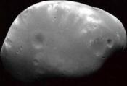
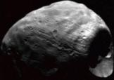
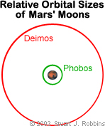
Mars has two moons . . .
Astronomers think these moons were small asteroids captured by Mars’s gravity.
Deimos and Phobos
(not to scale)

Slide 21
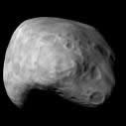
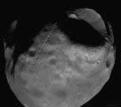
Mars’s moons
Mars
  Phobos
  Deimos

Slide 22
Jupiter's moons
Jupiter
  Metis
  Adrastea
  Amalthea
  Thebe
  Io
  Europa
  Ganymede
  Callisto
  Leda
  Himalia
  Lysithea
  Elara
  Ananke, Carme, Pasiphae and Sinope
  Recently discovered (numbered) moons

Slide 23
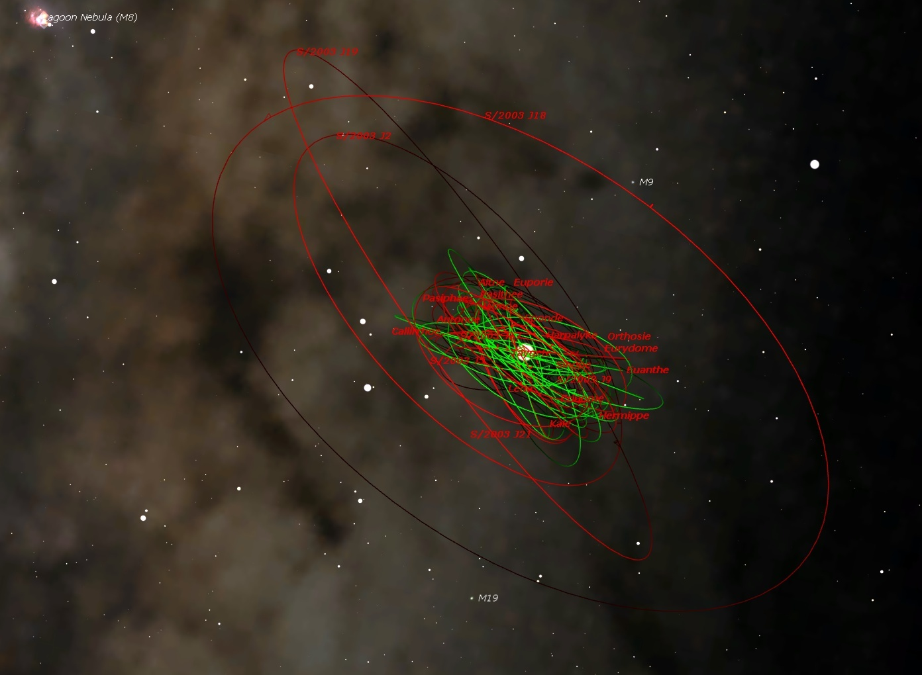

Slide 24
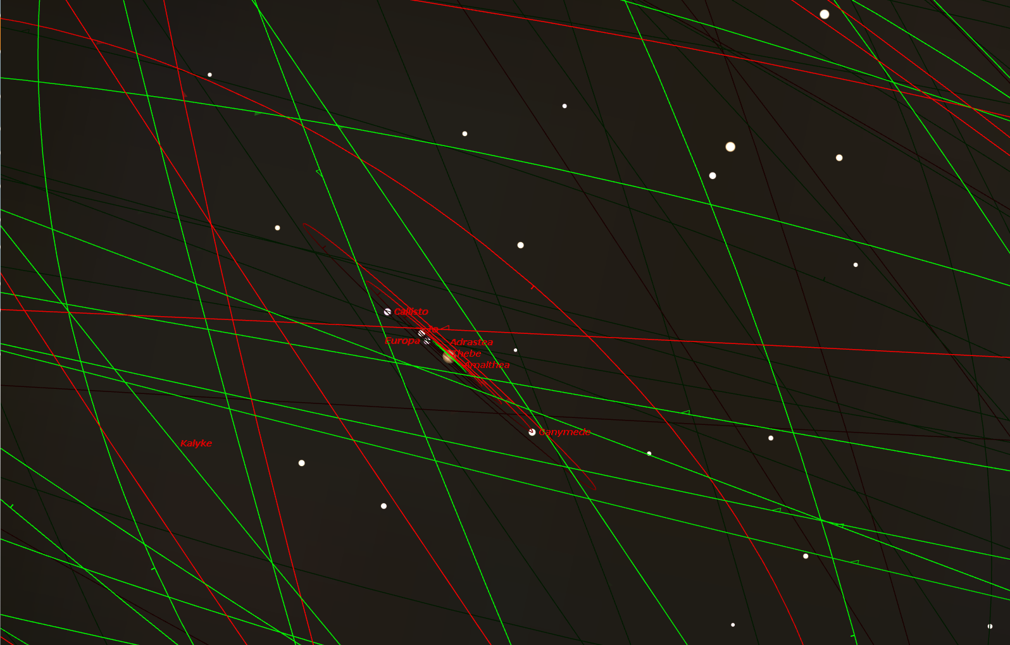

Slide 25
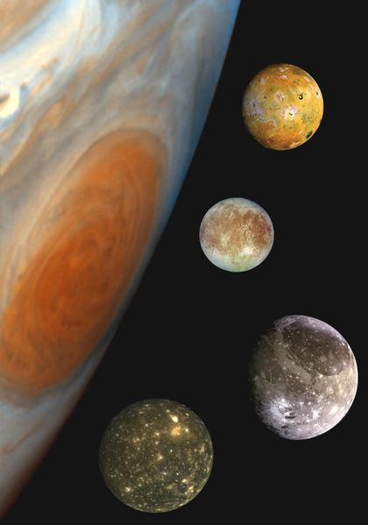
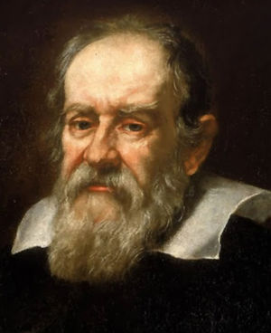
Galileo Galilei discovered the first four of them in 1610
Io
Europa
Ganymede
Callisto

Slide 26
Saturn’s moons
Saturn
  Pan and Atlas
  Prometheus and Pandora
  Epimetheus
  Janus
  Mimas
  Enceladus
  Tethys, Telesto and Calypso
  Dione and Helene
  Rhea
  Titan
  Hyperion
  Iapetus
  Phoebe
  Recently discovered satellites

Slide 27
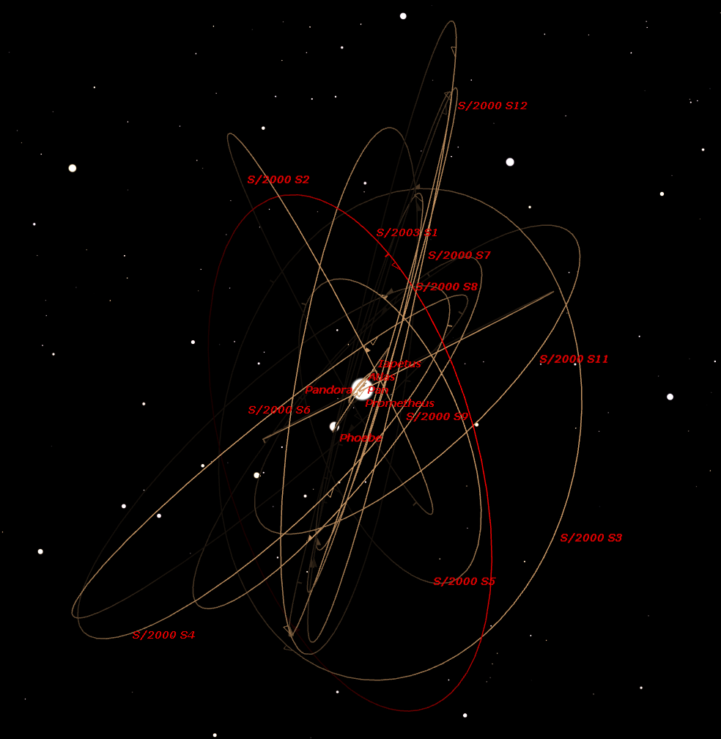

Slide 28
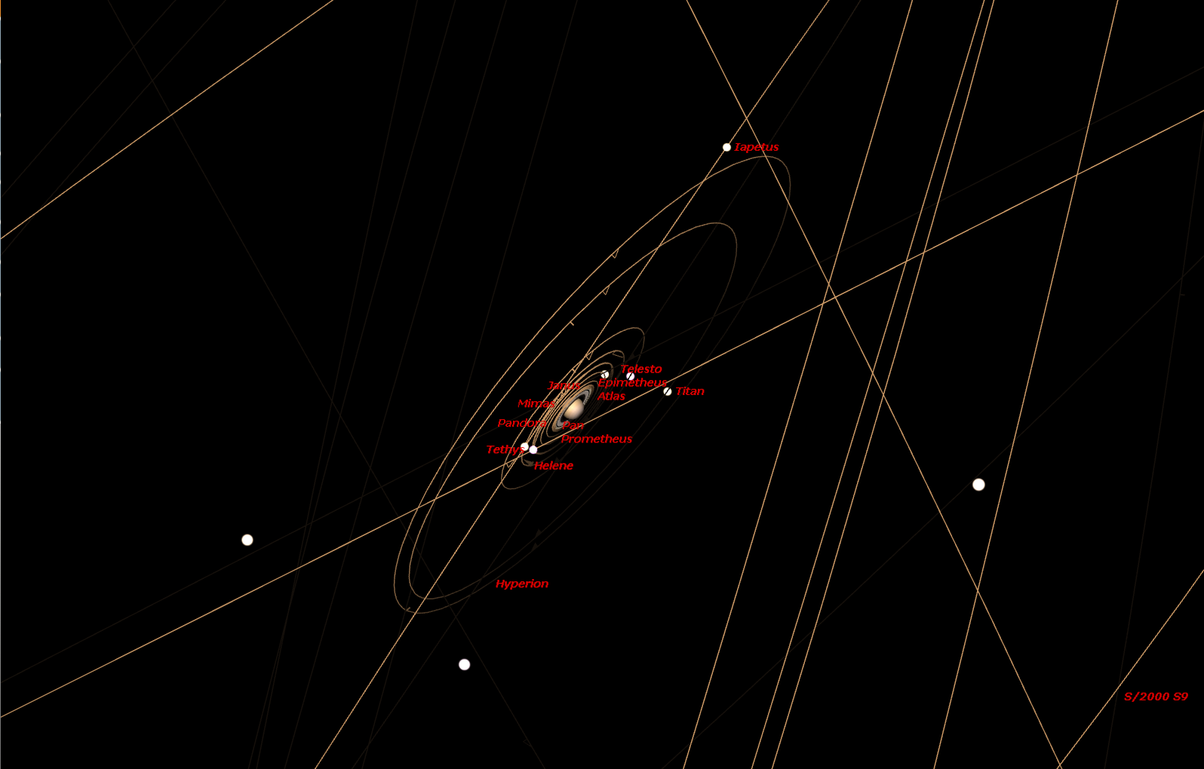

Slide 29
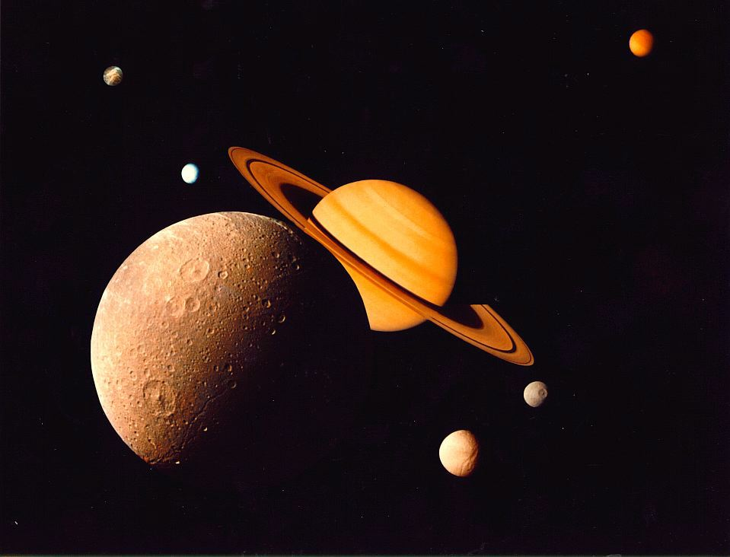
Moons of Saturn
Saturn has 31 known moons.
Montage of Saturn’s six largest moons
Dione, Tethys, Mimas, Enceladus, Rhea and Titan

Slide 30
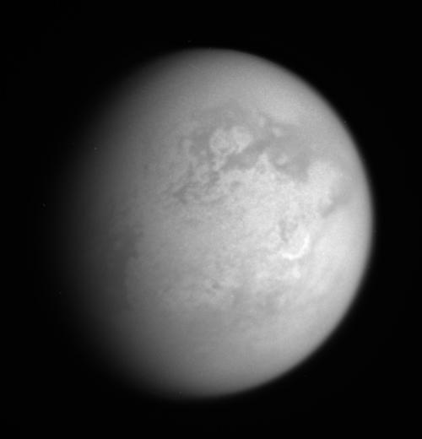
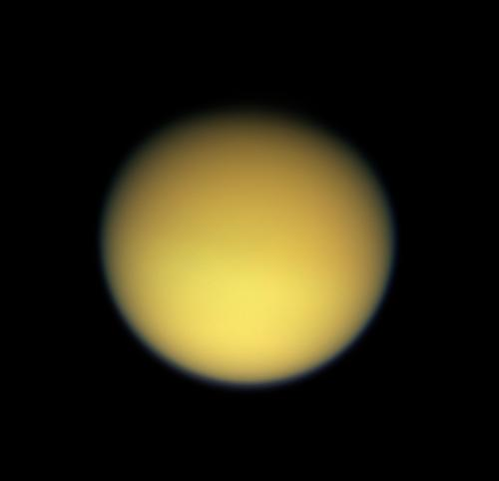
Moons of Saturn
Saturn’s largest moon, Titan – 2 views
One of the few Moons with an atmosphere

Slide 31

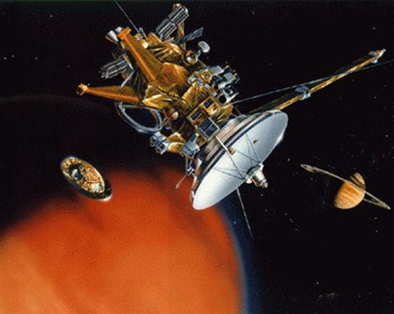
Cassini spacecraft releases Huygens probe to Titan

Slide 32
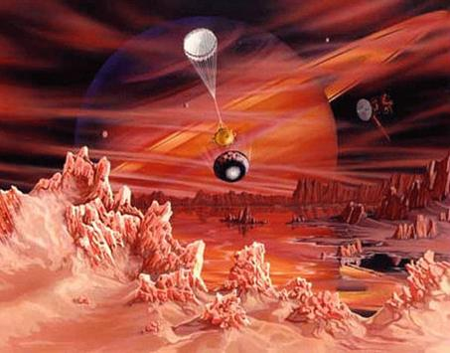
Huygens probe landing on Titan (artist’s conception)

Slide 33
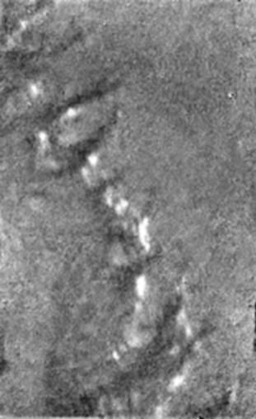

Huygens probe results – actual photos
Titan water ice and methane springs
Titan 'island' surface features

Slide 34
Uranus’s moons
Uranus
  Cordelia
  Ophelia
  Bianca
  Cressida
  Desdemona
  Juliet
  Portia
  Rosalind
  Belinda, Puck, Miranda, Ariel, Umbriel, Titania, Oberon , Caliban, Sycorax, Prospero, Setebos, Stephano, and Trinculo, etc.

Slide 35
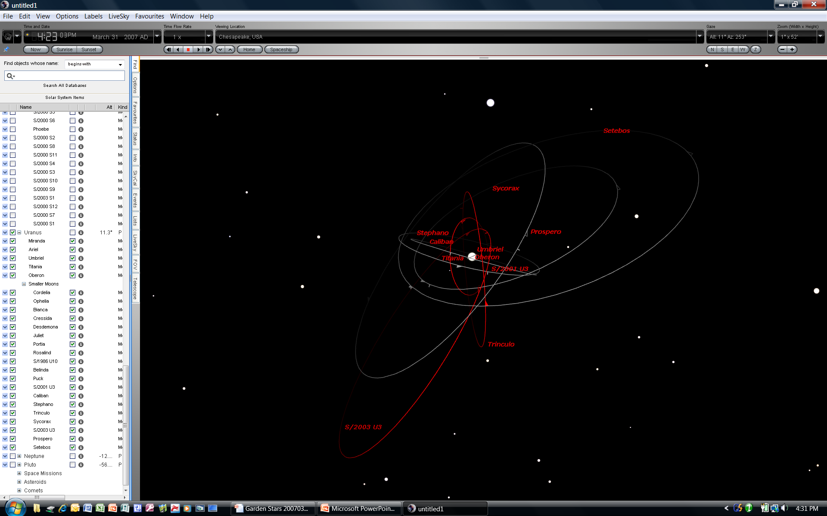

Slide 36
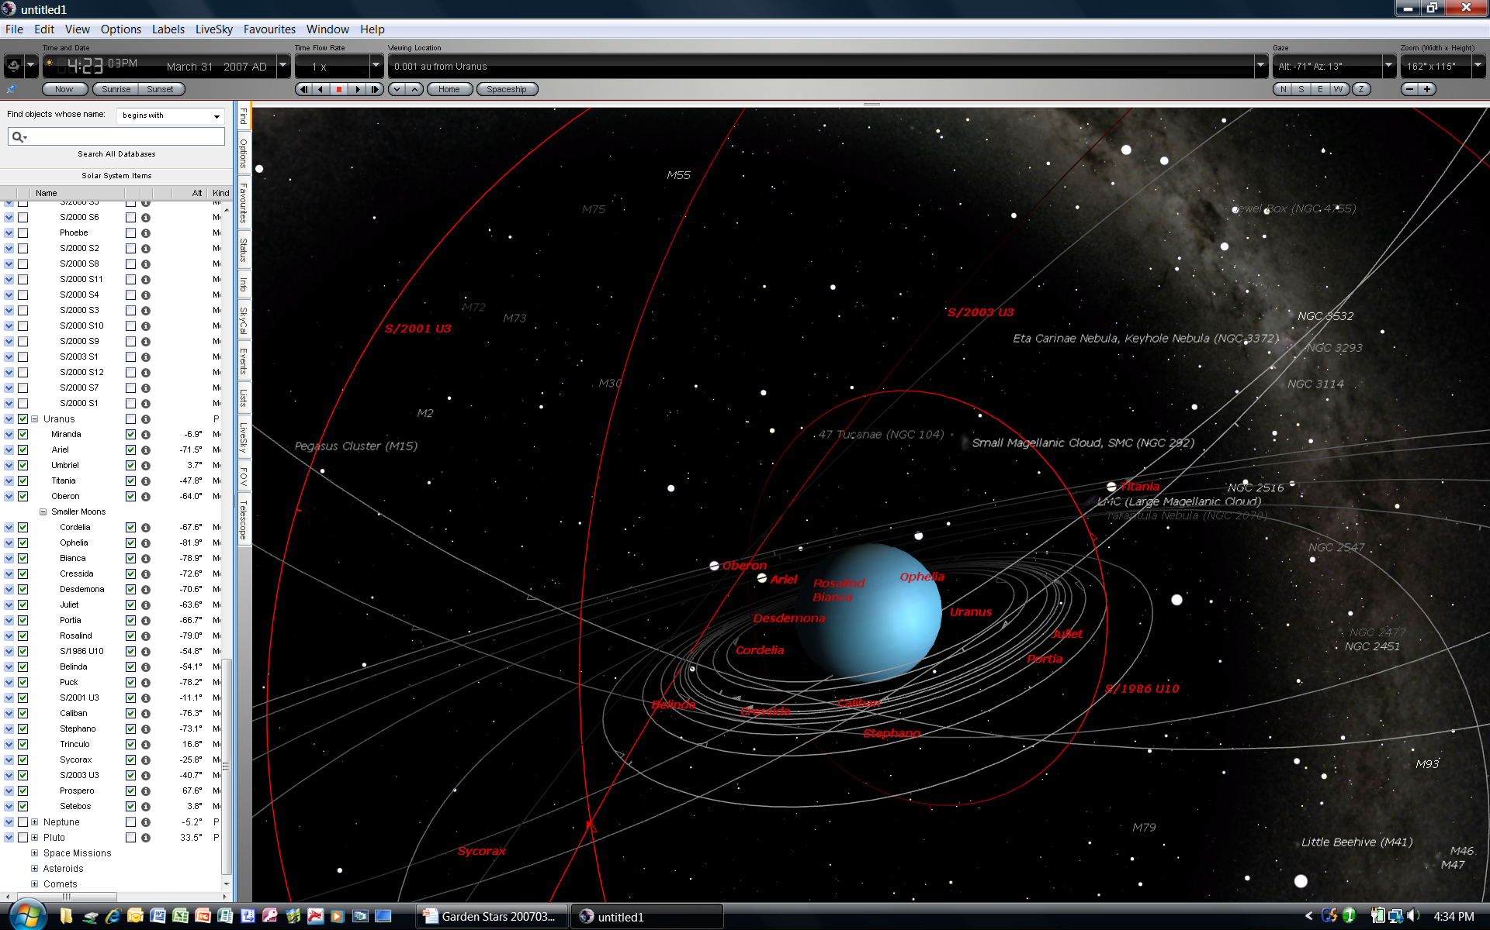

Slide 37
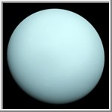
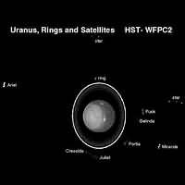
Uranus, the 7th Planet
Uranus is unique, in that it is tipped on its side. This is thought to be the result of a collision with a planet-sized body early in the solar system's history.
Uranus has 27 known moons.
It also has a ring system that is not visible to ground-based telescopes
Notes:
This is a poor lo-res image. I’ll try to get a better one.

Slide 38
Neptune’s moons
Neptune
  Naiad
  Thalassa
  Despina
  Galatea
  Larissa
  Proteus
  Triton
  Nereid
  Nix and Hydra

Slide 39
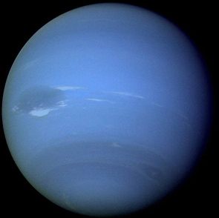
Moons of Neptune
Neptune has 13 known moons…
composed of rock and ice.
The first four, Naiad, Thalassa, Despina, and Galatea, are so close to Neptune that they orbit within its ring system. Little is known about them.
Notes:
This is a poor lo-res image. I’ll try to get a better one.

Slide 40
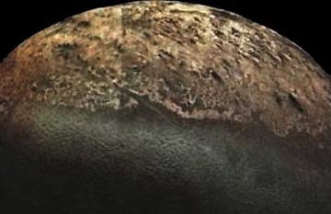
Moons of Neptune
Neptune’s largest moon is Triton.
Triton is one of the strangest moons in the solar system. It is one of only three moons in the solar system that has an atmosphere (Jupiter's Io and Saturn's Titan are the other two). It is thicker than Io's, yet much thinner than Titan's.
It has a retrograde orbit. It orbits the opposite way the planet spins.
Triton is two-thirds the size of our moon.

Slide 41
Pluto’s moons
Pluto
  Charon
  Nix
  Hydra

Slide 42
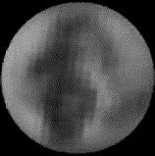
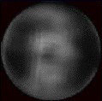
Moons of Pluto
Even though it has been downgraded to the status of a “dwarf planet” . . .
Poor Pluto!
Pluto has three moons!
Pluto’s moon Charon was discovered on July 7, 1978 by James W. Christy of the U.S. Naval Observatory
In October of 2005, two more moons were discovered in orbit around Pluto.

Slide 43
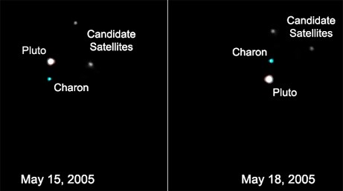
Moons of Pluto
They were intially called “candidate” moons . . .
After being verified by the Hubble Space Telescope, They were given the names “Nix” and “Hydra”.

Slide 44
Summary:
There are at least 140 moons orbiting planets (and dwarf planets)
Some have been discovered by earth-bound telescopes
Some have been seen by the Hubble Space Telescope
Many have been discovered by spacecraft, exploring the heavens

Slide 45
Tonight’s sky
SUNSET – 8:02 P.M. … so it won’t be very dark, until a little later.
PLANETS –
  Mercury, low in the West, Venus in Gemini in the Western sky.
  Jupiter rises in the East shortly after 9 p.m.
  Mars, Uranus, Neptune & Pluto are up in the daytime.
  Saturn – Also overhead in Leo. Watch for a close conjunction with the Moon!
Moon – In Leo overhead, near First Quarter, setting 10:30 p.m.
Notes:
These are a few of the celestial objects it is possible to see in tonight’s sky. We probably won’t see them all, depending on their position in the sky and our location with regard to obstacles such as trees, buildings, and perhaps some cloud cover.

Slide 46
Tonight’s sky
DSO -
Open Cluster M44 “The Beehive Cluster” - In Cancer the Crab to the west (right) of Saturn and the Moon.
Constellations and bright stars –
  Gemini (The Twins) with Castor and Pollux
  Ursa Major (The Great Bear, containing the Big Dipper asterism)
  Leo the Lion with stars Regulus and Deneb
  Boötes the Herdsman (“Ice Cream Cone”) with bright Arcturus
  Virgo the Virgin (low in the East) with bright star Spica
Notes:
These are a few of the celestial objects it is possible to see in tonight’s sky. We probably won’t see them all, depending on their position in the sky and our location with regard to obstacles such as trees, buildings, and perhaps some cloud cover.

Slide 47
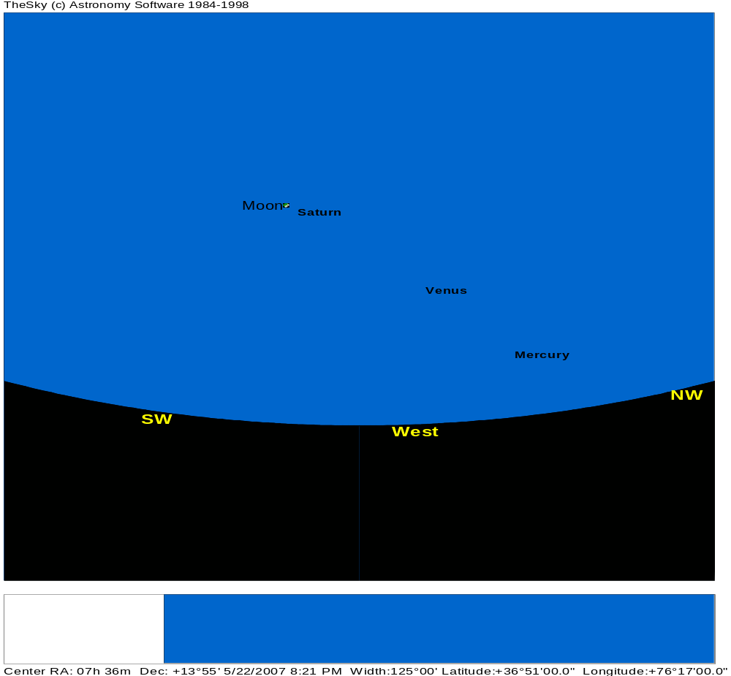
TONIGHT’S SKY
March 31th
at 8:00 P.M.
Notes:
47
If we had low horizons all around, like out on the ocean, here is what you could see tonight. This sky chart shows the major constellations, groupings of stars that men have named over the centuries, to help us be more familiar with our starry tapestry above.
If conditions outside permit, we will point out some of these constellations to you.

Slide 48
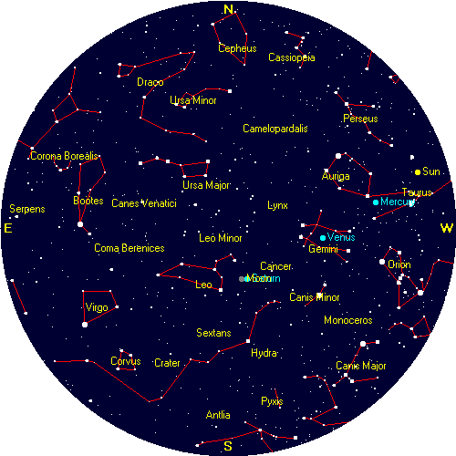
TONIGHT’S SKY
NOTE: the sun has not yet set (Sunset 8:02pm)
Mercury Venus in Gemini
Moon Saturn M44 “The Beehive Cluster” –
Gemini Castor & Pollux
Big Dipper
Leo Regulus & Deneb
Boötes Arcturus
Virgo
Spica
May 22nd
at 7:00 P.M.
Notes:
48
If we had low horizons all around, like out on the ocean, here is what you could see tonight. This sky chart shows the major constellations, groupings of stars that men have named over the centuries, to help us be more familiar with our starry tapestry above.
If conditions outside permit, we will point out some of these constellations to you.

Slide 49
Questions
Questions
?
http://www.BackBayAstro.org

Slide 50
Safety First!
We will go outside in just a moment.
Please remember, Safety First!
Please do not run or horseplay around the telescopes.
Please remember, Safety First!
Please do not run or horseplay around the telescopes.

Slide 51
And now, we urge you . . .

Slide 52
Now, please Join us outside for a “tour” of the night sky followed by a look through the telescopes.
Boldly GO!

Slide 53
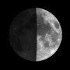
Go out and look
. . . for some Moons!
Lunar Festival, May 22, 2007

