Slide 1

GardenStars – June 23, 2007
Welcome to GardenStars
An Evening Under the Stars
Presented by
The Norfolk Botanical Garden
And
Back Bay Amateur Astronomers

Slide 2

The Back Bay Amateur Astronomers
Bringing Astronomy to the People of Hampton Roads
The Back Bay Amateur Astronomers
PO Box 9877
Virginia Beach, VA 23450

Slide 3
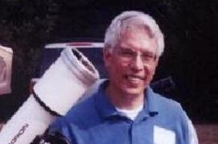
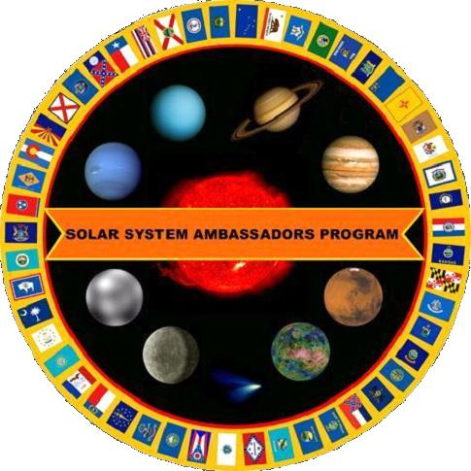
Your “Solar System Ambassadors”
George Reynolds

Slide 4
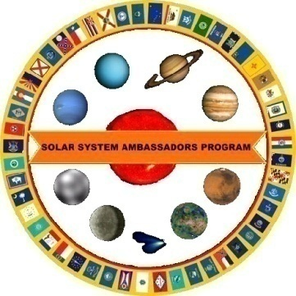
Introductions
Back Bay Amateur Astronomers
  George Reynolds
  Chuck and Karen Jagow
  Kevin and Barb Weiner
  Matt McLaughlin
  Bruce Bodner
  James Kresky
  Bill McLean

Slide 5
Tonight's Agenda...
Star lore
30 minute presentation
  Exoplanets – Orbiting Other stars
  Tonight’s sky
Guided tour of the sky
Telescope viewing
Norfolk Botanical Garden / Back Bay Amateur Astronomers

Slide 6
Star lore...
Norfolk Botanical Garden / Back Bay Amateur Astronomers
Notes:
Amateur Astronomers – What are they?
Well, some people stereotype astronomers as nerdy individuals with pocket protectors and taped-up glasses.
I will admit to wearing glasses, but I don’t own a pocket protector. ;-)

Slide 7
Amateur Astronomers...
We are ordinary people with a love of the heavens. We contribute to science thru discovery, study and by sharing information with others.
Norfolk Botanical Garden / Back Bay Amateur Astronomers
Notes:
As the slide says, we are ordinary folks . . . With an interest in science, nature, Creation, you name it.
Some of us are computer geeks, some work in offices or schools, some are students, and some are retired. We have some ladies in the club, and a lot of guys. We have a few teenagers, some old men, and a lot of in-between folks.
I know some people think that science is BORING . . . ➔

Slide 8
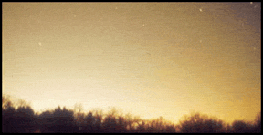
Why can’t I see any stars?
Sky Glow!
Another term for
Light Pollution!
Notes:
You may ask, “what is there to see up in the night sky? When I look up, I don’t see much of anything.”
LIGHT POLLUTION: streetlights, car lots, shopping centers, illuminated buildings, “security” lights, decorative lighting, etc., etc.

Slide 9
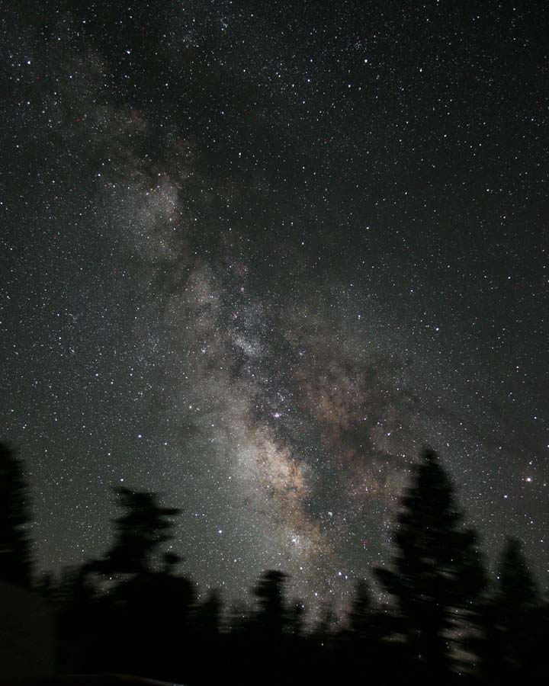
Here is what it should look like!
James Jacobson
Notes:
The Milky Way – looking toward the center of our home galaxy in the summertime.
In the winter we are looking toward the outer edge of the galaxy, so it is not quite as bright.
In order to see the Milky Way and more stars, we find it necessary to get out of town, away from the sky glow and light pollution. We need to drive an hour away to get a decent dark sky.

Slide 10
Exoplanets
What are exoplanets?
What kind of exo-solar systems do we expect to find?
How do we find exoplanets?
What do they teach us?
Outlook: Is there life around other stars?

Slide 11
What is a Planet? – Official Definition
(1) A "planet” is a celestial body that:
  (a) is in orbit around the parent star,
  (b) has sufficient mass for its self-gravity to overcome rigid body forces so that it assumes a hydrostatic equilibrium (nearly round) shape, and
  (c) has cleared the neighborhood around its orbit.
(2) A "dwarf planet" is a celestial body that:
  (a) is in orbit around the parent star,
  (b) has sufficient mass for its self-gravity to overcome rigid body forces so that it assumes a hydrostatic equilibrium (nearly round) shape,
  (c) has not cleared the neighborhood around its orbit, and
  (d) is not a satellite.
(3) All other objects, except satellites, orbiting the star shall be referred to collectively as "Small Star System Bodies".

Slide 12
What are Exoplanets?
Planets orbiting a star other than the Sun
As of today, 241 known exoplanets
Over 19 exo-solar systems with multiple planets
Super-Earth Orbiting Gliese 876. A 7.5 Earth-mass planet orbits very close to GJ 876. It is the third planet discovered around this star. This is the lowest mass exoplanet known around any nearby star.

Slide 13
Contents of a generic planetary system around a star
The host star
(Exo-)Planets
Natural satellites (moons)
Asteroids (dwarf planets)
Comets
Rings
Dust
Notes:
Some of this debris lands on earth as meteorites
Most of the solar system is a better vacuum than we can produce in the laboratory on earth!
Meteoroids = bodies < 100 m across

Slide 14
Contents of our own solar system
The sun (Sol)
Planets – 9 known (now: 8)
  Mercury, Venus, Earth, Mars (“Terrestrials”)
  Jupiter, Saturn, Uranus, Neptune (“Jovian”)
  Pluto (a TNO, Kuiper Belt object)
Natural satellites (moons) – over a hundred
Asteroids and Meteoroids
  6 known that are larger than 300 km across
  Largest, Ceres, is about 940 km in diameter
Comets
Rings
Dust
Notes:
Some of this debris lands on earth as meteorites
Most of the solar system is a better vacuum than we can produce in the laboratory on earth!
Meteoroids = bodies < 100 m across

Slide 15
Features of our own solar system
G2 star (yellow, temperature 5800K)
Terrestrial Planets
Gap with some dwarf planets
Jovian Planets
Kuiper Belt (outer dwarf planets)

Slide 16
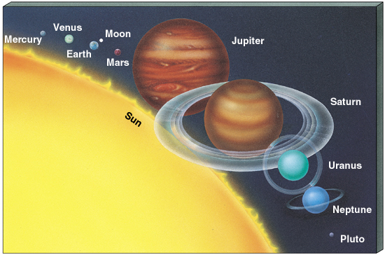
Size matters: radii of the Planets

Slide 17
Typical distances in Solar Systems: The Astronomical Unit
A convenient unit of length for discussing solar systems is the Astronomical Unit (A.U.)
One A.U. is the average distance between the Earth and Sun
  About 93 million miles or 8 light-minutes
Entire solar system is about 80 A.U. across
Notes:
Size of solar sys ~ 1/1000 lyr; distance to nearest star ~ 4.3 lyr

Slide 18
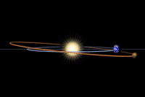
Side view: Inclination of Orbits
Orbits (here: Mars) are very slightly tilted with respect to the sun-earth plane
→ Planets appear close to the path of the sun in the sky, the ecliptic

Slide 19
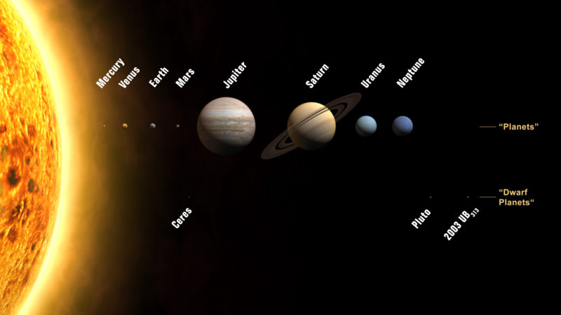
Two types of planets
Eris
…and then there are also those “dwarf planets”

Slide 20
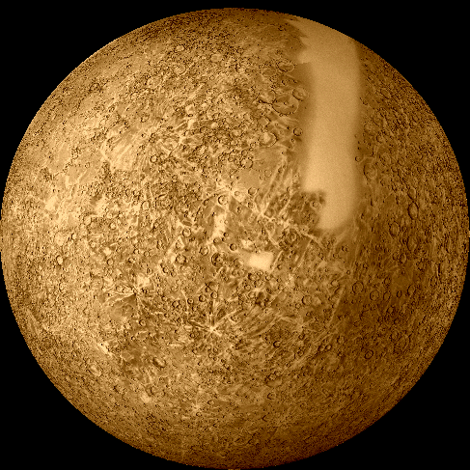
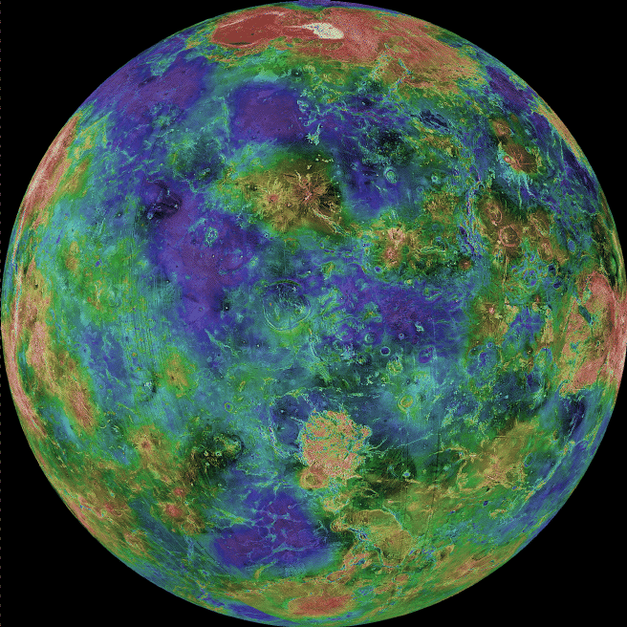
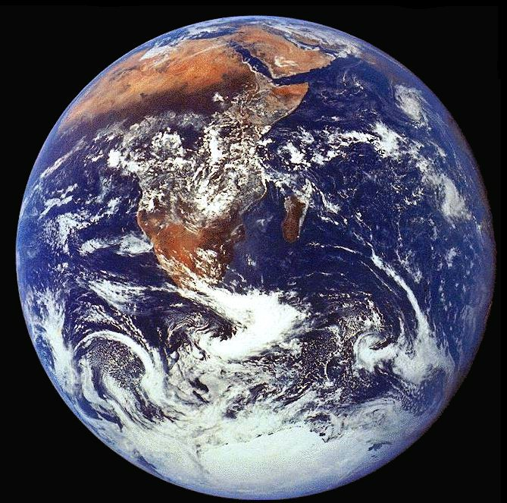
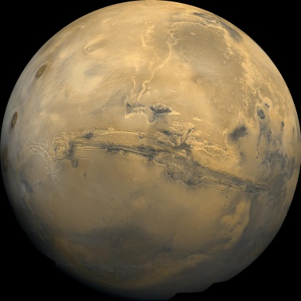
The Terrestrial (inner) Planets
Distances from Sun: less than 2 A.U.
Small, dense and rocky
Few moons, no rings
Mercury
Mars
Venus
Earth

Slide 21
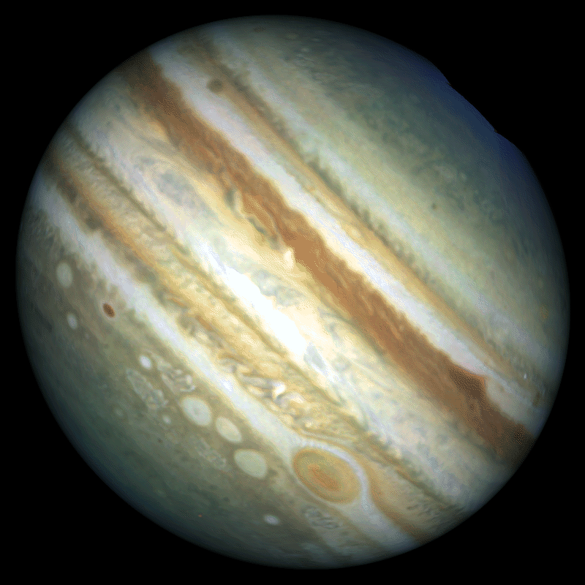
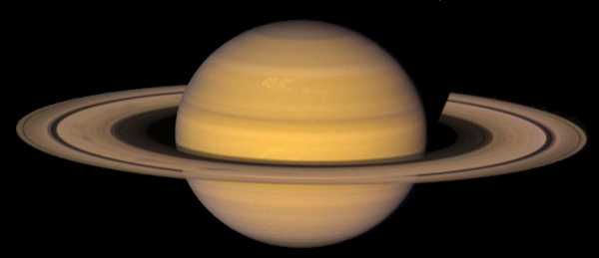
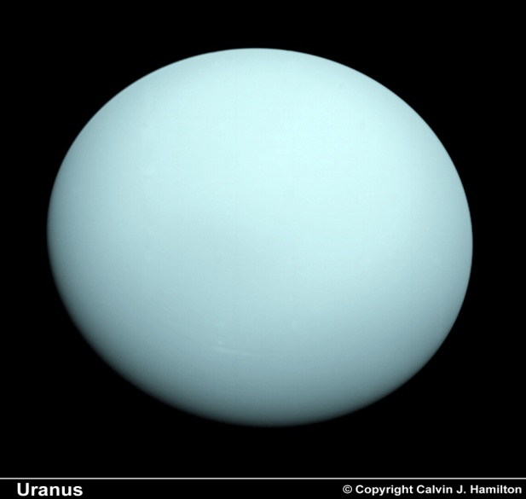
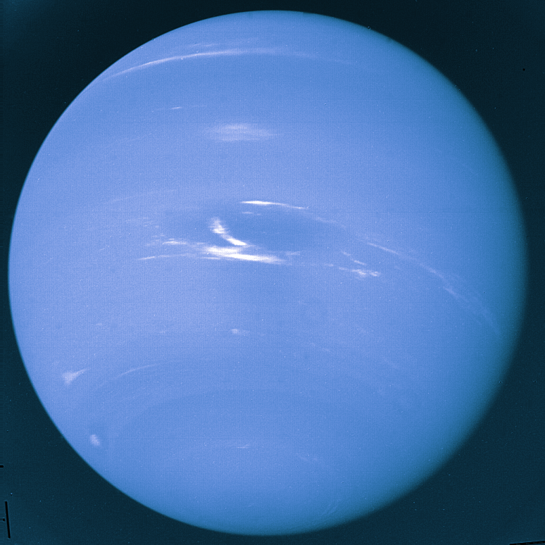
The Jovian (Outer) Planets
Distances from Sun: greater than 5 A.U.
Large, gaseous, lots of moons, rings
Saturn
Jupiter
Uranus
Neptune
Notes:
Terrestrial-type cores

Slide 22
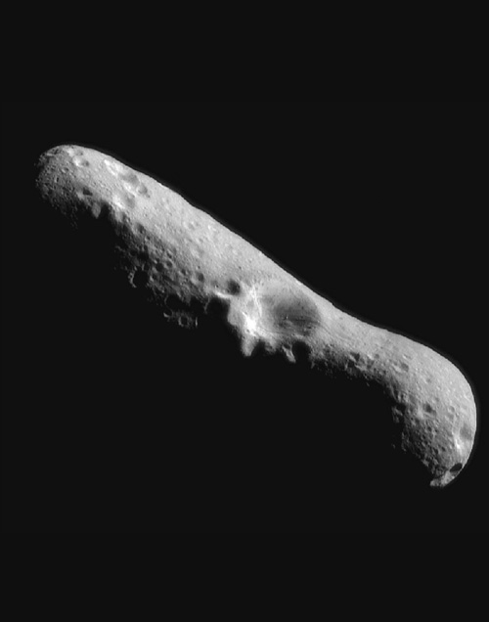
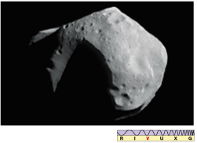
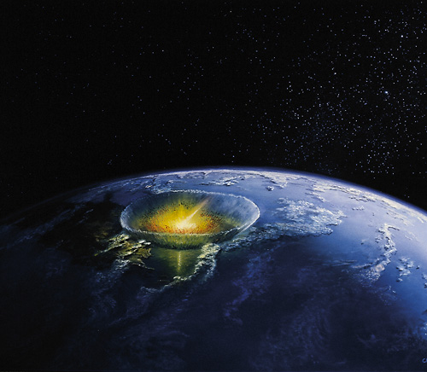
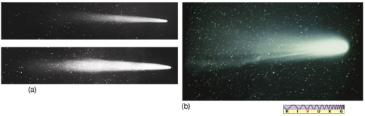
The Rest: Asteroids, Comets and Meteors
“Debris” in the Solar System
Too small to detect from afar
Notes:
Some of this debris lands on earth as meteorites
Most of the solar system is a better vacuum than we can produce in the laboratory on earth!
Meteoroids = bodies < 100 m across

Slide 23
What kind of exo-solar system do we expect to find?
If we live in a typical solar system, we will likely find copies of our own solar system
If we live in a special solar system, we will find exo-solar systems that look very different

Slide 24
What kind of exoplanets do we expect to find?
Big (heavy) planets are easiest to find → expect to find mostly those “Jupiters”
Smaller, rocky planets are harder to find, but the most interesting, since life could exist on these “Earths”

Slide 25
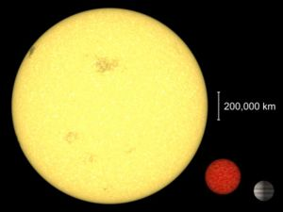
Brown dwarfs: Big planets or small Stars?
If a planet is “too” big, it will start to look like a star giving off more energy than it is receiving
Dwarfish compared to Sun, giant compared to Jupiter
Sun Brown Jupiter
Dwarf

Slide 26
How do we find Exoplanets?
Direct Observation (works only for double stars, planets are too dim)
Observe gravitational wiggles (Doppler effect)
Observe exoplanet transits (Brightness curve)
Or: Look them up on the internet ☺ http://exoplanets.org/

Slide 27
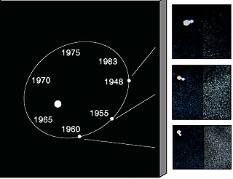
Direct Observation
Members of system are well separated, distinguishable
Works only for double stars, not planets

Slide 28
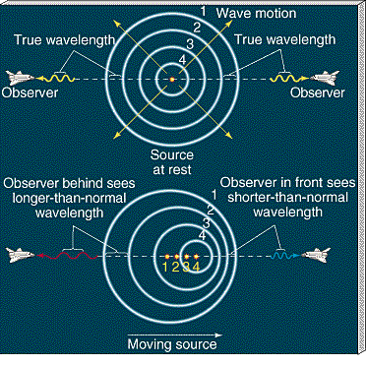
Doppler Shift
Shift in optical frequency, analogy to shift in acoustic frequency shift (“emergency vehicle passing”)
Notes:
radiation from receding bodies is shifted to longer wavelengths (red shift; appear cooler)
radiation from approaching bodies is shifted to shorter wavelengths (blue shift; appear hotter)
Very small effect if v is small compared to c – almost always the case
Just like an ambulance passing by
SIREN ON A STRING DEMO

Slide 29
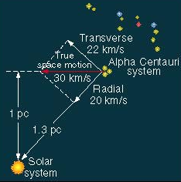
Doppler Shift
Can use the Doppler shift to determine radial velocity of distant objects relative to us:
  How fast is the object coming towards us or receding from us
Notes:
velocity towards or away is radial; across the field of view, transverse. Only radial velocity contributes to Doppler shift.
Also, temperature and rotation can be detected by a broadening of a narrow spectral line.
Rotation of Venus detected via Doppler shift of reflected radar waves
“Ringing” of the sun similarly

Slide 30
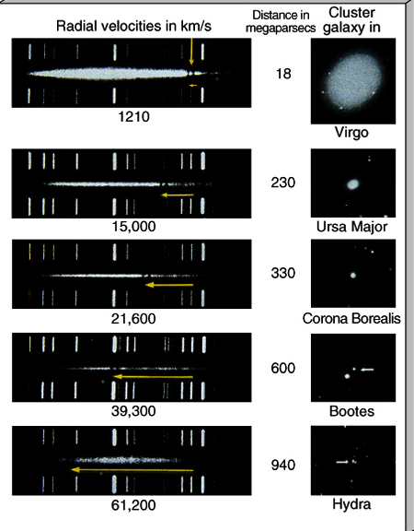
Compare lines in spectrum
Measure spectrum of objects and compare to laboratory measurement
Doppler effect:
  if lines are shifted towards red, the object is moving away from us
  if lines are shifted towards blue, the object is moving towards us

Slide 31
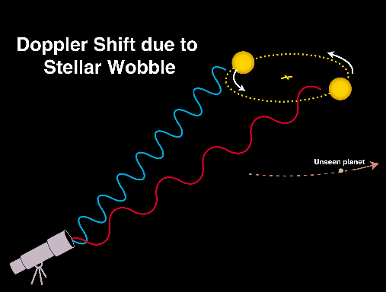
Doppler Detection
Example:
Jupiter's gravitational pull causes the Sun to wobble around in a circle with a velocity of 12 meters per second.

Slide 32
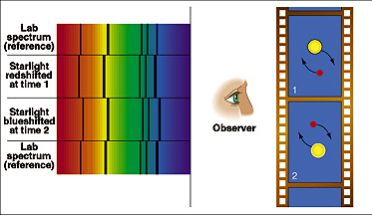
Doppler Shift
Indirect observation by measuring the back-and-forth Doppler shifts of the spectral lines

Slide 33
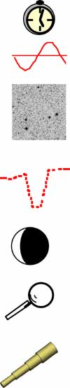
TECHNIQUES FOR FINDING EXTRASOLAR PLANETS
Method Yield Mass Limit Status
Pulsar Timing m/M ; τ Lunar Successful (3)
Radial Velocity m sini ; τ super-Earth Successful (~200)
Astrometry m ; τ ; Ds ; a
Ground: Interferometer sub-Jupiter In development
Space: Interferometer Uranus Being studied
Transit Photometry A ; τ ; sini=1
Ground sub-Jupiter HD209458, OGLE TR-56
Space (2006) sub-Jupiter HST (~16)
Space (2006, 2008) Venus Planned CoRoT, Kepler
Reflection Photometry: albedo*A ; τ
Space Saturn Planned Kepler
Microlensing: f(m,M,r,Ds,DL )
Ground sub-Uranus On-going
Direct Imaging albedo*A ; τ ; Ds ; a ; M
Ground Saturn Being studied
Space Earth Being studied
(Source: J. Lissauer)
33

Slide 34
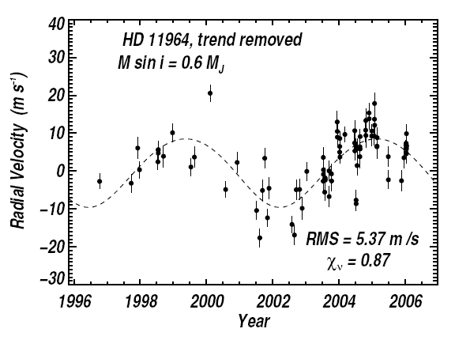
Example: Exoplanet around HD 11964
Doppler shift:
  Red
  Blue

Slide 35
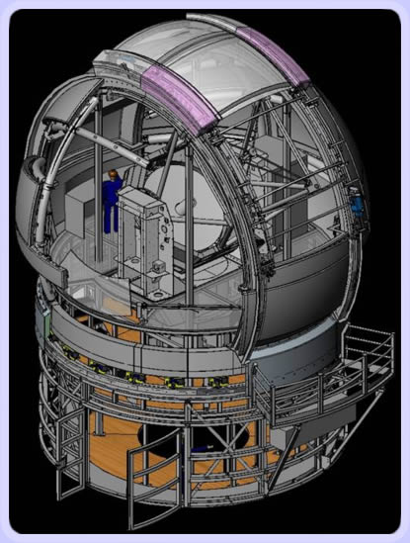
Doppler Detection: The Automated Planet Finder Telescope
“The Automated Planet Finder Telescope is optimized specifically for the Doppler detection of planets having masses 5 to 20 times that of Earth. Such planets would likely be rocky with atmospheres, and able to retain water. The 2.4-meter, robotic, telescope will be dedicated every night to this planet search.”
http://exoplanets.org/telescope.html

Slide 36
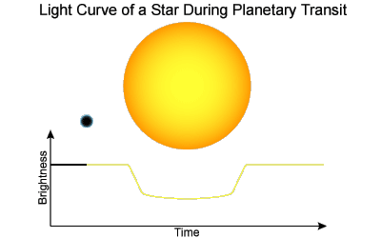
Eclipsing (Transiting) Exoplanets
Orbital plane of the planet need to be almost edge-on to our line of sight
We observe periodic changes in the starlight as the (dark) planet passes in front of the star

Slide 37
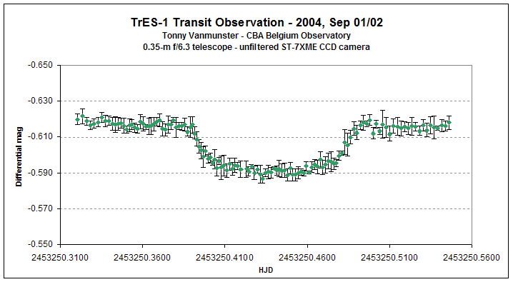
Example: Amateur discovers Exoplanet
Brightness / time

Slide 38
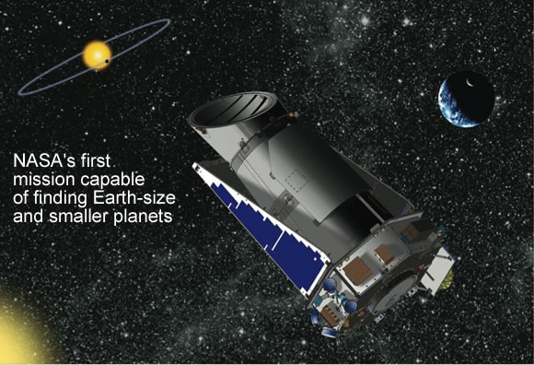
Kepler Satellite Mission
Detect Earth-size exoplanets by observing transits

Slide 39
What do exoplanets teach us?
Is our picture of a “typical” solar system correct?
Is our theory about the formation of solar systems correct?

Slide 40
Formation of the Solar System
Features to explain:
  planets are far apart, not bunched together
  orbits of planets are nearly circular
  orbits of planets lie mostly in a single plane
  directions of revolution of planets about Sun is the same, and is the same as the direction of the Sun's rotation
  directions of rotation of planets about their axes is also mostly in the same direction as the Sun's (exceptions: Venus, Uranus, Pluto)
  most moons revolve around their planets in the same direction as the rotation of the planets
  differentiation between inner (terrestrial) and outer (Jovian) planets
  existence and properties of the asteroids
  existence and properties of the comets

Slide 41
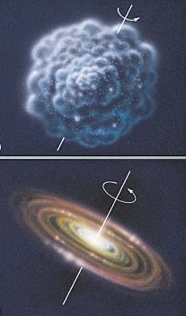
Standard Theory of the formation of the Solar System
Condenses from a rotating cloud of gas and dust
  Conservation of angular momentum flattens it
Dust helps cool the nebula and acts as seeds for the clumping of matter

Slide 42
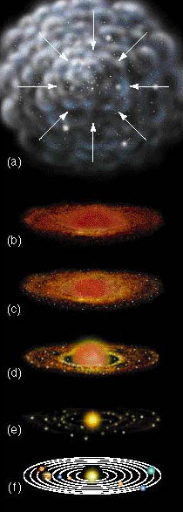
Formation of Planets
Orbiting dust – planitesimals
Planitesimals collide
Different elements form in different regions due to temperature
Asteroids
Remaining gas

Slide 43
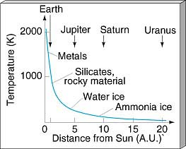
Structure of the Planets explained
Temperature and density of materials drop with distance to sun

Slide 44
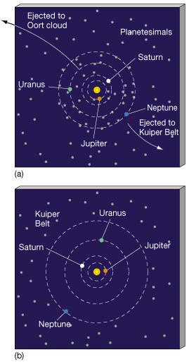
Cleaning up the Solar System
Small objects are forced out of the inner Solar System by gravitational pull of bigger planets
Small planetesimals collide and form planets
-- or are thrown out!

Slide 45
What kind of exoplanets are we finding?
So far mostly “big Jupiters”, as expected
Two types of orbits:
  Either highly eccentric and close to star
  Or circular orbits and “typical” spacing

Slide 46
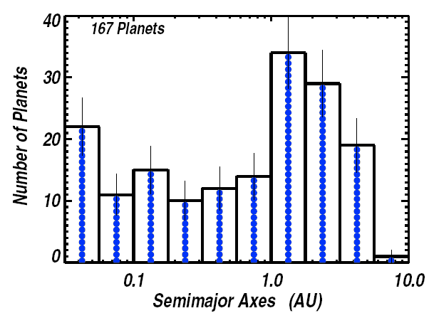
Distances from Host Star
Mercury Earth Jupiter

Slide 47
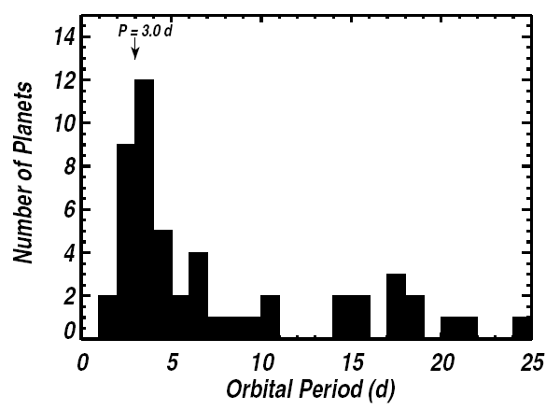
“Hot Jupiters” – very big and close to the host star
Earth has d = 365 days

Slide 48
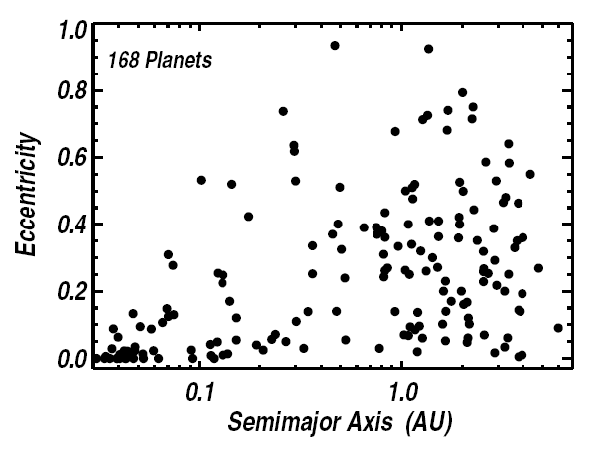
“Tidal circularization”
The closer an exoplanet is to its star, the more circular is its orbit

Slide 49
Resonances
It seems that our solar system is very stable with respect to gravitational effects
  The heavy planets are far out
  The lighter planets are closer together
  (Force of gravity grow with mass, decreases with distance)
This is no accident! If it weren’t like this, the big planets would gravitationally “bully” the others around:
  Force them into eccentric orbits
  Throw them out of the solar system

Slide 50
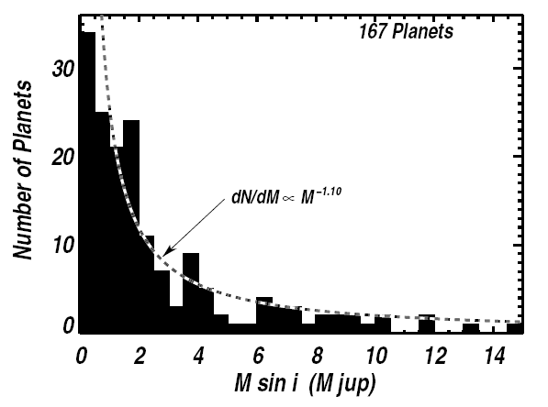
Masses of Exoplanets
There seem to be more planets out there with small masses

Slide 51
A refined Picture
New picture emerges from lessons learned from exoplanets
  Formation of a solar system is not necessarily the final word on appearance of a planetary system
  Dramatic changes can happen in the millions of years
    Collisions
    Clean up
    migration

Slide 52
Heritage and History
How a planetary system looks like today is determined by how it formed AND what happened in its history
Our solar system seems to be protected from “drama” by its hierarchy and associated stabilizing resonances
  Still: Jupiter probably migrated inward by throwing out lots of small bodies (“gravitational slingshot”)

Slide 53
Is there life around other suns?
“Habitable Zones” around the host stars depend on their temperature

Slide 54
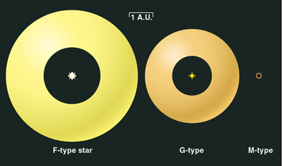
Habitable Zones
1 A.U. = average Earth-Sun distance

Slide 55
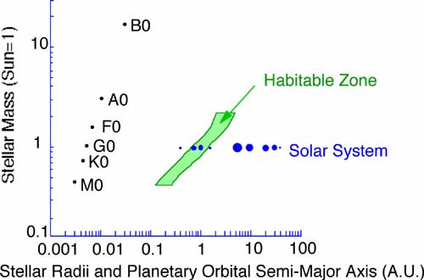
Habitable Zones

Slide 56
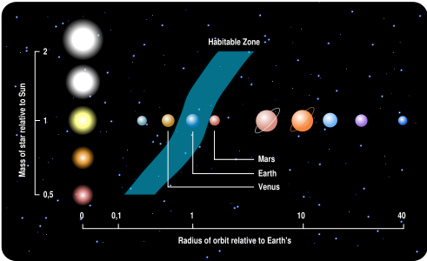
Habitable Zones

Slide 57
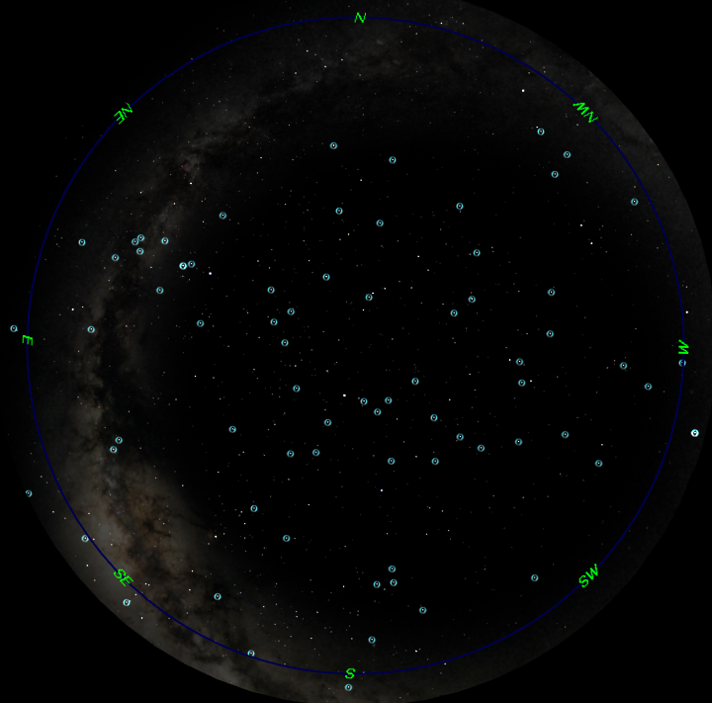
Visible Stars tonight with Planets
June 23th
at 9:00 p.m.

Slide 58
Out of this World Fun for Kids
A kid-friendly (and parent-friendly)
Web site by NASA
FUN learning about Space and Exploration!
http://www.nasa.gov/audience/forkids/kidsclub/flash/index.html
http://spaceplace.nasa.gov/en/kids/

Slide 59

Space Exploration . . .
The Final Frontier

Slide 60
Current Events in Astronomy
TONIGHT . . .
Star with Planet – Iota Draconis, Iota Dra, 12 Dra
  HD 137759, SAO 29520, HIP 75458, TYC 03875-1620 1
  It also has the traditional name Edasich.
Observation data (Epoch J2000.0)
  Constellation Draco
  orange giant star
  Right ascension 15h 24m 55.7747s
  Declination +58° 57' 57.836“
  Apparent magnitude (V) 3.31
  Distance 102.7 ly
Notes:
These are a few of the celestial objects it is possible to see in tonight’s sky. We probably won’t see them all, depending on their position in the sky and our location with regard to obstacles such as trees, buildings, and perhaps some cloud cover.

Slide 61
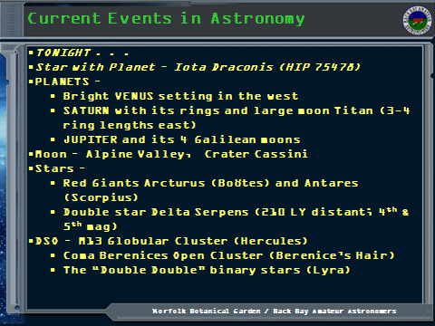

Slide 62
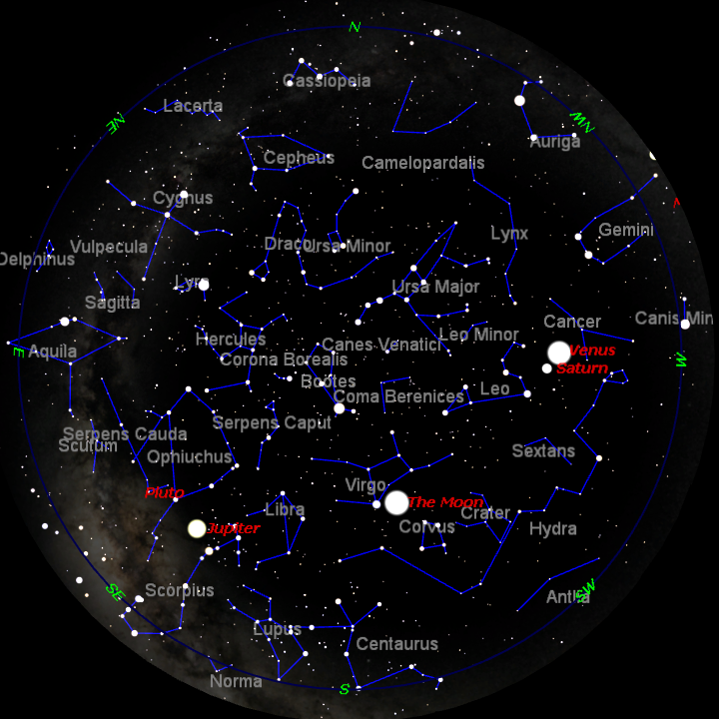
TONIGHT’S SKY
June 23th
at 9:00 p.m.
Notes:
If we had low horizons all around, like out on the ocean, here is what you could see tonight. This sky chart shows the major constellations, groupings of stars that men have named over the centuries, to help us be more familiar with our starry tapestry above.
If conditions outside permit, we will point out some of these constellations to you.

Slide 63
Questions
Questions
?
http://www.BackBayAstro.org

Slide 64
Safety First!
We will go outside in just a moment.
Please remember, Safety First!
Please do not run or horseplay around the water fountains and telescopes.
Please remember, Safety First!
Please do not run or horseplay around the water fountains and telescopes.

Slide 65
And now, we urge you . . .

Slide 66
Now, please Join us outside for a “tour” of the night sky followed by a look through the telescopes.
Boldly GO!

Slide 67
Now, please Join us outside for a “tour” of the night sky followed by a look through the telescopes.
Please remain seated for a few minutes with the lights out and let your eyes begin to adapt to the darkness.

