Slide 1

GardenStars – February 24, 2007
Welcome to GardenStars
An Evening Under the Stars
Presented by
The Norfolk Botanical Garden
And
Back Bay Amateur Astronomers

Slide 2


The Back Bay Amateur Astronomers
Bringing Astronomy to the People of Hampton Roads
The Back Bay Amateur Astronomers
PO Box 9877
Virginia Beach, VA 23450

Slide 3
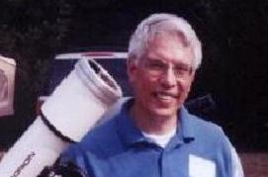
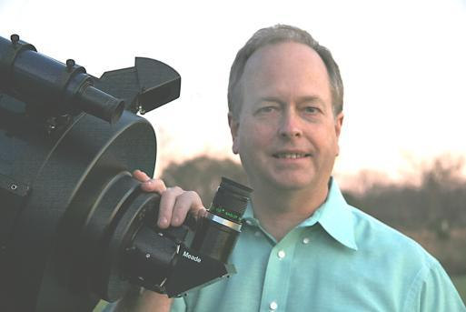

Your “Solar System Ambassadors”
George Reynolds
Chuck Rippel

Slide 4

Introductions
Back Bay Amateur Astronomers
  George Reynolds
  Chuck Rippel
  Kevin and Barb Weiner
  Matt McLaughlin
  Larry Channel
  Bruce Bodner
  Ron Repinski

Slide 5
Tonight's Agenda...
Star lore
30 minute presentation
Guided tour of the sky
Telescope viewing
Norfolk Botanical Garden / Back Bay Amateur Astronomers

Slide 6
Star lore...
Norfolk Botanical Garden / Back Bay Amateur Astronomers
Notes:
Amateur Astronomers – What are they?
Well, some people stereotype astronomers as nerdy individuals with pocket protectors and taped-up glasses.
I will admit to wearing glasses, but I don’t own a pocket protector. ;-)

Slide 7
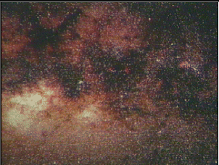
Amateur Astronomers...
We are ordinary people with a love of the heavens. We contribute to science thru discovery, study and by sharing information with others.
Norfolk Botanical Garden / Back Bay Amateur Astronomers
Notes:
As the slide says, we are ordinary folks . . . With an interest in science, nature, Creation, you name it.
Some of us are computer geeks, some work in offices or schools, some are students, and some are retired. We have some ladies in the club, and a lot of guys. We have a few teenagers, some old men, and a lot of in-between folks.
I know some people think that science is BORING . . . ➔

Slide 8
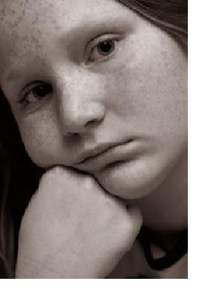

Science is B O R I N G !
Notes:
.. . . But I say that science is FUN! ➔

Slide 9
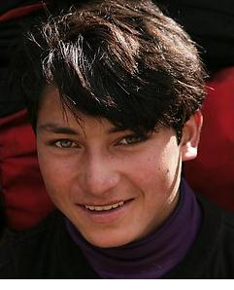
Science is FUN!!
Notes:
There are many Web sites kids can go to for fun and infromation about science and astronomy.
Here are just a couple of examples . . . ➔

Slide 10
Out of this World Fun for Kids
A kid-friendly (and parent-friendly)
Web site by NASA
FUN learning about Space and Exploration!
http://www.nasa.gov/audience/forkids/kidsclub/flash/index.html
http://spaceplace.nasa.gov/en/kids/

Slide 11
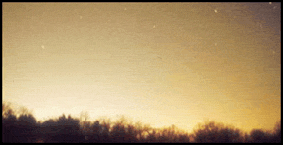
Why can’t I see any stars?
Sky Glow!
Another term for
Light Pollution!
Notes:
You may ask, “what is there to see up in the night sky? When I look up, I don’t see much of anything.”
LIGHT POLLUTION: streetlights, car lots, shopping centers, illuminated buildings, “security” lights, decorative lighting, etc., etc.

Slide 12
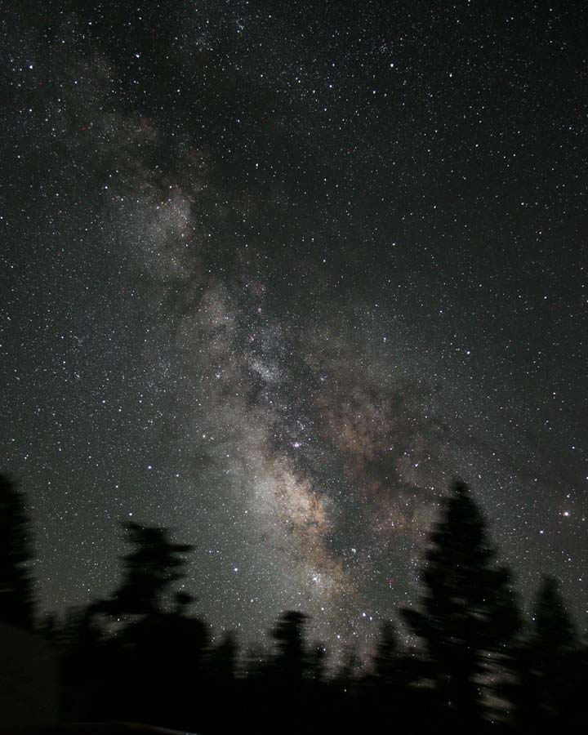
Here is what it should look like!
James Jacobson
Notes:
The Milky Way – looking toward the center of our home galaxy in the summertime.
In the winter we are looking toward the outer edge of the galaxy, so it is not quite as bright.
In order to see the Milky Way and more stars, we find it necessary to get out of town, away from the skyglow and light pollution. We need to drive an hour away to get a decent dark sky.

Slide 13



How can I see in a dark sky?
The unaided eye (“Naked eye”)
Binoculars
Telescopes
Notes:
HOW can I see . . .

Slide 14
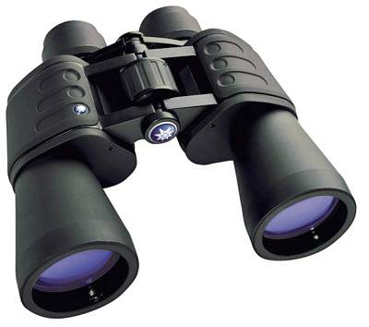
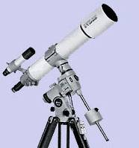
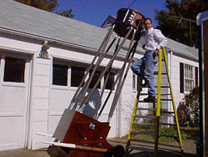
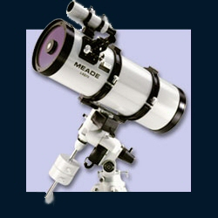
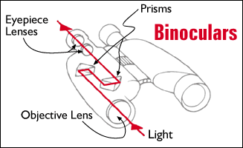
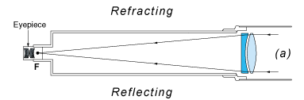
Observing aids
Eyes, Binoculars, Refractors, Reflectors, Catadioptric
Norfolk Botanical Garden / Back Bay Amateur Astronomers
Notes:
These are some devices you can use to enhance your eyes’ ability to see faraway objects in the night sky: Binoculars, and Telescopes of various types and sizes.
Your next question may well be, “WHAT can I expect to see in a dark sky?”
Well, there are PLANETS, MOONS, COMETS, and ASTEROIDS in our SOLAR SYSTEM, and STARS, STAR Clusters, and NEBULAS in our GALAXY . . . And outside our own galaxy, there are countless billions of other galaxies in the far reaches of outer space.

Slide 15
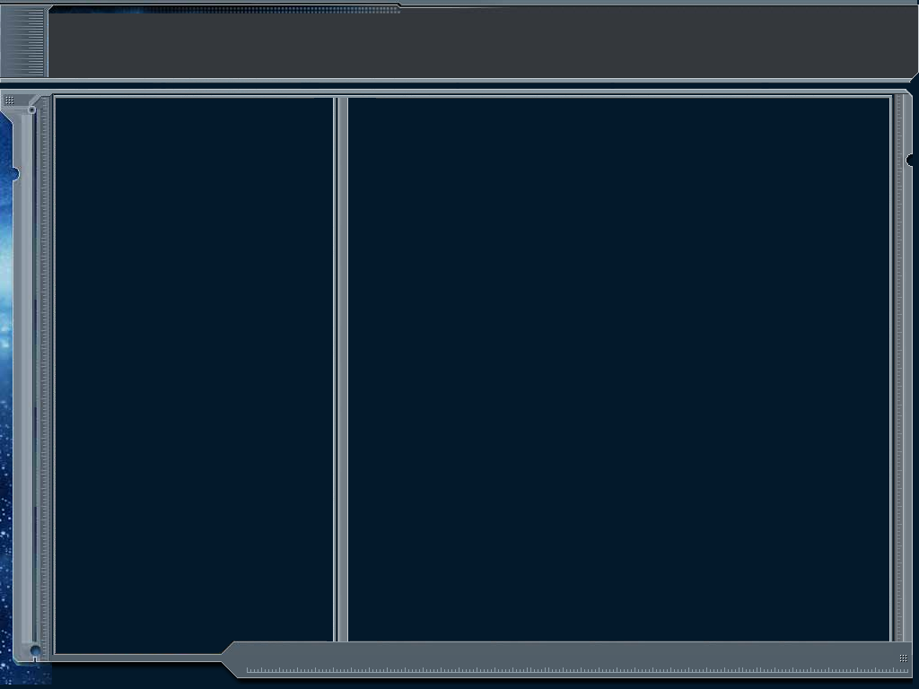
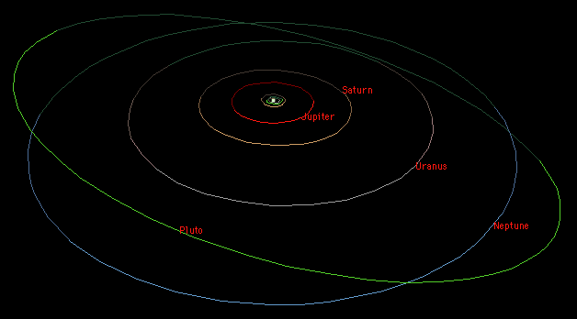
Our Solar System
Overview
The Sun
8 Major Planets
4 Dwarf Planets
Many “minor planets”
Comets
Asteroids
Norfolk Botanical Garden / Back Bay Amateur Astronomers
Notes:
Our SOLAR SYSTEM is the system of planets, moons, asteroids, comets, and other objects that trabvel in orbits around our SUN. Our Sun has a name, and it is “SOL”. That’s why it is called the “SOLar system”. If we lived on a planet orbiting the star Rigel, we would be in the Rigelian System.
You may have heard that Pluto was recently demoted from full planet status to a “Dwarf Planet”. Many astronomers don’t agree with that decision, and it may change again in a few years. We’ll wait and see.
Let’s take a quick tour through our solar system. ➔

Slide 16
Space Exploration . . .
The Final Frontier

Slide 17
Current Events in Astronomy
TONIGHT . . .
PLANETS – Most of them now are up in the DAYTIME!
Mars, Jupiter, Mercury, Venus, & Pluto*
Moon – In Capricornus low in the SSW, a Waxing Crescent rising 11:19 a.m., setting 9:09 p.m.
Saturn – Rises around midnight, low in the ENE
Uranus & Neptune – Very dim and far away; in Aquarius and Capricornus, respectively
Open Cluster M45 “The Pleiades” - In Taurus the Bull
Double Cluster in Perseus – Almost straight up
M15 Globular Cluster – In Pegasus overhead
M31 Andromeda Galaxy – Between Pegasus & Cassiopeia
Double star Albireo – In Cygnus the Swan
“Double Double” – In Lyra
Comet C/2006 M4 (SWAN) – Low in the West in the constellation Aquila the Eagle, very faint
Notes:
These are a few of the celestial objects it is possible to see in tonight’s sky. We probably won’t see them all, depending on their position in the sky and our location with regard to obstacles such as trees, buildings, and perhaps some cloud cover.

Slide 18
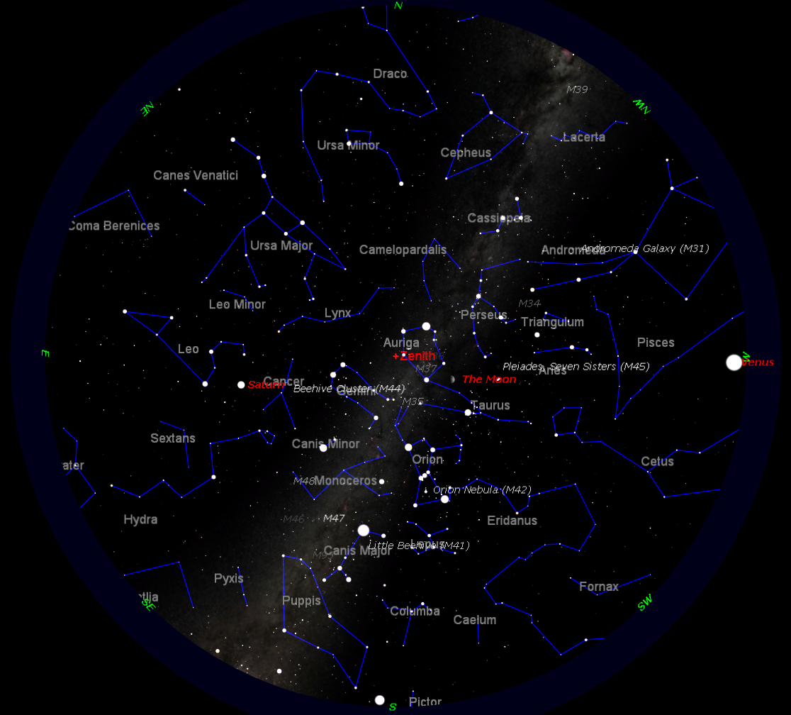
TONIGHT’S SKY
February 24th
at 8:00 p.m.
Notes:
If we had low horizons all around, like out on the ocean, here is what you could see tonight. This sky chart shows the major constellations, groupings of stars that men have named over the centuries, to help us be more familiar with our starry tapestry above.
If conditions outside permit, we will point out some of these constellations to you.

Slide 19
Questions
Questions
?
http://www.BackBayAstro.org

Slide 20
Safety First!
We will go outside in just a moment.
Please remember, Safety First!
Please do not run or horseplay around the water fountains and telescopes.
Please remember, Safety First!
Please do not run or horseplay around the water fountains and telescopes.

Slide 21
And now, we urge you . . .

Slide 22
Now, please Join us outside for a “tour” of the night sky followed by a look through the telescopes.
Boldly GO!

Slide 23
Please remain seated for a few minutes with the lights out and let your eyes begin to adapt to the darkness.
Now, please Join us outside for a “tour” of the night sky followed by a look through the telescopes.
Boldly GO!

