Slide 1


GardenStars – November 25, 2006
Welcome to GardenStars
An Evening Under the Stars
Presented by
The Norfolk Botanical Garden
And
Back Bay Amateur Astronomers

Slide 2


The Back Bay Amateur Astronomers
Bringing Astronomy to the People of Hampton Roads
The Back Bay Amateur Astronomers
PO Box 9877
Virginia Beach, VA 23450

Slide 3
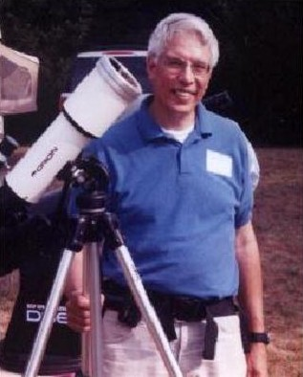

Your “Solar System Ambassador”
George Reynolds

Slide 4

Introductions
Back Bay Amateur Astronomers
  George Reynolds
  Kevin and Barb Weiner
  Matt McLaughlin
  Larry Channel
  Bruce Bodner
  Ron Repinski

Slide 5

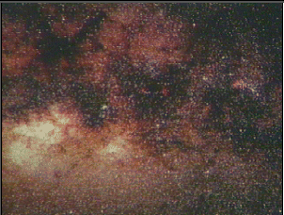
Tonight's Agenda...
Star lore
~20 minute presentation
Guided tour of the sky
Telescope viewing
Norfolk Botanical Garden / Back Bay Amateur Astronomers

Slide 6
Star lore...
Norfolk Botanical Garden / Back Bay Amateur Astronomers
Notes:
Amateur Astronomers – What are they?
Well, some people stereotype astronomers as nerdy individuals with pocket protectors and taped-up glasses.
I will admit to wearing glasses, but I don’t own a pocket protector. ;-)

Slide 7
Amateur Astronomers...
We are ordinary people with a love of the heavens. We contribute to science thru discovery, study and by sharing information with others.
Norfolk Botanical Garden / Back Bay Amateur Astronomers
Notes:
As the slide says, we are ordinary folks . . . With an interest in science, nature, Creation, you name it.
Some of us are computer geeks, some work in offices or schools, some are students, and some are retired. We have some ladies in the club, and a lot of guys. We have a few teenagers, some old men, and a lot of in-between folks.
I know some people think that science is BORING . . . ➔

Slide 8


Science is BORING!
Notes:
.. . . But I say that science is FUN! ➔

Slide 9
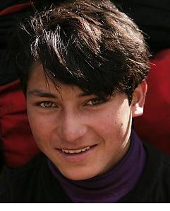
Science is FUN!!
Notes:
There are many Web sites kids can go to for fun and infromation about science and astronomy.
Here are just a couple of examples . . . ➔

Slide 10
Out of this World Fun for Kids
A kid-friendly (and parent-friendly) Web site by NASA
FUN learning about Space and Exploration!
http://www.nasa.gov/audience/forkids/kidsclub/flash/index.html
http://spaceplace.nasa.gov/en/kids/

Slide 11
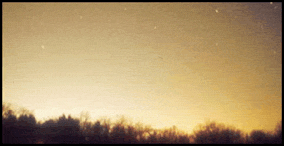
Why can’t I see any stars?
Sky Glow!
Another term for
Light Pollution!
Notes:
You may ask, “what is there to see up in the night sky? When I look up, I don’t see much of anything.”
LIGHT POLLUTION: streetlights, car lots, shopping centers, illuminated buildings, “security” lights, decorative lighting, etc., etc.

Slide 12
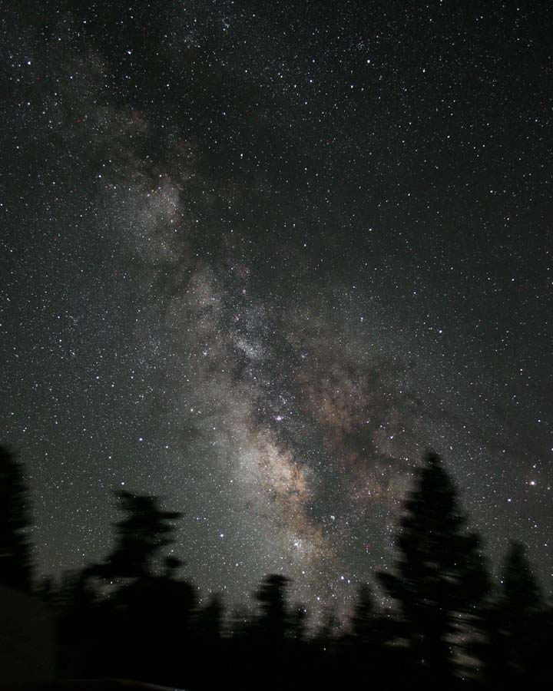
James Jacobson
Here’s what it SHOULD look like!
Notes:
The Milky Way – looking toward the center of our home galaxy in the summertime.
In the winter we are looking toward the outer edge of the galaxy, so it is not quite as bright.
In order to see the Milky Way and more stars, we find it necessary to get out of town, away from the skyglow and light pollution. We need to drive an hour away to get a decent dark sky.

Slide 13



HOW can I see in a dark sky?
The unaided eye (“Naked eye”)
Binoculars
Telescopes
Notes:
HOW can I see . . .

Slide 14
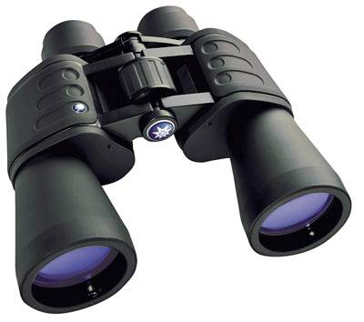
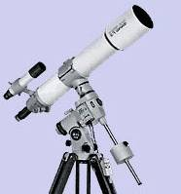
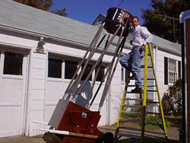
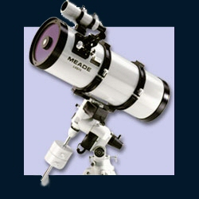
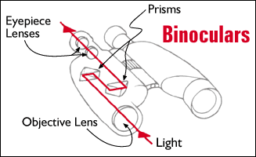
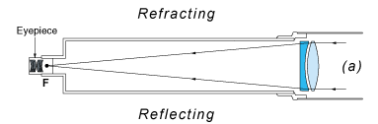
Telescopes – Types
Eyes, Binoculars, Refractors, Reflectors, Catadioptric
Norfolk Botanical Garden / Back Bay Amateur Astronomers
Notes:
These are some devices you can use to enhance your eyes’ ability to see faraway objects in the night sky: Binoculars, and Telescopes of various types and sizes.
Your next question may well be, “WHAT can I expect to see in a dark sky?”
Well, there are PLANETS, MOONS, COMETS, and ASTEROIDS in our SOLAR SYSTEM, and STARS, STAR Clusters, and NEBULAS in our GALAXY . . . And outside our own galaxy, there are countless billions of other galaxies in the far reaches of outer space.

Slide 15
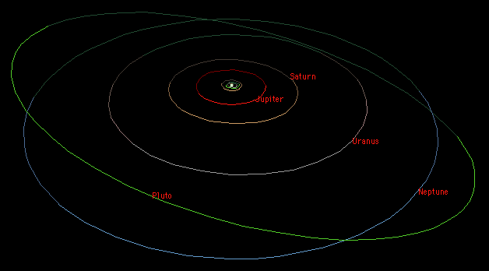
Our Solar System
Overview
The Sun
8 Major Planets
4 Dwarf Planets
Many “minor planets”
Comets
Asteroids
Norfolk Botanical Garden / Back Bay Amateur Astronomers
Notes:
Our SOLAR SYSTEM is the system of planets, moons, asteroids, comets, and other objects that trabvel in orbits around our SUN. Our Sun has a name, and it is “SOL”. That’s why it is called the “SOLar system”. If we lived on a planet orbiting the star Rigel, we would be in the Rigelian System.
You may have heard that Pluto was recently demoted from full planet status to a “Dwarf Planet”. Many astronomers don’t agree with that decision, and it may change again in a few years. We’ll wait and see.
Let’s take a quick tour through our solar system. ➔

Slide 16
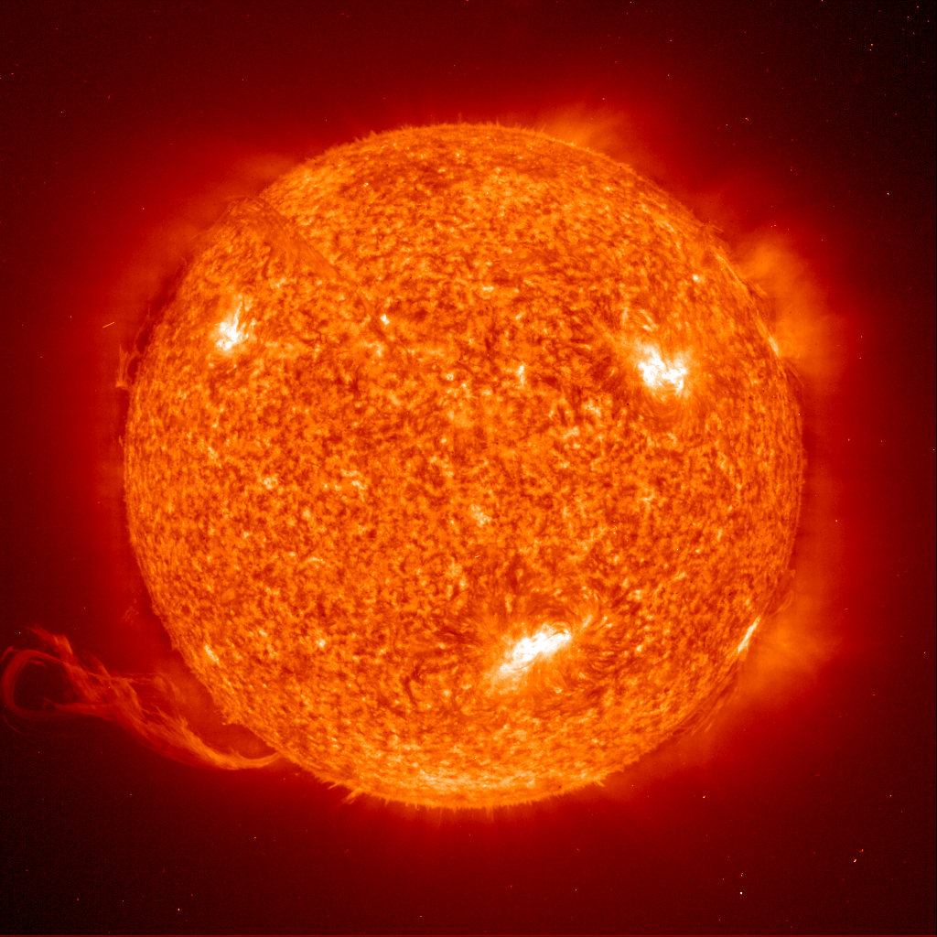
Our Solar System
1,391,000 km (864,400 mi) diameter
Apx 70% Hydrogen
Medium-small size star
The Sun
(Our Star)
“Sol”
Norfolk Botanical Garden / Back Bay Amateur Astronomers

Slide 17
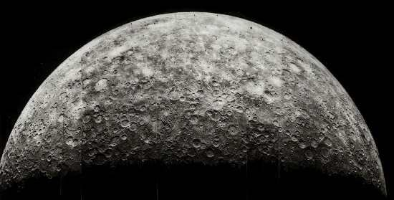
Our Solar System
4,480 km diameter
Average Temperature 167 C
Almost no Atmosphere
The Sun
(Our Star)
Mercury
Norfolk Botanical Garden / Back Bay Amateur Astronomers

Slide 18
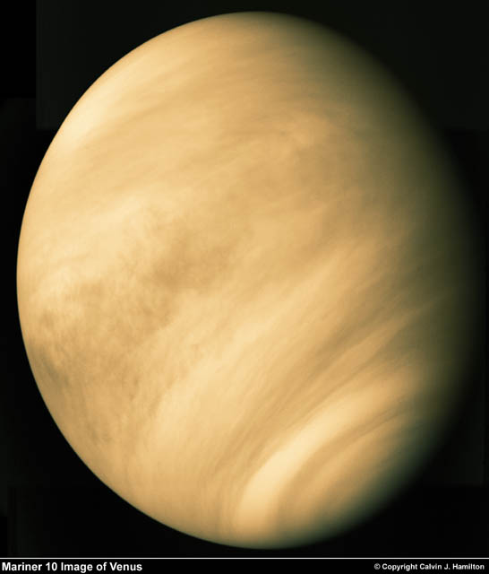
Our Solar System
12,103 km diameter
Our nearest neighbor
Sulphuric Atmosphere
The Sun
(Our Star)
Mercury
Venus
Norfolk Botanical Garden / Back Bay Amateur Astronomers

Slide 19
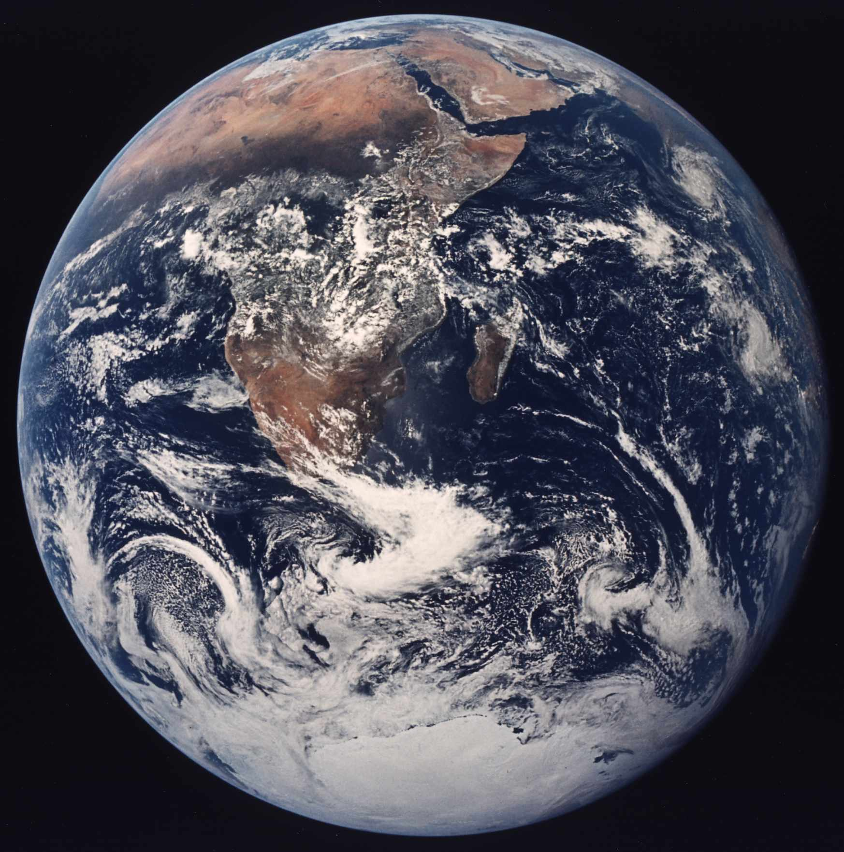
Our Solar System
12,756 km diameter
Our Home
Only Planet with life that we know of
The Sun
(Our Star)
Mercury
Venus
Earth
Norfolk Botanical Garden / Back Bay Amateur Astronomers

Slide 20
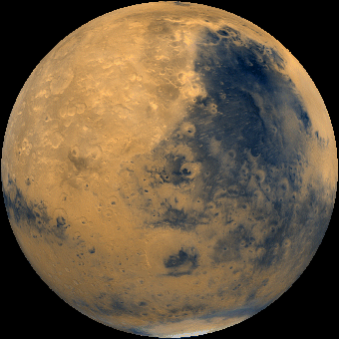
Our Solar System
6,794 km diameter
-133C – 80C Temperature
Possible water (frozen or beneath the surface)
The Sun
(Our Star)
Mercury
Venus
Earth
Mars
Norfolk Botanical Garden / Back Bay Amateur Astronomers

Slide 21
Our Solar System
142,984 km diameter
Gas Giant
63 + Moons
Great Red Spot
The Sun
(Our Star)
Mercury
Venus
Earth
Mars
Jupiter
Norfolk Botanical Garden / Back Bay Amateur Astronomers

Slide 22
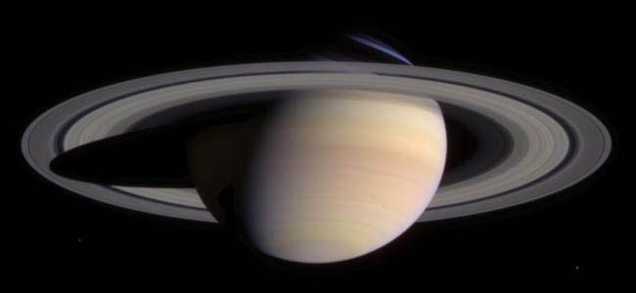
Our Solar System
120,536 km diameter
Gas Planet
Only planet with rings that can be easily seen from earth
The Sun
(Our Star)
Mercury
Venus
Earth
Mars
Jupiter
Saturn
Norfolk Botanical Garden / Back Bay Amateur Astronomers

Slide 23
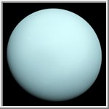
Our Solar System
51,118 km diameter
Gas Planet
Axis is sideways
The Sun
(Our Star)
Mercury
Venus
Earth
Mars
Jupiter
Saturn
Uranus
Norfolk Botanical Garden / Back Bay Amateur Astronomers

Slide 24
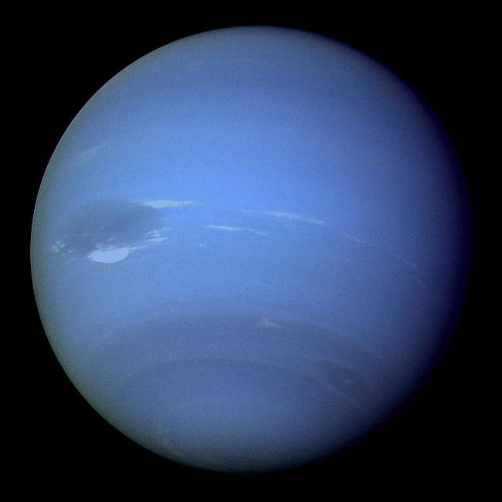
Our Solar System
49,532 km diameter
Gas Planet – Possible Core
Also has a “Blue Spot”
The Sun
(Our Star)
Mercury
Venus
Earth
Mars
Jupiter
Saturn
Uranus
Neptune
Norfolk Botanical Garden / Back Bay Amateur Astronomers

Slide 25
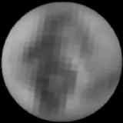
Our Solar System
2,274 km diameter
Dwarf Planet
Planet to Moon ratio similar to Earth
The Sun
(Our Star)
Mercury
Venus
Earth
Mars
Jupiter
Saturn
Uranus
Neptune
Pluto
Norfolk Botanical Garden / Back Bay Amateur Astronomers

Slide 26
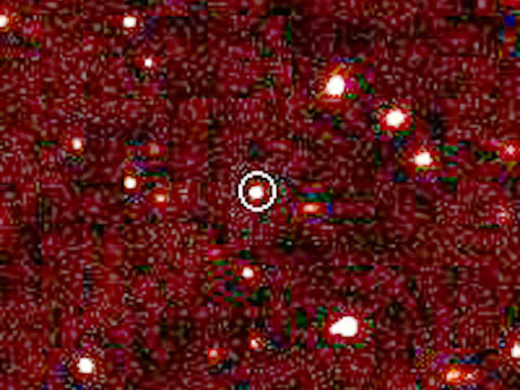
Our Solar System
Larger than Pluto
nearly 100 times the Earth-Sun distance -- over twice the average Pluto-Sun distance
The Sun
(Our Star)
Mercury
Venus
Earth
Mars
Jupiter
Saturn
Uranus
Neptune
Pluto
Eris
Eris
Norfolk Botanical Garden / Back Bay Amateur Astronomers

Slide 27
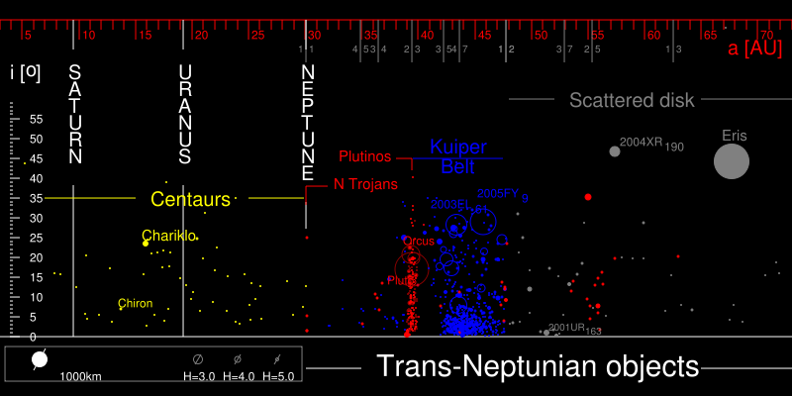
A trans-Neptunian object (TNO) is any object in the solar system that orbits the sun at a greater distance on average than Neptune. The Kuiper belt, Scattered disk, and Oort cloud are names for three divisions of this volume of space.
Notes:
This slide may be hard to read and understand. Simply put, it just shows that there are a whole lot of things out beyond the planets; comets, asteroids, “dwarf planets”, and a lot of things left to be discovered.

Slide 28
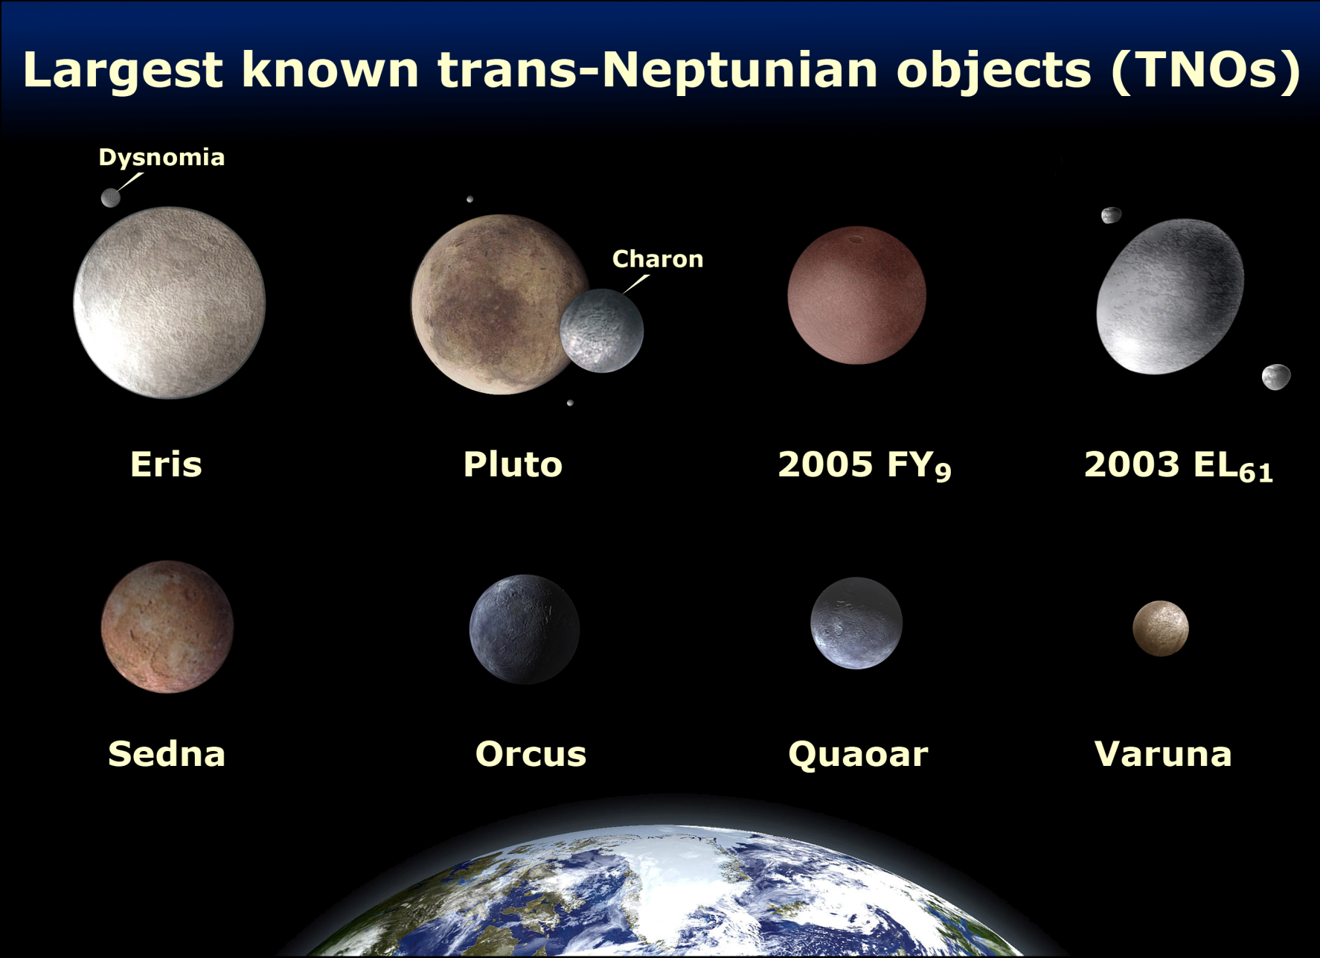
A trans-Neptunian object (TNO) is any object in the solar system that orbits the sun at a greater distance on average than Neptune. The Kuiper belt, Scattered disk, and Oort cloud are names for three divisions of this volume of space.
Notes:
Any fairly large solar system object that is not a planet, a moon, or a comet may be called a “minor planet”. Here are some examples, some of which fall into the new category of “dwarf planet”.

Slide 29
Space Exploration . . .
The Final Frontier

Slide 30
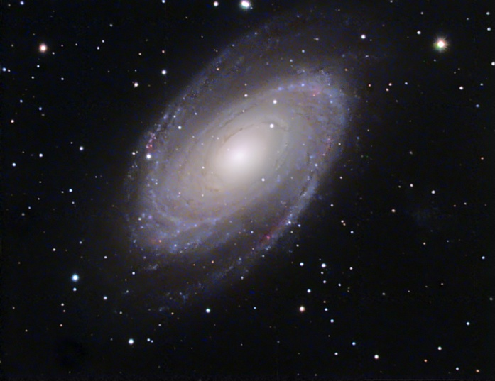
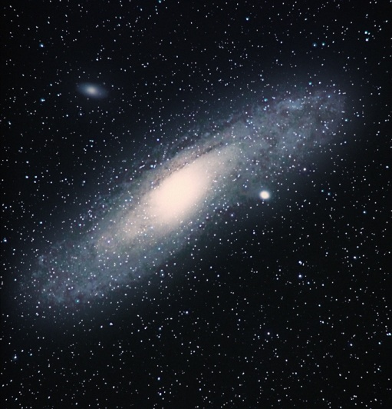
Deep Space
“Island Universes”
Billions of stars and possible Planets
Billions of Galaxies
Milky Way is Our Galaxy
Galaxies
Norfolk Botanical Garden / Back Bay Amateur Astronomers
Notes:
Out beyond our home galaxy, the Milky Way Galaxy, there are billions of other galaxies, of all shapes and sizes. Some are larger and some are smaller than our own galaxy. Ours in a spiral galaxy, as are these pictured here. The one on the right is the great Andromeda Galaxy, our nearest galactic “neighbor”, 2.5 million light-years away. On a clear night in a dark sky, you can see the glow of Andromeda without optical assistance.

Slide 31
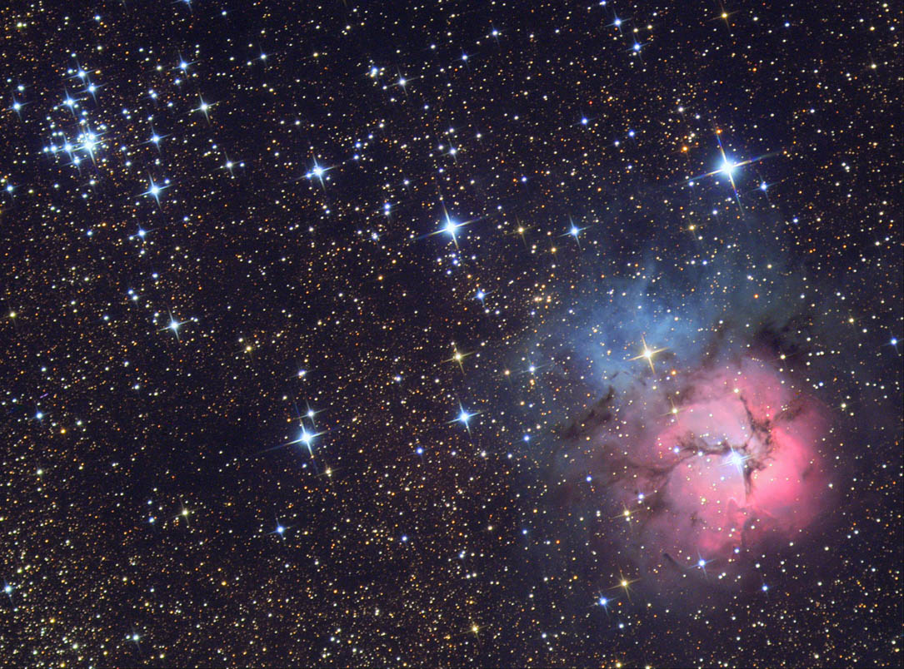
Deep Space
Galaxies
Gas Clouds
Emission, Reflection, Planetary
All we can see are within our Galaxy
Nebulae
Norfolk Botanical Garden / Back Bay Amateur Astronomers

Slide 32
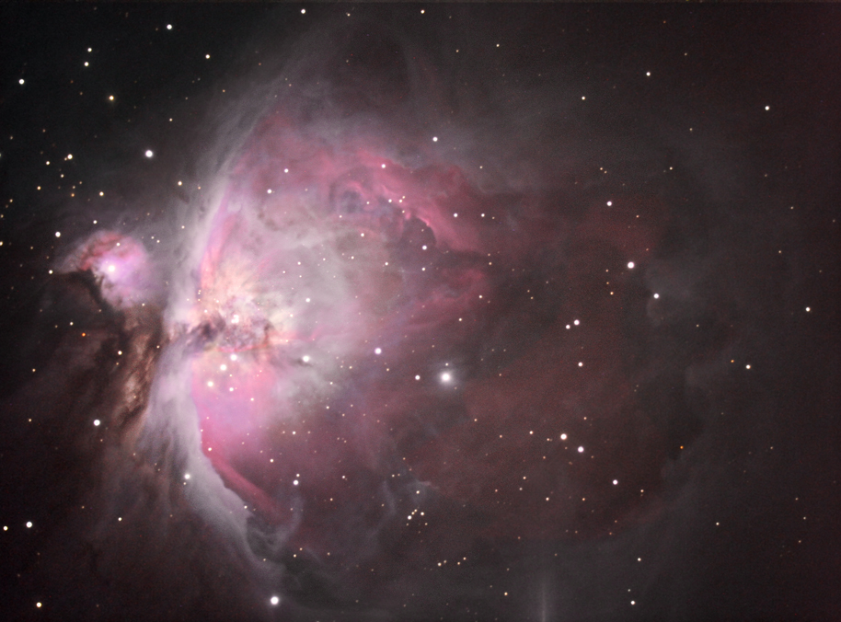
Deep Space
Galaxies
Gas Clouds
Star Nurseries
Light is emitted from within the cloud by new stars
Nebulae
  Emission
Norfolk Botanical Garden / Back Bay Amateur Astronomers

Slide 33
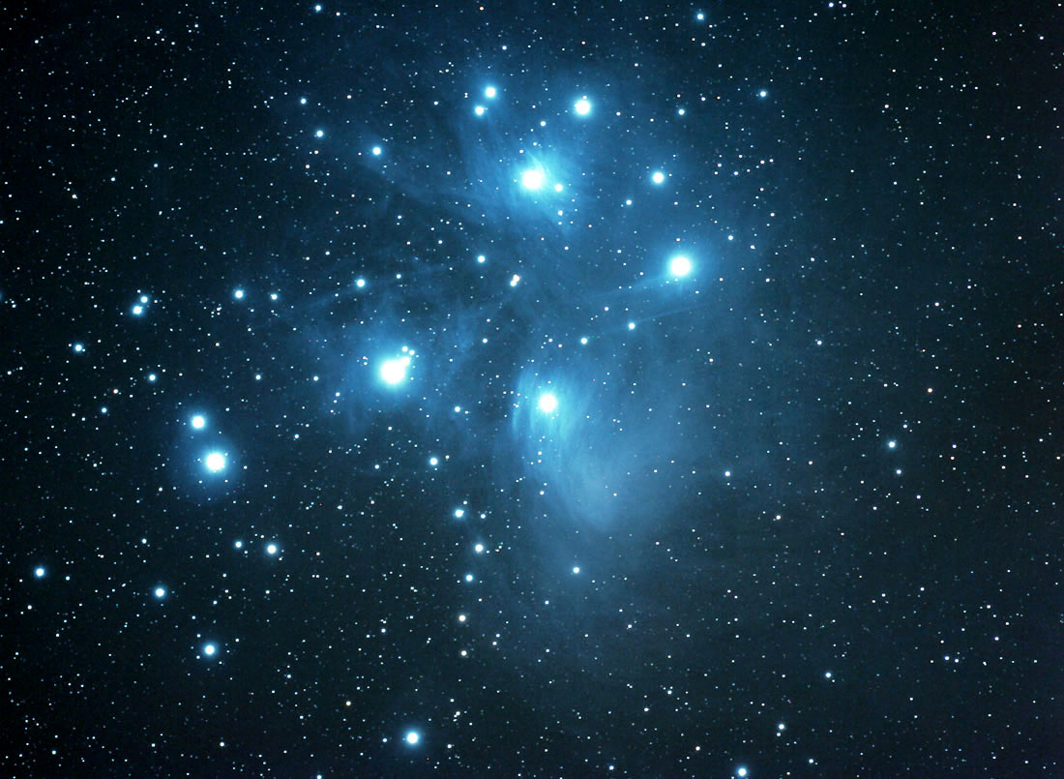
Deep Space
Galaxies
Light reflects from Nearby Stars
Gas is probably left over from previously formed stars or exploded stars
Nebulae
  Emission
  Reflection
Norfolk Botanical Garden / Back Bay Amateur Astronomers

Slide 34
Deep Space
Galaxies
Exploded Stars - Novas (Novae)
Gas forms a ring around the original Star
Not a planet, early astronomers thought the center was a planet
Nebulae
  Emission
  Reflection
  Planetary
Norfolk Botanical Garden / Back Bay Amateur Astronomers

Slide 35
Current Events in Astronomy
TONIGHT . . .
PLANETS – Most of them now are up in the DAYTIME!
Mars, Jupiter, Mercury, Venus, & Pluto*
Moon – In Capricornus low in the SSW, a Waxing Crescent rising 11:19 a.m., setting 9:09 p.m.
Saturn – Rises around midnight, low in the ENE
Uranus & Neptune – Very dim and far away; in Aquarius and Capricornus, respectively
Open Cluster M45 “The Pleiades” - In Taurus the Bull
Double Cluster in Perseus – Almost straight up
M15 Globular Cluster – In Pegasus overhead
M31 Andromeda Galaxy – Between Pegasus & Cassiopeia
Double star Albireo – In Cygnus the Swan
“Double Double” – In Lyra
Comet C/2006 M4 (SWAN) – Low in the West in the constellation Aquila the Eagle, very faint
Notes:
These are a few of the celestial objects it is possible to see in tonight’s sky. We probably won’t see them all, depending on their position in the sky and our location with regard to obstacles such as trees, buildings, and perhaps some cloud cover.

Slide 36
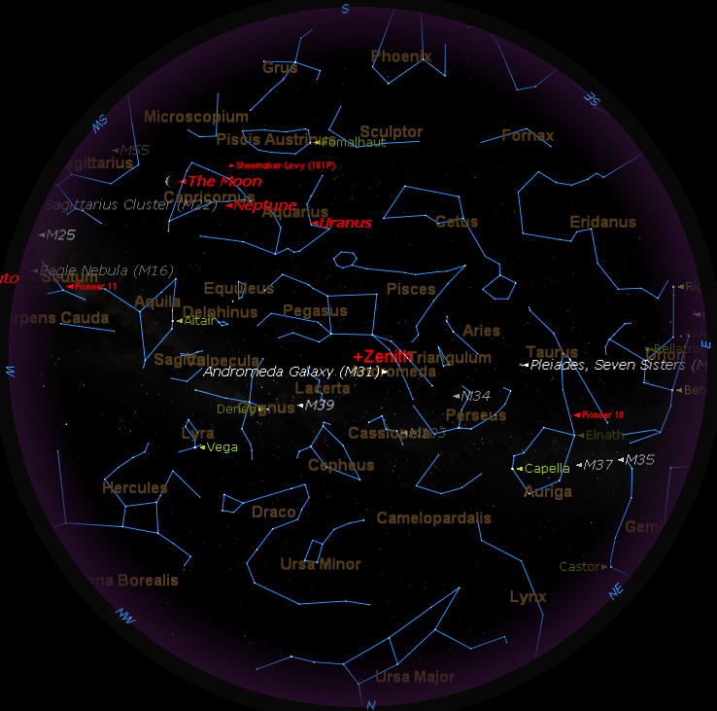
TONIGHT’S SKY
7:30 p.m.
Notes:
If we had low horizons all around, like out on the ocean, here is what you could see tonight. This sky chart shows the major constellations, groupings of stars that men have named over the centuries, to help us be more familiar with our starry tapestry above.
If conditions outside permit, we will point out some of these constellations to you.

Slide 37
Questions
Questions
?
http://www.BackBayAstro.org

Slide 38
Safety First!
We will go outside in just a moment.
Please remember, Safety First!
Please do not run or horseplay around the water fountains and telescopes.
Please remember, Safety First!
Please do not run or horseplay around the water fountains and telescopes.

Slide 39
And now, we urge you . . .

Slide 40
Now, please Join us outside for a “tour” of the night sky followed by a look through the telescopes.
Boldly GO!

Slide 41
Please remain seated for a few minutes with the lights out and let your eyes begin to adapt to the darkness.
Now, please Join us outside for a “tour” of the night sky followed by a look through the telescopes.
Boldly GO!

