Slide 2


GardenStars – March 18, 2006
Welcome to GardenStars
An Evening Under the Stars
Presented by
The Norfolk Botanical Garden
And
Back Bay Amateur Astronomers

Slide 3
Tonight’s Agenda
Introduction
Astronomy Overview
Types of Telescopes
Our Solar System
Deep Space
  Galaxies
  Nebulae
Current Space Events
Questions
Viewing Outside

Slide 4
Introductions
Back Bay Amateur Astronomers
  Kevin and Barb Weiner
  Matt McLaughlin
  Bruce Bodner

Slide 5

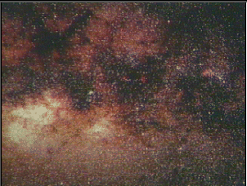
Astronomy Overview
Definition
Amateur
Astronomy
Ordinary People with a love of the heavens
Viewing Planets and Deep Space Objects
Taking images of Astronomical objects
Contributing to Science thru discovery and study
Sharing their experiences with others
Norfolk Botanical Garden / Back Bay Amateur Astronomers

Slide 6
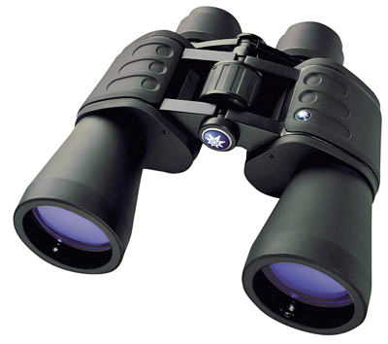
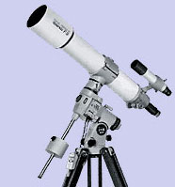
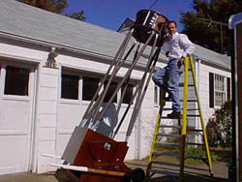
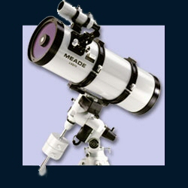
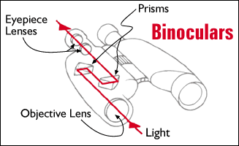
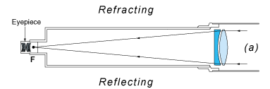
Telescopes – Types
Eyes, Binoculars, Refractors, Reflectors, Catadioptric
Norfolk Botanical Garden / Back Bay Amateur Astronomers

Slide 7
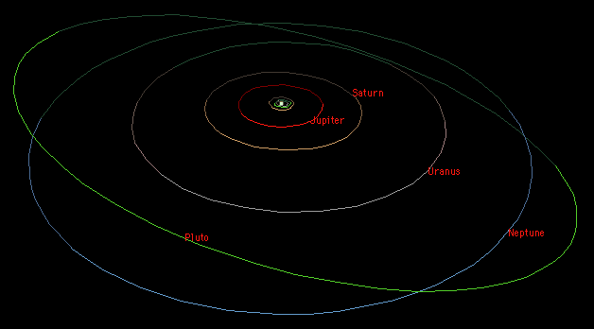
Our Solar System
Overview
The Sun
10 Planets
Comets
Asteroids
Norfolk Botanical Garden / Back Bay Amateur Astronomers

Slide 8
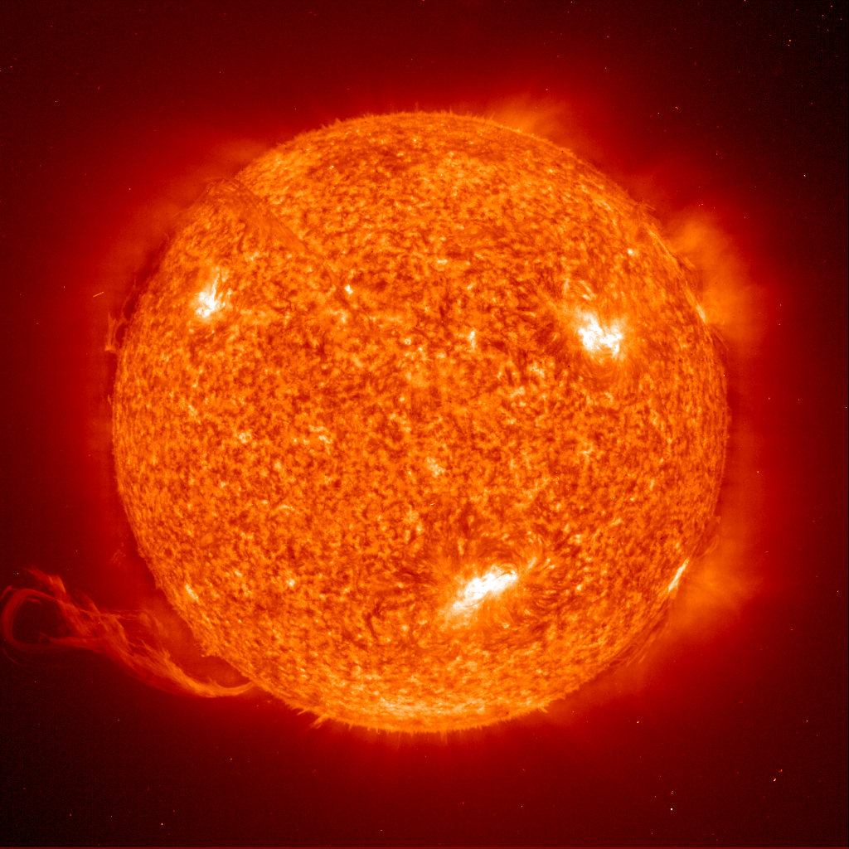
Our Solar System
Overview
1,390,000 Km diameter
Apx 70% Hydrogen
Medium Size Star
The Sun (Our
Local Star)
Norfolk Botanical Garden / Back Bay Amateur Astronomers

Slide 9
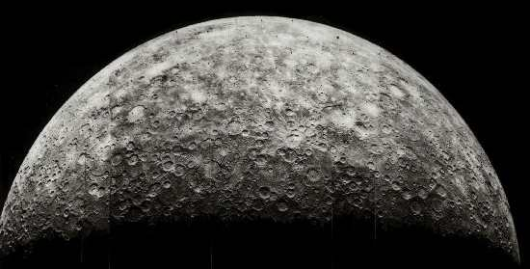
Our Solar System
Overview
4,480 Km diameter
Average Temperature 167 C
Almost no Atmosphere
The Sun (Our
Local Star)
Mercury
Norfolk Botanical Garden / Back Bay Amateur Astronomers

Slide 10
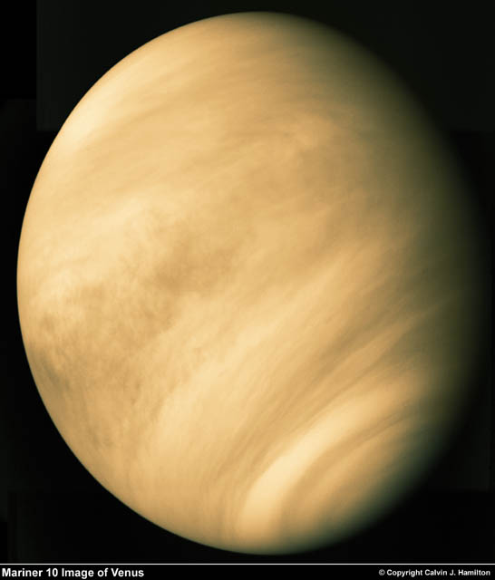
Our Solar System
Overview
12,103 Km diameter
Our nearest neighbor
Sulphuric Atmosphere
The Sun (Our
Local Star)
Mercury
Venus
Norfolk Botanical Garden / Back Bay Amateur Astronomers

Slide 11
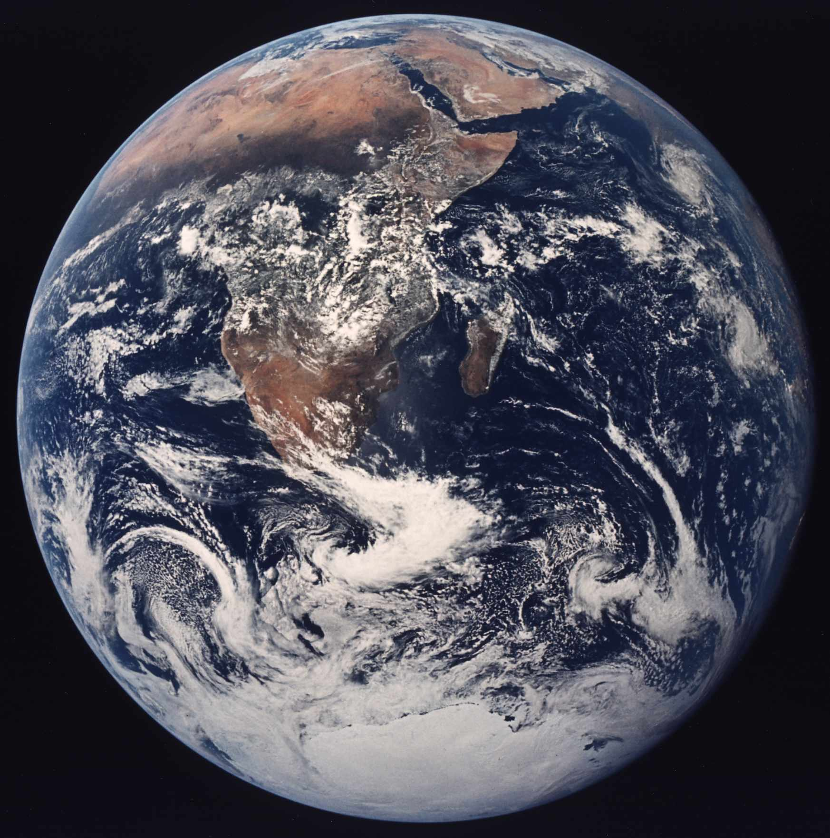
Our Solar System
Overview
12,756 Km diameter
Our Home
Only Planet with life that we know of
The Sun (Our
Local Star)
Mercury
Venus
Earth
Norfolk Botanical Garden / Back Bay Amateur Astronomers

Slide 12
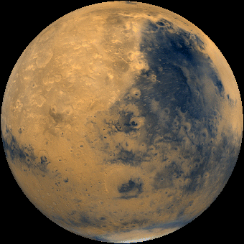
Our Solar System
Overview
6,794 Km diameter
-133C – 80C Temperature
Possible water (frozen or beneath the surface)
The Sun (Our
Local Star)
Mercury
Venus
Earth
Mars
Norfolk Botanical Garden / Back Bay Amateur Astronomers

Slide 13
Our Solar System
Overview
142,984 Km diameter
Gas Giant
63 + Moons
Great Red Spot
The Sun (Our
Local Star)
Mercury
Venus
Earth
Mars
Jupiter
Norfolk Botanical Garden / Back Bay Amateur Astronomers

Slide 14
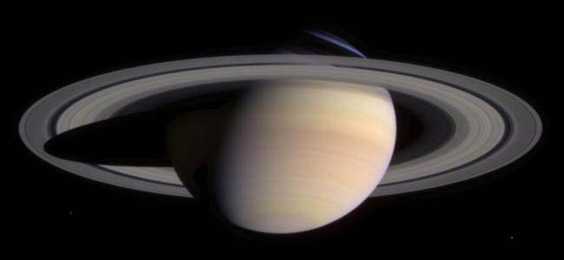
Our Solar System
Overview
120,536 Km diameter
Gas Planet
Only planet with rings that can be easily seen from earth
The Sun (Our
Local Star)
Mercury
Venus
Earth
Mars
Jupiter
Saturn
Norfolk Botanical Garden / Back Bay Amateur Astronomers

Slide 15
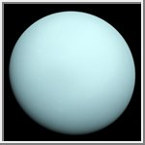
Our Solar System
Overview
51,118 Km diameter
Gas Planet
Axis is sideways
The Sun (Our
Local Star)
Mercury
Venus
Earth
Mars
Jupiter
Saturn
Uranus
Norfolk Botanical Garden / Back Bay Amateur Astronomers

Slide 16
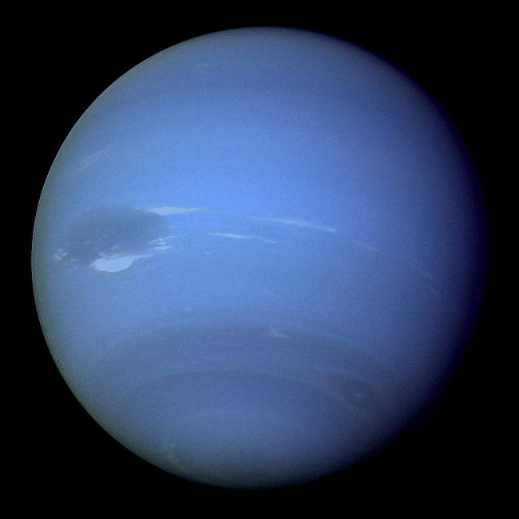
Our Solar System
Overview
49,532 Km diameter
Gas Planet – Possible Core
Also has a “Blue Spot”
The Sun (Our
Local Star)
Mercury
Venus
Earth
Mars
Jupiter
Saturn
Uranus
Neptune
Norfolk Botanical Garden / Back Bay Amateur Astronomers

Slide 17
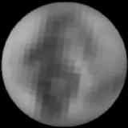
Our Solar System
Overview
2,274 Km diameter
Smallest Planet
Planet to Moon ratio similar to Earth
The Sun (Our
Local Star)
Mercury
Venus
Earth
Mars
Jupiter
Saturn
Uranus
Neptune
Pluto
Norfolk Botanical Garden / Back Bay Amateur Astronomers

Slide 18
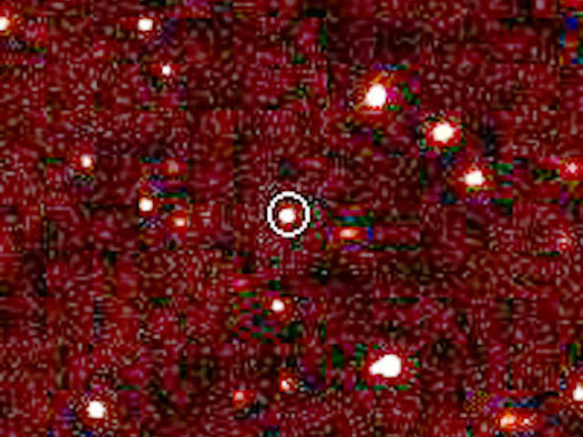
Our Solar System
Overview
Unknown - diameter
Larger than Pluto
nearly 100 times the Earth-Sun distance -- over twice the average Pluto-Sun distance
The Sun (Our
Local Star)
Mercury
Venus
Earth
Mars
Jupiter
Saturn
Uranus
Neptune
Pluto
2003 UB313
Norfolk Botanical Garden / Back Bay Amateur Astronomers

Slide 19
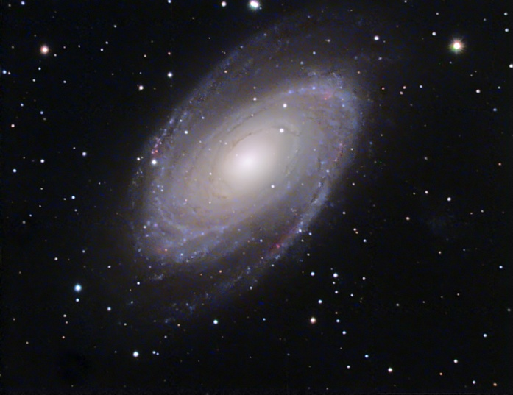
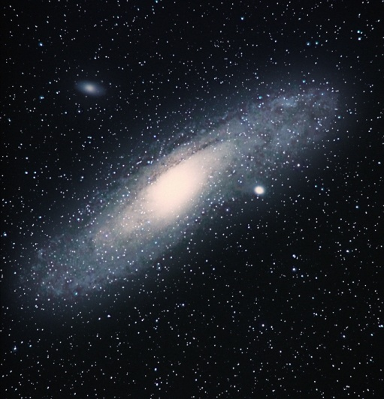
Deep Space
“Island Universes”
Billions of stars and possible Planets
Billions of Galaxies
Milky Way is Our Galaxy
Galaxies
Norfolk Botanical Garden / Back Bay Amateur Astronomers

Slide 20
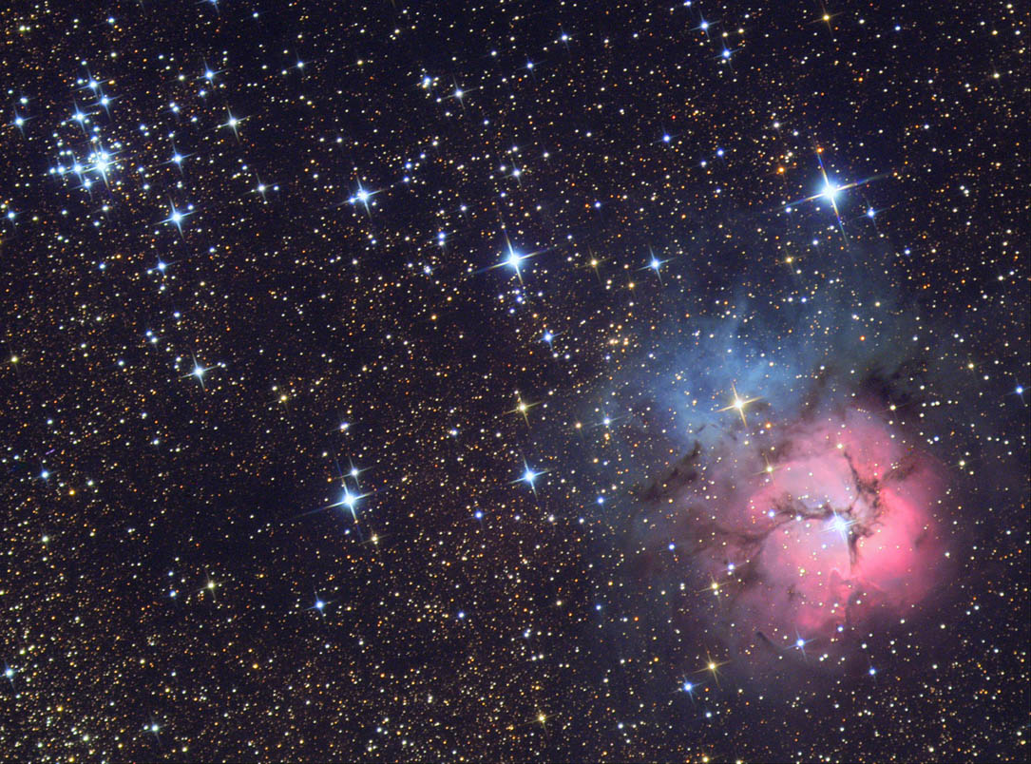
Deep Space
Galaxies
Gas Clouds
Emission, Reflection, Planetary
All we can see are within our Galaxy
Nebulae
Norfolk Botanical Garden / Back Bay Amateur Astronomers

Slide 21
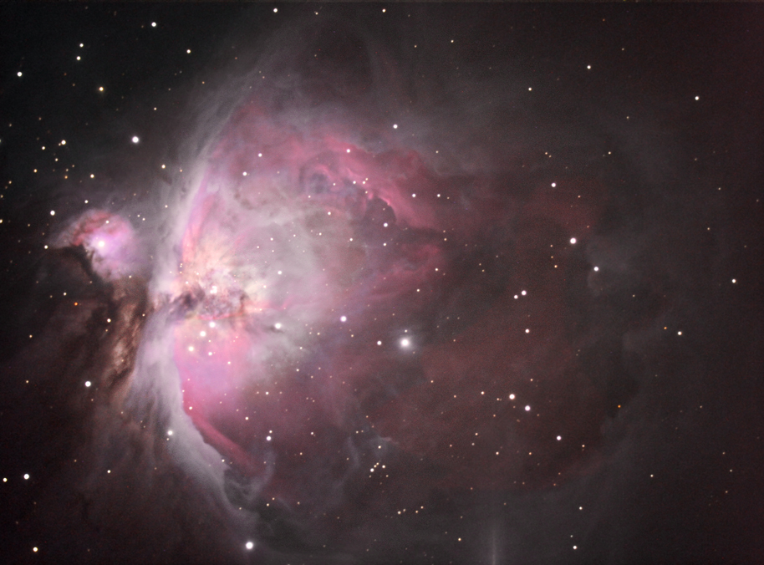
Deep Space
Galaxies
Gas Clouds
Star Nurseries
Light is emitted from within the cloud by new stars
Nebulae
  Emission
Norfolk Botanical Garden / Back Bay Amateur Astronomers

Slide 22
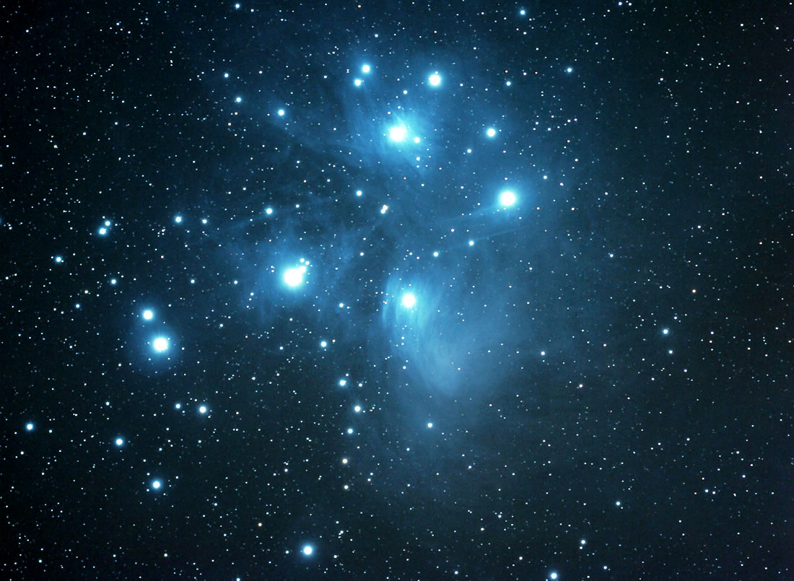
Deep Space
Galaxies
Light reflects from Nearby Stars
Gas is probably left over from previously formed stars or exploded stars
Nebulae
  Emission
  Reflection
Norfolk Botanical Garden / Back Bay Amateur Astronomers

Slide 23
Deep Space
Exploded Stars - Nova’s
Gas forms a ring around the original Star
Not a planet, early astronomers though the center was a planet
Galaxies
Nebulae
  Emission
  Reflection
  Planetary
Norfolk Botanical Garden / Back Bay Amateur Astronomers

Slide 24
Current Events in Astronomy
Saturn - High in the South-East
Mars - High in the West
Moon – Rises at 10:04 P.M. Waning Gibbous
The Great Orion Nebula – In the SW
The Open Cluster “Christmas Tree” – In the SSW
The Pleiades (Seven Sisters) – In the West
IRIDIUM 41

Slide 25
Questions
Questions
Thank You
Please Join us at the scopes
http://www.BackBayAstro.org

