Slide 1
Please take your seat

Slide 2
MOONS
Many
Presented to
Garden Stars at Norfolk Botanical Garden
April 28, 2007

Slide 3
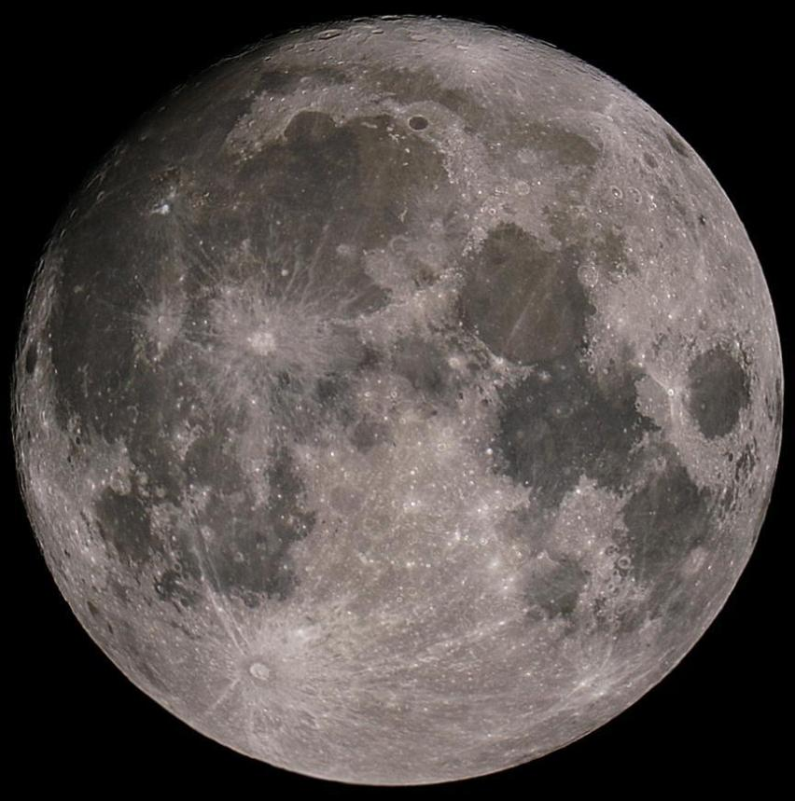
MOONS
Many
Presented to
Garden Stars at Norfolk Botanical Garden
April 28, 2007

Slide 4
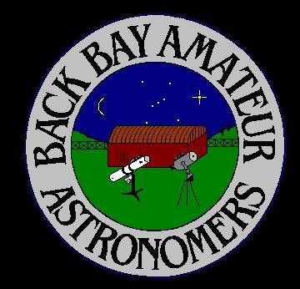
The Back Bay Amateur Astronomers
Bringing Astronomy to the People of Hampton Roads
The Back Bay Amateur Astronomers
PO Box 9877
Virginia Beach, VA 23450

Slide 5
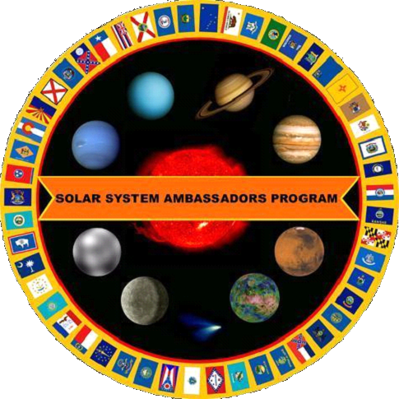
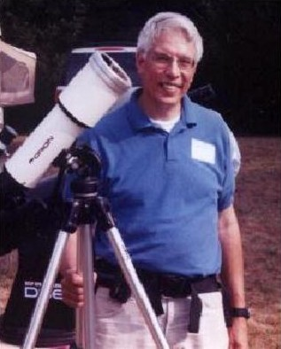

Your “Solar System Ambassador”
George Reynolds

Slide 6
“Solar System Ambassador”
George Reynolds
Assisted by BBAA members…
George Reynolds
Kevin Weiner
Dr. Bruce Bodner
Kevin Swann

Slide 7
A MOON…
What is it?…
Does every planet have one?.
Can we see them?
Let’s find out!
Let’s find out!

Slide 8
Our Solar System
8 “official” Planets
Mercury Jupiter
Venus Saturn
Earth Uranus
Mars Neptune
3 “Dwarf” Planets
Pluto Eris
Ceres

Slide 9
Planets with moons in our
Solar System
Earth
  The Moon (Luna)

Slide 10
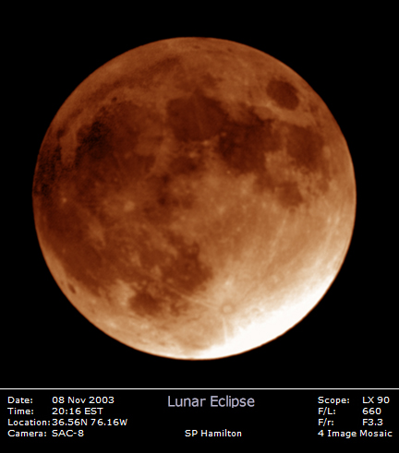
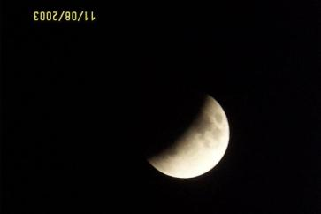
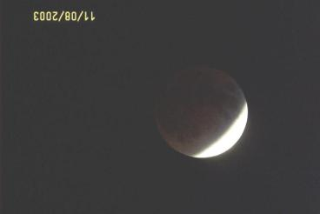
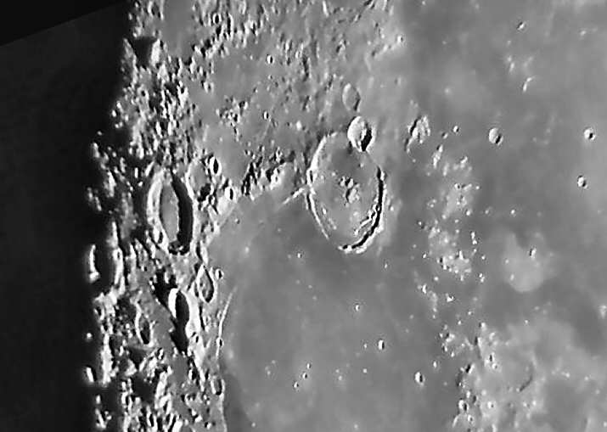
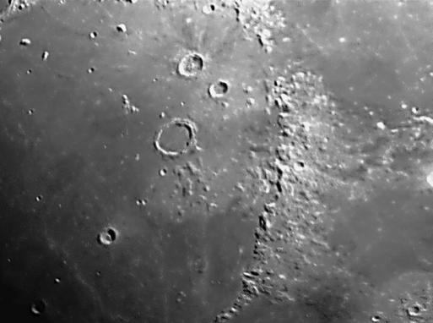
Our Moon, Luna
Phases
Lunar Eclipse
Craters
Mountains

Slide 11

The Moon – The Whole Thing!
Can you see…
The Man in the Moon?
The Woman in the Moon?
The Rabbit in the Moon?
The cow jumping over the Moon?

Slide 12
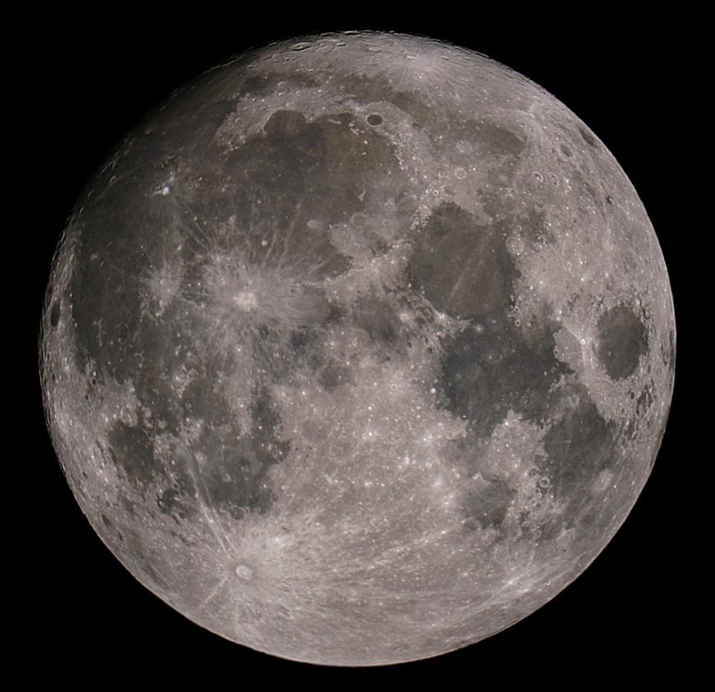
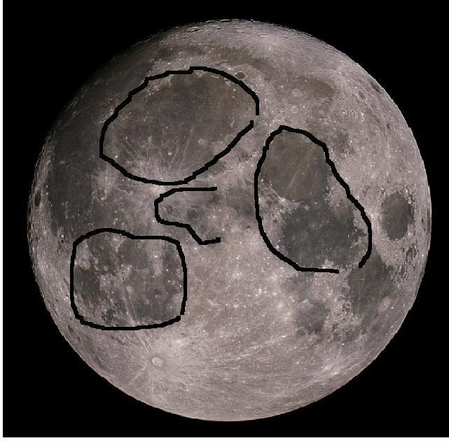
The Man in the Moon

Slide 13
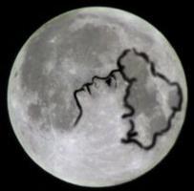
The Woman in the Moon

Slide 14
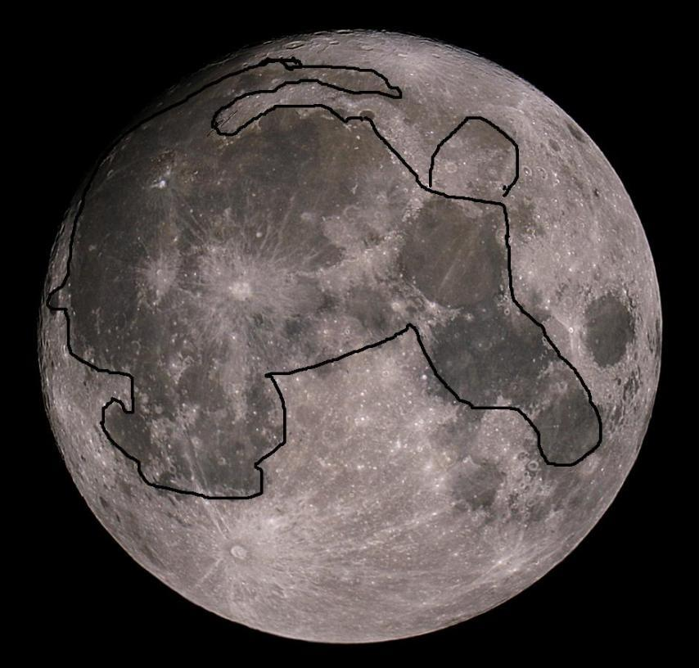
The Rabbit in the Moon

Slide 15
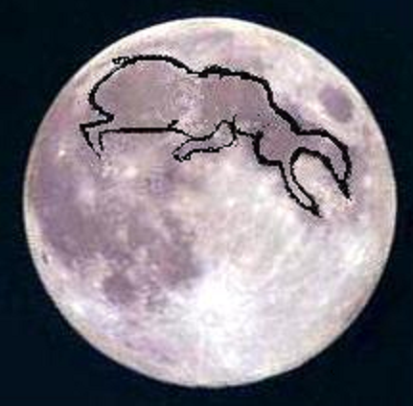
The Cow Jumping Over the Moon

Slide 16
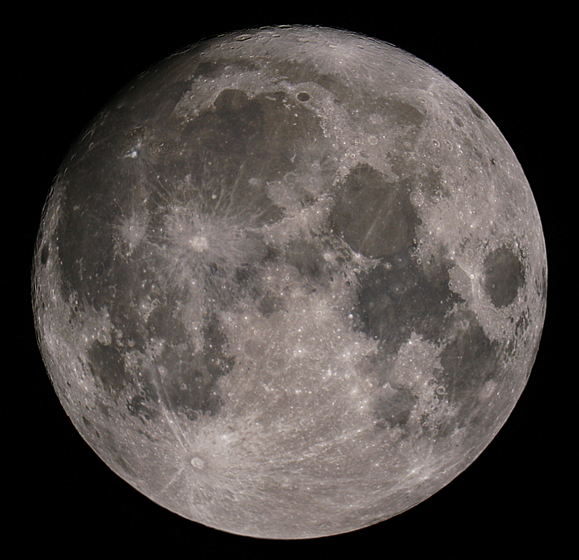
The Moon – The Whole Thing!
The Big Craters with Bright “Rays” are
Copernicus
and
Tycho

Slide 17
The Moon – Dry “Seas”,
Or “Maria”
Oceanus Procellarum
Mare Imbrium
Mare Nubium
Mare Serenitatus
Mare Tranquillitatus
Mare Crisium, “Sea of Crises”

Slide 18
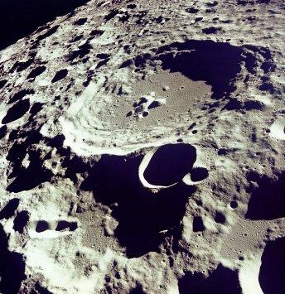
More “Moon Shots”
Craters on the Far Side of the Moon
Gassendi Crater

Slide 19
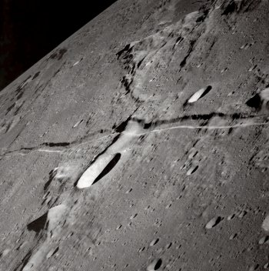
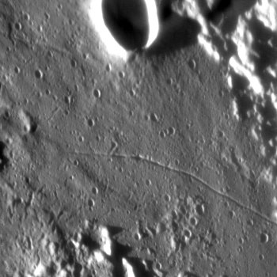
More “Moon Shots”
Craters and Rilles, Peaks and Valleys

Slide 20
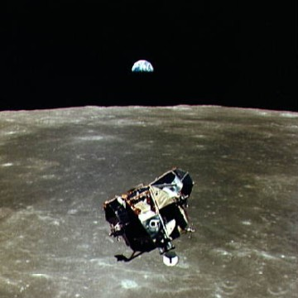
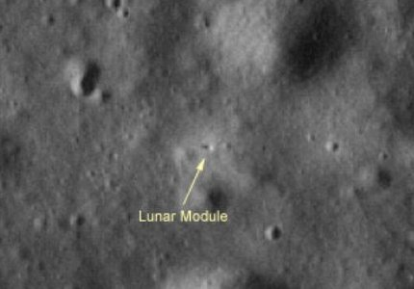
Moon Exploration
Apollo 17 Lunar Module – Telescopic View from Earth
Apollo 11 Lunar Module
View from Command Module

Slide 21
But our Moon, Luna, is just one of many moons in our solar system
There are at least 103 moons orbiting planets (and dwarf planets)
Some have been discovered by earth-bound telescopes
Some have been seen by the Hubble Space Telescope
Many have been discovered by spacecraft, exploring the heavens

Slide 22
Planets with moons in our
Solar System
Mars
  Phobos
  Deimos

Slide 23
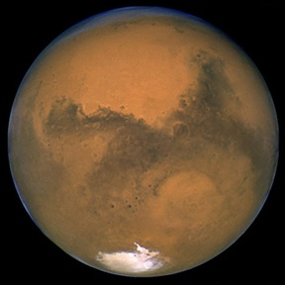
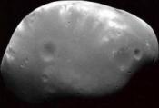
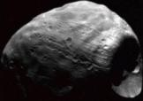
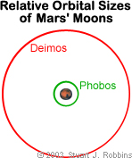
Mars has two moons . . .
Astronomers think these moons were small asteroids captured by Mars’s gravity.
Deimos and Phobos
(not to scale)

Slide 24
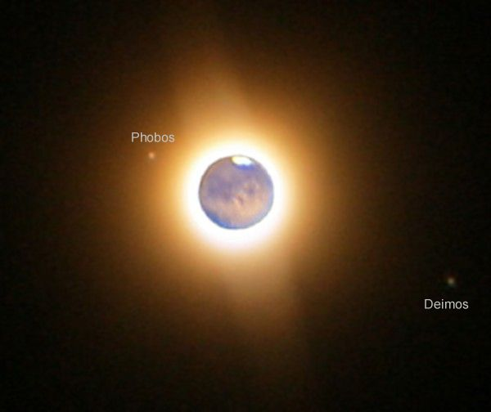
Mars’s Moons
Astronomy Picture of the Day (APOD) 2003 October 24
Mars has two moons,
Deimos (Panic)
and
Phobos (Fear)

Slide 25
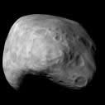
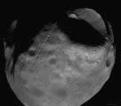
Mars’s Moons
Close up and personal
Deimos (Panic)
and
Phobos (Fear)

Slide 26
Planets with moons in our
Solar System
Jupiter
  Metis
  Adrastea
  Amalthea
  Thebe
  Io
  Europa
  Ganymede
  Callisto
  Leda
  Himalia
  Lysithea
  Elara
  Ananke, Carme, Pasiphae and Sinope
  Recently discovered (numbered) moons

Slide 27
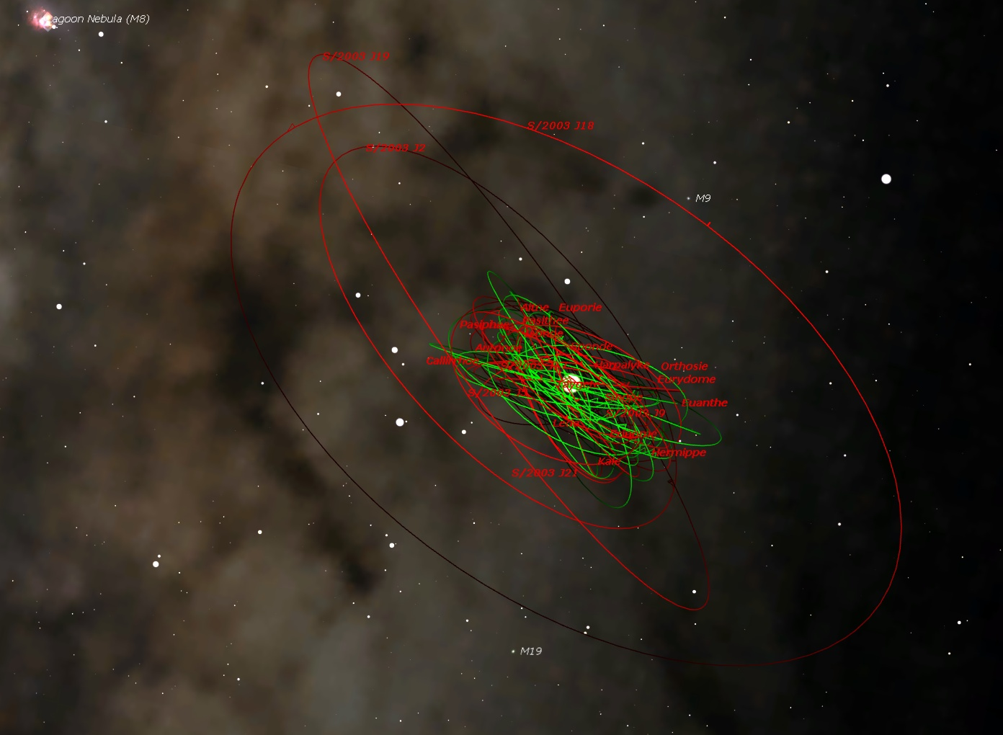

Slide 28
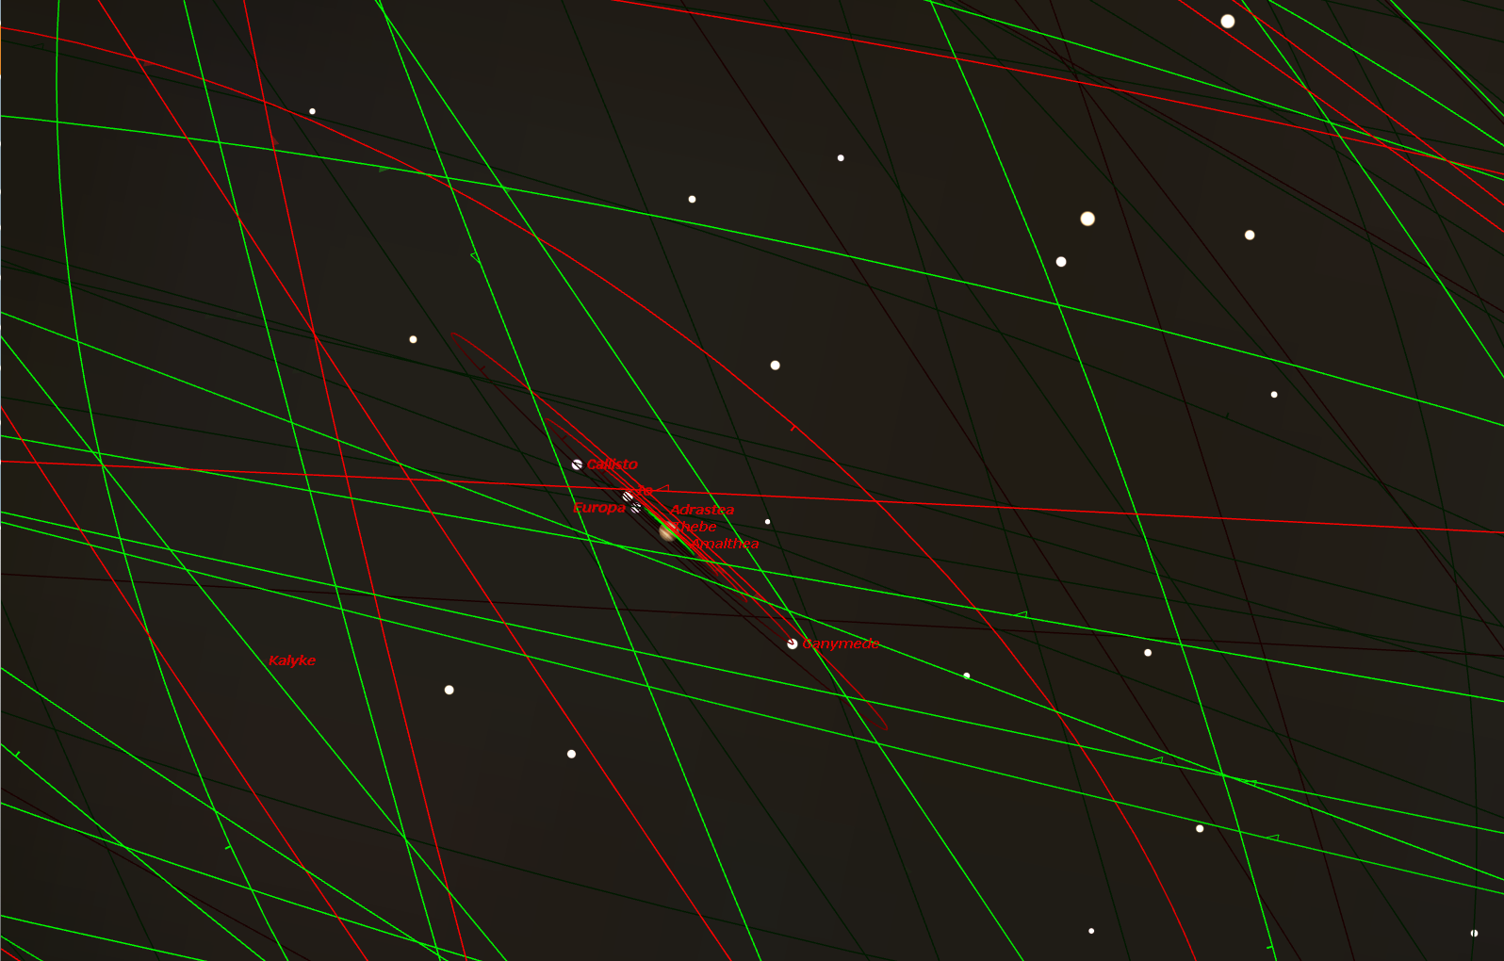

Slide 29
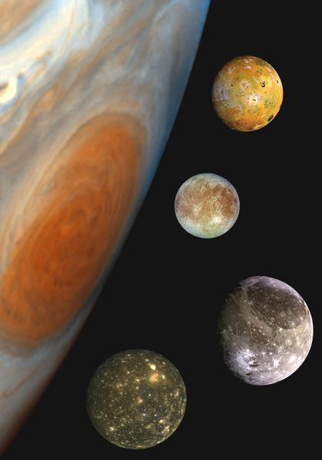
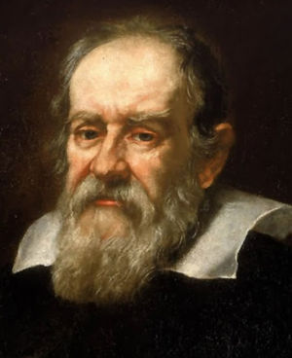
Galileo Galilei discovered the first four of them in 1610
Io
Europa
Ganymede
Callisto

Slide 30
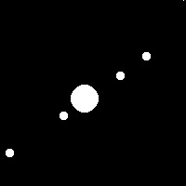
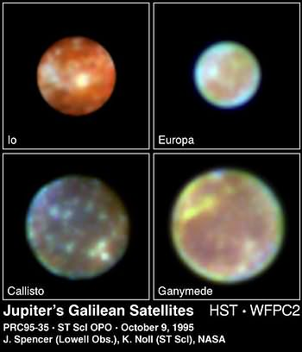
Jupiter’s 4 Largest (Galilean) Moons
Galileo discovered 4 moons of Jupiter in 1610 with a primitive telescope
Hubble
Space Telescope
View
Telescope View from Earth

Slide 31
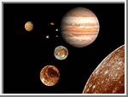
Jupiter’s Moons
There are 59 other moons that have been discovered around Jupiter. All of them are smaller than the Galilean Satellites, and most of them are the size of small asteroids.

Slide 32
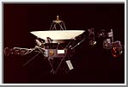
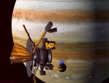


Others were discovered by . . .
Voyager spacecraft
Galileo spacecraft
Other . . . .
  Ground-based telescopes

Slide 33
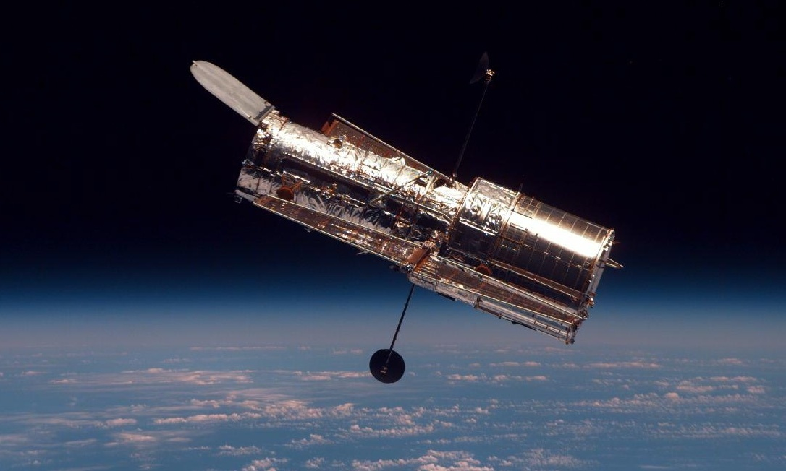
and . . .
The Hubble Space Telescope

Slide 34
Planets with moons in our
Solar System
Saturn
  Pan and Atlas
  Prometheus and Pandora
  Epimetheus
  Janus
  Mimas
  Enceladus
  Tethys, Telesto and Calypso
  Dione and Helene
  Rhea
  Titan
  Hyperion
  Iapetus
  Phoebe
  Recently discovered satellites

Slide 35
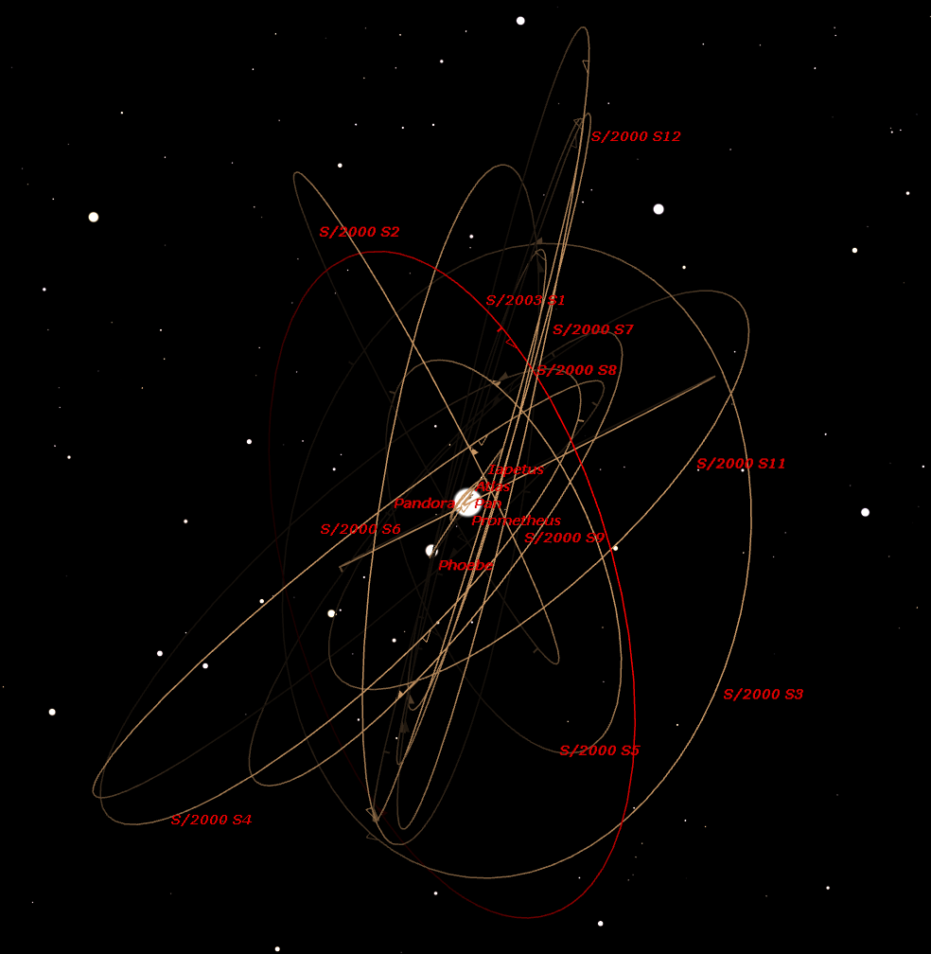

Slide 36
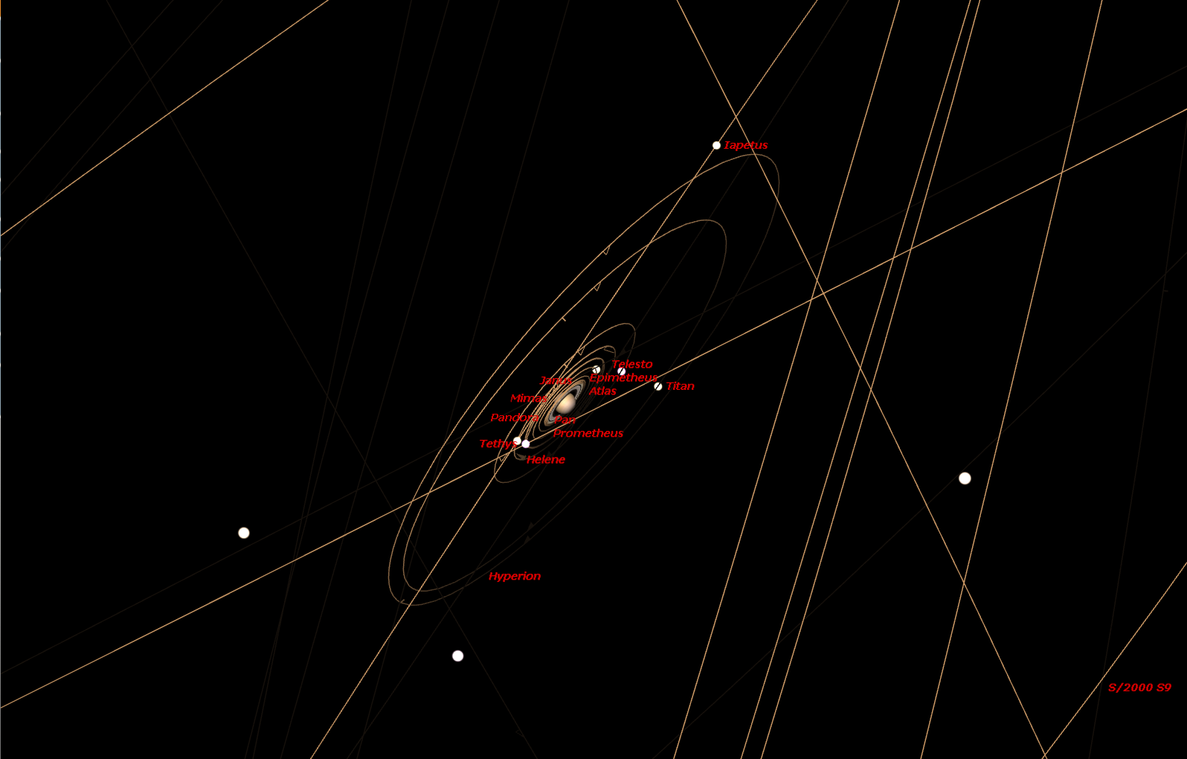

Slide 37
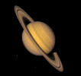
. . . famous for its rings . . .
Saturn has 31 known moons.
Titan is the largest, about the size of our moon . . . but it has an atmosphere . . . of methane gas!
Cassini spacecraft is in orbit now.
Huygens probe landed on its surface
  January, 2006

Slide 38
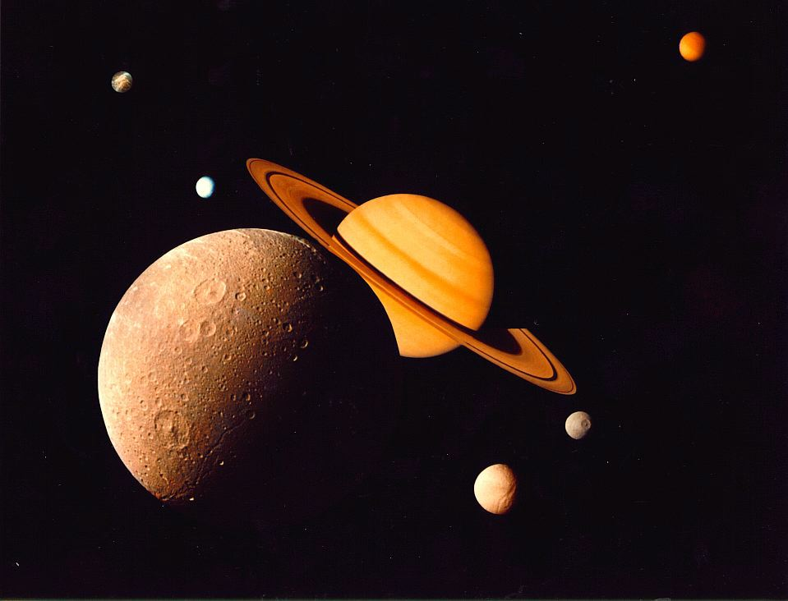
Moons of Saturn
Montage of Saturn’s six largest moons
Dione, Tethys, Mimas, Enceladus, Rhea and Titan

Slide 39
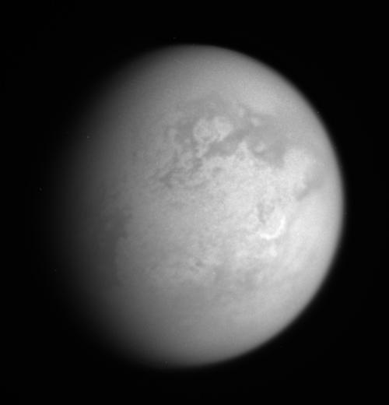
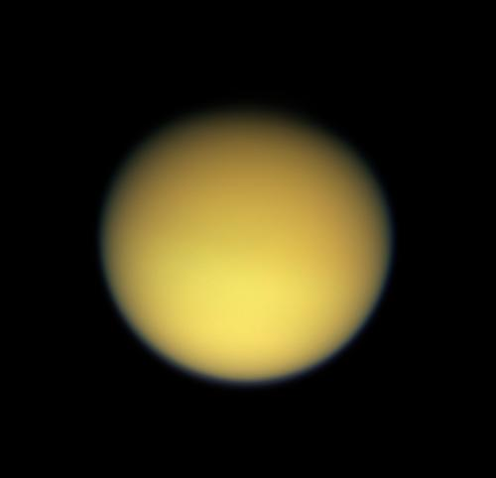
Moons of Saturn
Saturn’s largest moon, Titan – 2 views
One of the few Moons with an atmosphere

Slide 40
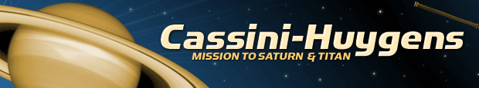
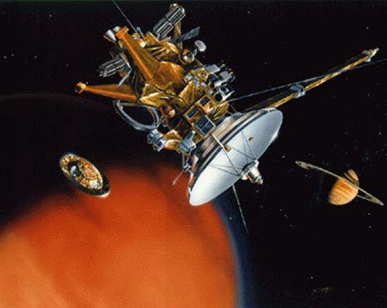
Cassini spacecraft releases Huygens probe to Titan

Slide 41
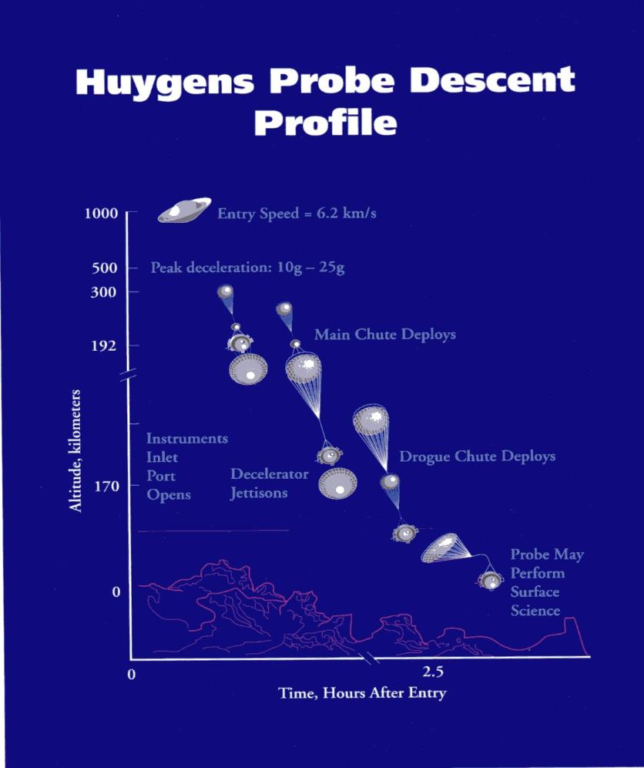
Huygens probe landing trajectory

Slide 42
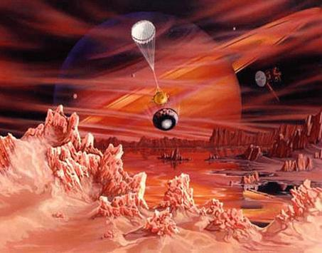
Huygens probe landing on Titan (artist’s conception)

Slide 43
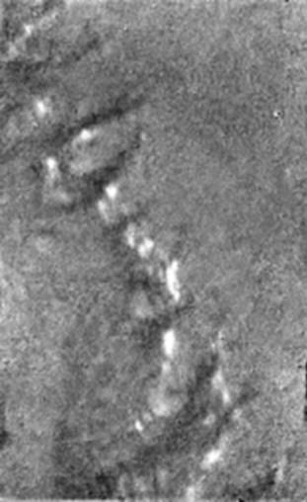

Huygens probe results – actual photos
Titan water ice and methane springs
Titan 'island' surface features

Slide 44
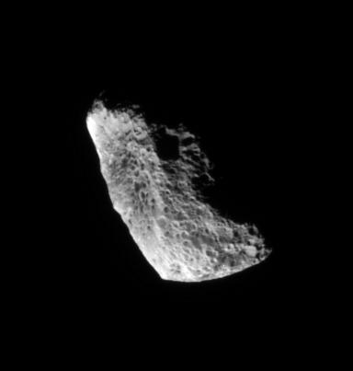

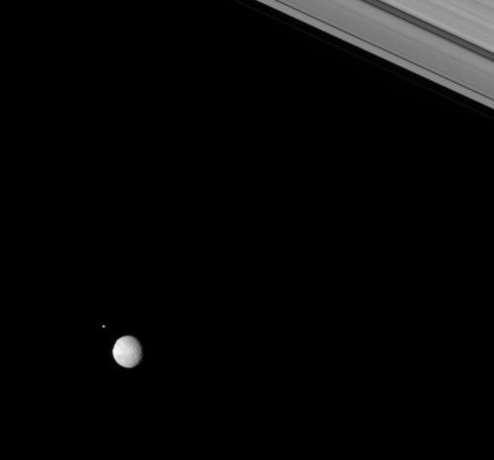

Other Moons of Saturn
Hyperion
Iapetus
Helene & Mimas
Dione

Slide 45
Planets with moons in our
Solar System
Uranus
  Cordelia
  Ophelia
  Bianca
  Cressida
  Desdemona
  Juliet
  Portia
  Rosalind
  Belinda, Puck, Miranda, Ariel, Umbriel, Titania, Oberon , Caliban, Sycorax, Prospero, Setebos, Stephano, and Trinculo, etc.

Slide 46


Slide 47


Slide 48


Uranus, the 7th Planet
Uranus is unique, in that it is tipped on its side. This is thought to be the result of a collision with a planet-sized body early in the solar system's history.
Uranus has 27 known moons.
It also has a ring system that is not visible to ground-based telescopes
Notes:
This is a poor lo-res image. I’ll try to get a better one.

Slide 49



Moons of Uranus
-- The 5 largest moons of Uranus –
From left to right, they are Miranda, Ariel, Umbriel, Titania and Oberon
Image courtesy of: NASA-Voyager mission
Titania, the largest, is about half the size of our own moon.
Close-up view of Titania
Notes:
This is a poor lo-res image. I’ll try to get a better one.

Slide 50
Planets with moons in our
Solar System
Neptune
  Naiad
  Thalassa
  Despina
  Galatea
  Larissa
  Proteus
  Triton
  Nereid
  Nix and Hydra

Slide 51

Moons of Neptune
Neptune has 13 known moons…
composed of rock and ice.
The first four, Naiad, Thalassa, Despina, and Galatea, are so close to Neptune that they orbit within its ring system. Little is known about them.
The next one out, Larissa, was actually discovered in 1981, when it blocked a star. being re-discovered by Voyager 2 in 1989.
Proteus is the second-largest moon in orbit around Neptune. It is so close to the planet that Earth-bound telescopes cannot see it.
Notes:
This is a poor lo-res image. I’ll try to get a better one.

Slide 52

Moons of Neptune
Neptune’s largest moon is Triton.
Triton is one of the strangest moons in the solar system. It is one of only three moons in the solar system that has an atmosphere (Jupiter's Io and Saturn's Titan are the other two). It is thicker than Io's, yet much thinner than Titan's.
It has a retrograde orbit. It orbits the opposite way the planet spins.
Triton is two-thirds the size of our moon.

Slide 53
Planets with moons in our
Solar System
Pluto
  Charon
  Nix
  Hydra

Slide 54


Moons of Pluto
Even though it has been downgraded to the status of a “dwarf planet” . . .
Poor Pluto!
Pluto has three moons!
Pluto’s moon Charon was discovered on July 7, 1978 by James W. Christy of the U.S. Naval Observatory
In October of 2005, two more moons were discovered in orbit around Pluto.

Slide 55

Moons of Pluto
They were intially called “candidate” moons . . .
After being verified by the Hubble Space Telescope, They were given the names “Nix” and “Hydra”.

Slide 56
There are at least 103 moons orbiting planets (and dwarf planets)
Some have been discovered by earth-bound telescopes
Some have been seen by the Hubble Space Telescope
Many have been discovered by spacecraft, exploring the heavens

Slide 57

Space Exploration . . .
The Final Frontier

Slide 58
Current Events in Astronomy
TONIGHT . . .
PLANETS – Most of them now are up in the DAYTIME!
Mars, Jupiter, Mercury, Venus, Uranus, Neptune & Pluto
Moon – In Leo in the East, a Waxing Gibbous setting 6:15 a.m. tomorrow.
Saturn – in the East setting at 4:47 a.m. tomorrow
Open Cluster M45 “The Pleiades” - In Taurus the Bull
Double Cluster in Perseus
M15 Globular Cluster – In Pegasus
The Beehive cluster - In Cancer
Orion Nebula – In Orion
Notes:
These are a few of the celestial objects it is possible to see in tonight’s sky. We probably won’t see them all, depending on their position in the sky and our location with regard to obstacles such as trees, buildings, and perhaps some cloud cover.

Slide 59

TONIGHT’S SKY
March 31th
at 8:00 P.M.
Notes:
If we had low horizons all around, like out on the ocean, here is what you could see tonight. This sky chart shows the major constellations, groupings of stars that men have named over the centuries, to help us be more familiar with our starry tapestry above.
If conditions outside permit, we will point out some of these constellations to you.

Slide 60
Questions
Questions
?
http://www.BackBayAstro.org

Slide 61
Safety First!
We will go outside in just a moment.
Please remember, Safety First!
Please do not run or horseplay around the water fountains and telescopes.
Please remember, Safety First!
Please do not run or horseplay around the water fountains and telescopes.

Slide 62
And now, we urge you . . .

Slide 63
Now, please Join us outside for a “tour” of the night sky followed by a look through the telescopes.
Boldly GO!

Slide 64

Go out and look
. . . for some Moons!
Garden Stars, March 31, 2007

