Slide 1
Please take your seat

Slide 2
MOON!
.Shoot for the . . .
Presented to
Greenbrier Middle School Lunar Festival
May 5, 2006

Slide 3
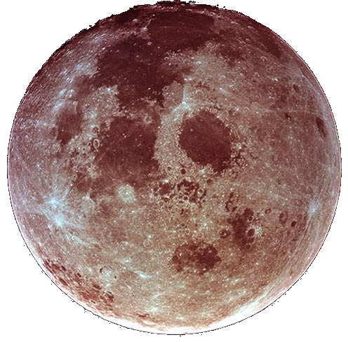
MOON!
.Shoot for the . . .
Presented to
Greenbrier Middle School Lunar Festival
May 5, 2006

Slide 4

The Back Bay Amateur Astronomers
Bringing Astronomy to the People of Hampton Roads
The Back Bay Amateur Astronomers
PO Box 9877
Virginia Beach, VA 23450

Slide 5

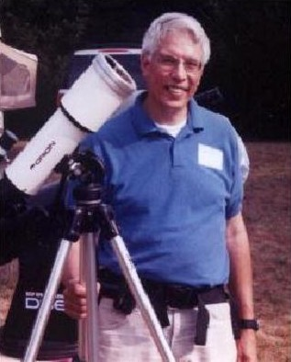

Your “Solar System Ambassador”
George Reynolds

Slide 6
“Solar System Ambassador”
George Reynolds
Assisted by BBAA members…
Matt McLaughlin
Ted Forte
Kevin Weiner
Jeanette Hamilton
and others

Slide 7
The MOON…
Luna…
So near, and yet so far.
So common, yet so
extraordinary!
extraordinary!

Slide 8
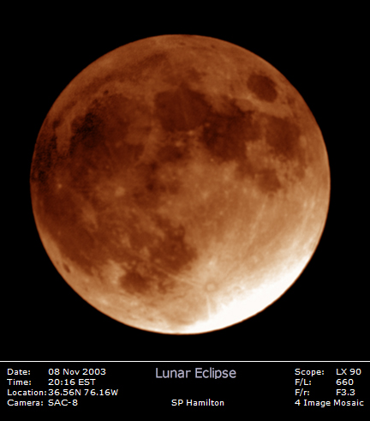
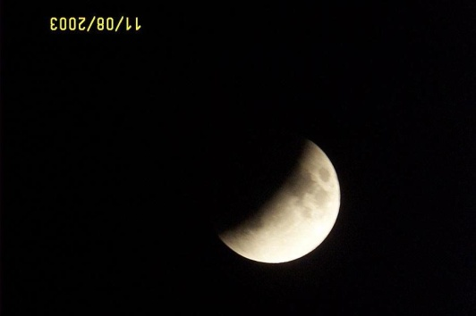
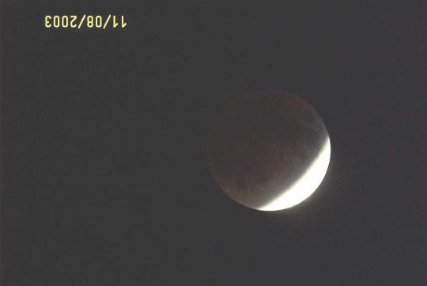
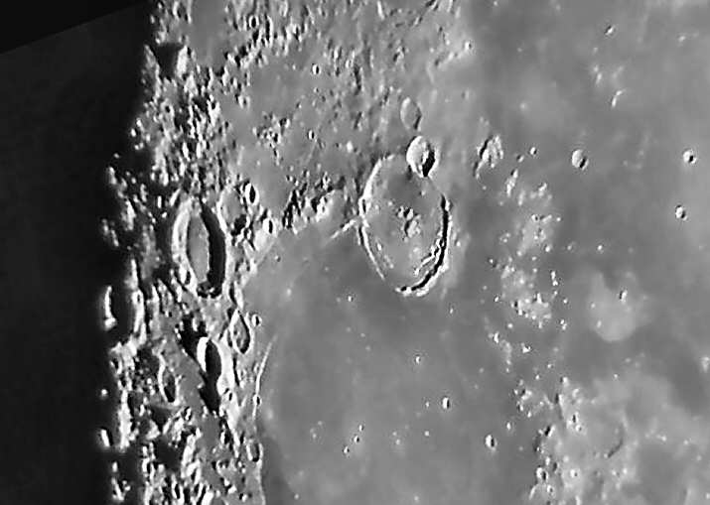
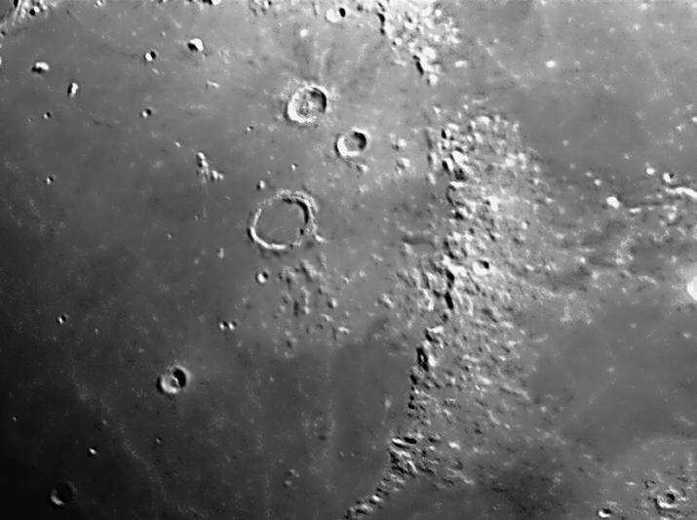
The Moon
Phases
Lunar Eclipse
Craters
Mountains

Slide 9
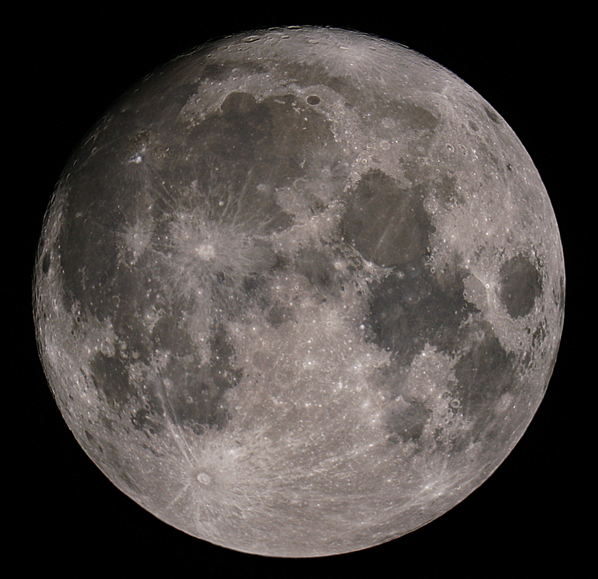
The Moon – The Whole Thing!
Can you see…
The Man in the Moon?
The Woman in the Moon?
The Rabbit in the Moon?
The cow jumping over the Moon?

Slide 10
The Man in the Moon

Slide 11
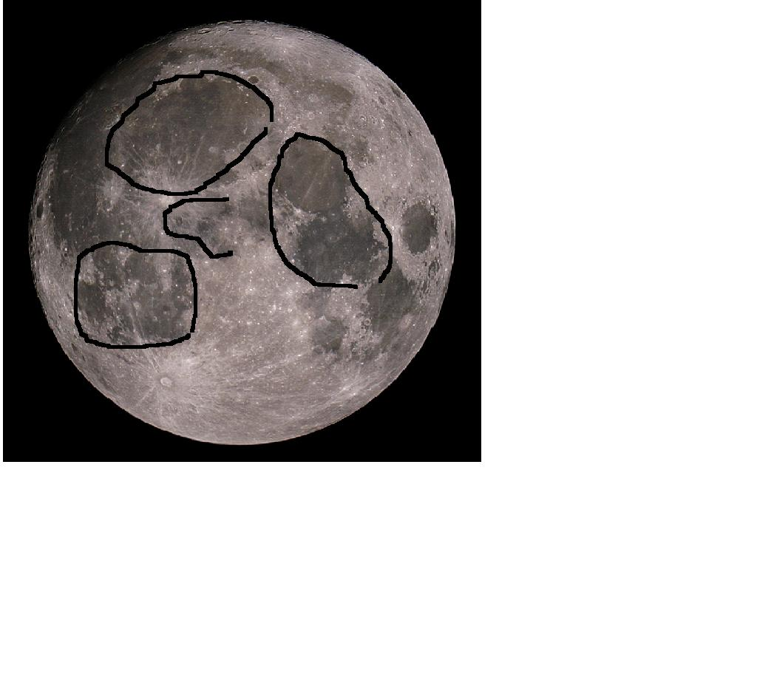
The Man in the Moon

Slide 12
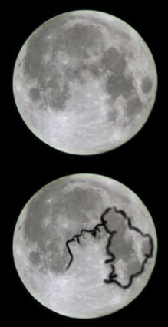
The Woman in the Moon

Slide 13
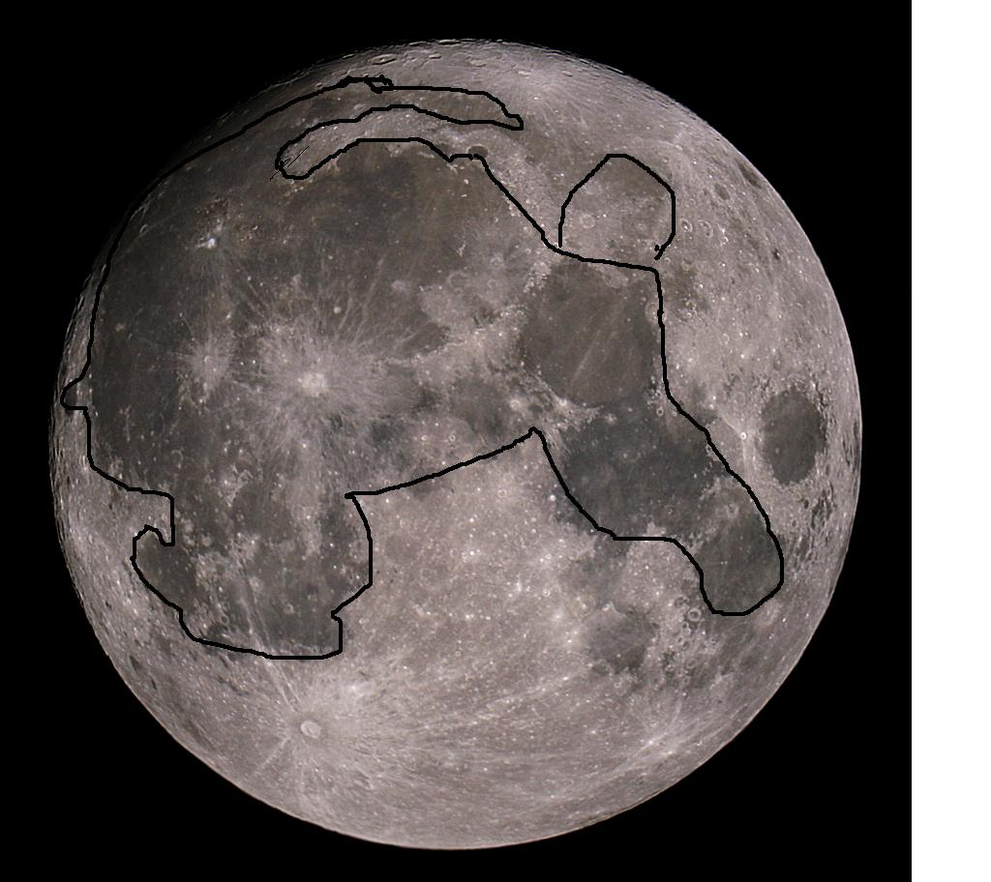
The Rabbit in the Moon

Slide 14
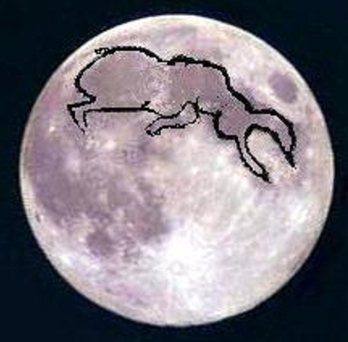
The Cow Jumping Over the Moon

Slide 15
The Moon – The Whole Thing!
The Big Craters with Bright “Rays” are
Copernicus
And
Tycho

Slide 16
The Moon – Dry “Seas”,
Or “Maria”
Oceanus Procellarum
Mare Imbrium
Mare Nubium
Mare Serenitatus
Mare Tranquillitatus
Mare Crisium, “Sea of Crises”

Slide 17
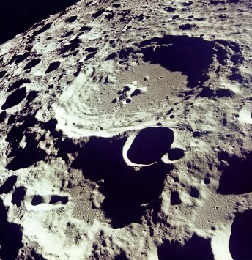
More “Moon Shots”
Craters on the Far Side of the Moon
Gssendi Crater

Slide 18
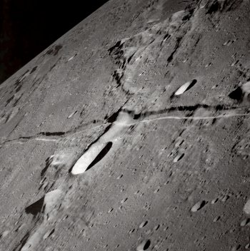
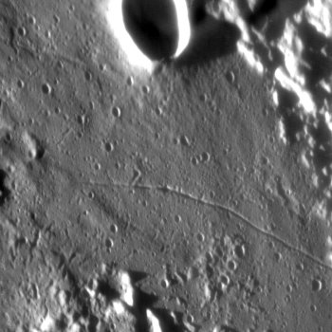
More “Moon Shots”
Craters and Rilles, Peaks and Valleys

Slide 19
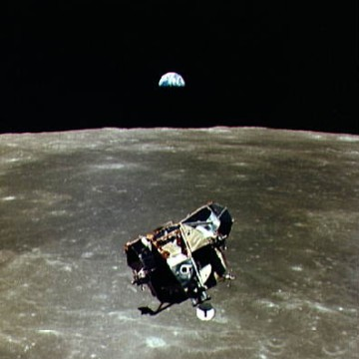
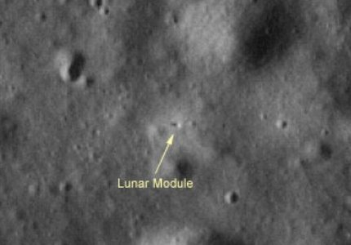
Moon Exploration
Apollo 17 Lunar Module – Telescopic View from Earth
Apollo 11 Lunar Module
View from Command Module

Slide 20
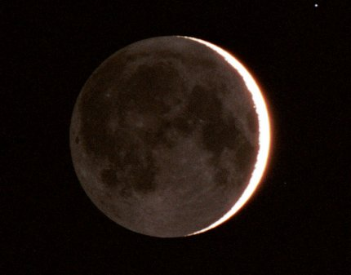
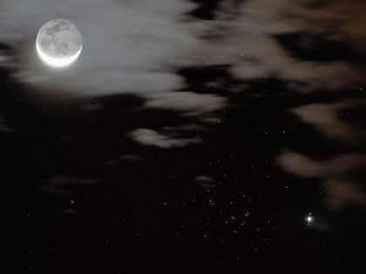
Crescent Moons
“The Old Moon in the New Moon’s Arms”
(Waning Crescent)
Earthshine
(Waxing Crescent)

Slide 21
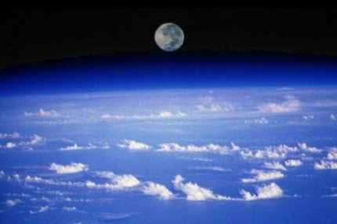
View of the Moon… from the Space Shuttle

Slide 22
Greenbrier Middle School Lunar Festival 2006
Besides the Moon, what can I expect to see?
Planets are bright enough to be seen in the city (must know when and where to look for them).
To see more, you need to get out away from the city lights, away from the skyglow.

Slide 23
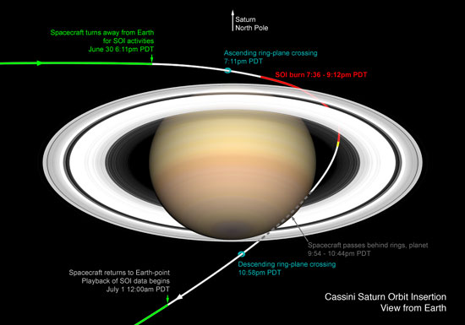
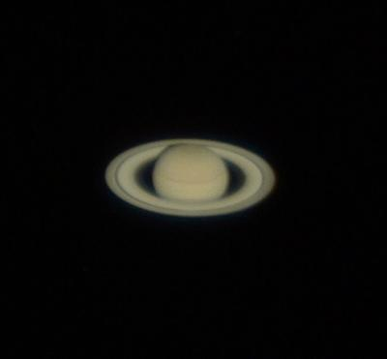
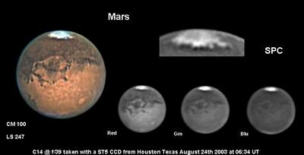
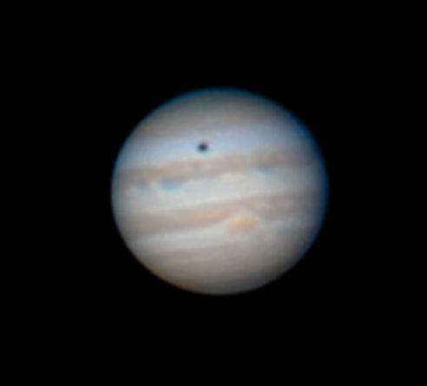
Planets and their Rise and Viewing Times
May 5, 2006
Rose 9:44 AM
View 8-11 PM
Rose 9:47 AM
View 8-10 PM
Saturn
Mars
Rises 7:57 PM
View all night
Jupiter
All these photos were taken through amateur astronomers’ telescopes.
Notes:
PLANETS: SATURN rises at 9:44 AM, will be high in the sky between 8 and 11 PM, and will set at 2:00 AM.
MARS rises at 9:47 AM, will be high in the sky between 8 and 10 PM, and will set at 12:34 AM.
JUPITER rises at 7:57 PM, and will be visible all night, setting at 6:29 AM.

Slide 24
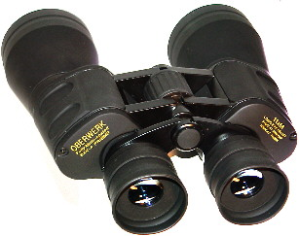
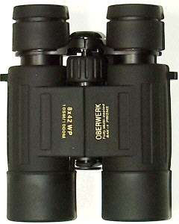
Binoculars
A great way to see the stars . . .
And learn the constellations
“A cheap pair of binoculars is better than a cheap telescope any day!”

Slide 25
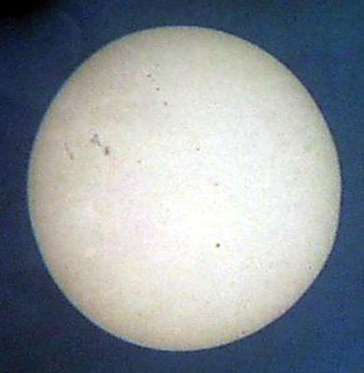
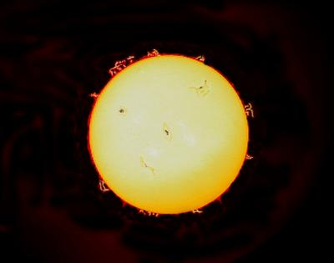
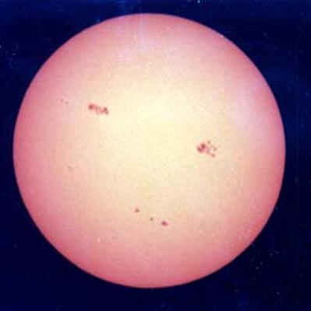
The Sun
CAUTION! NEVER look at the Sun directly without a proper filter!
Sunspots
Solar Flares
More Sunspots

Slide 26
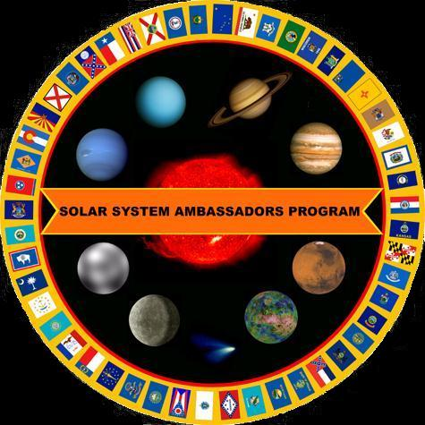
Your “Solar System Ambassador”
George Reynolds
Thank You!

Slide 27
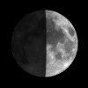
Go out and look
for the Moon!
Greenbrier Middle School Lunar Festival 2006

Slide 28
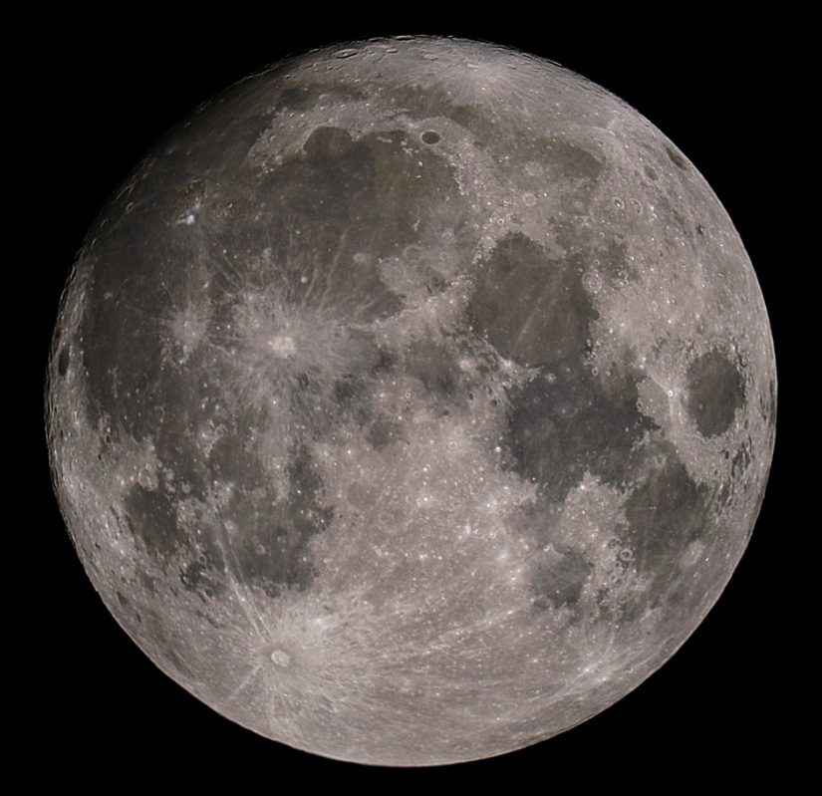
Go out and look
for the Moon!
Greenbrier Middle School Lunar Festival 2006

