Slide 1
Please take your seat

Slide 2
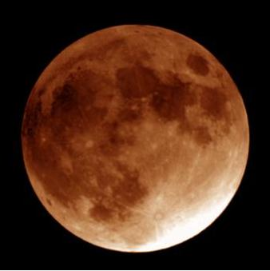

SPACE
!
. . . Lost In
Presented to
Greenbrier Middle School Lunar Festival
November 18, 2004

Slide 3


The Back Bay Amateur Astronomers
Bringing Astronomy to the People of Hampton Roads
The Back Bay Amateur Astronomers
PO Box 9877
Virginia Beach, VA 23450

Slide 4

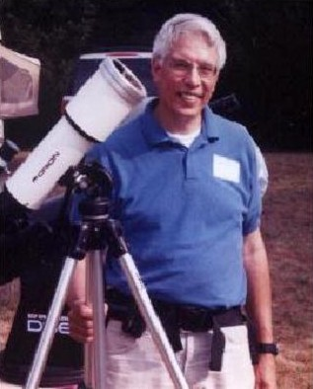
Your “Solar System Ambassador”
George Reynolds

Slide 5
“Solar System Ambassador”
George Reynolds
Assisted by BBAA members…
Georgie June
Ted Forte
Kevin Weiner
Jeanette Hamilton
and others

Slide 6
If you want to see the Moon…
You’d better go outside immediately after this presentation, because it will set early tonight.
Look at these sky charts . . . .

Slide 7
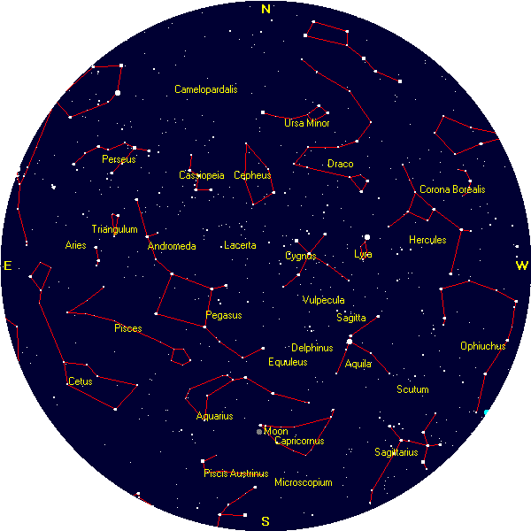
Tonight’s Sky
at 6:00 p.m.
Courtesy, Heavens-Above (www.heavens-above.com)

Slide 8
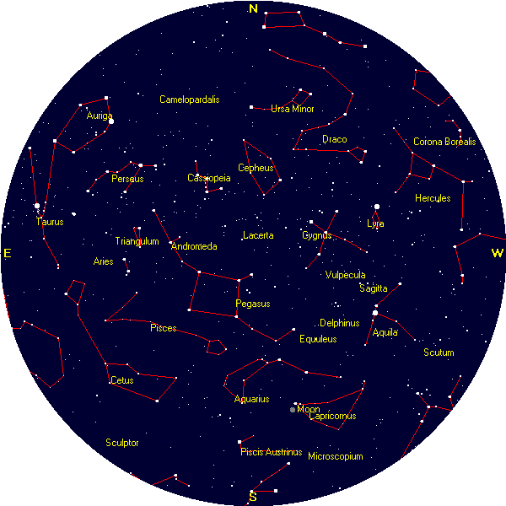
Tonight’s Sky
at 7:00 p.m.
Courtesy, Heavens-Above (www.heavens-above.com)

Slide 9
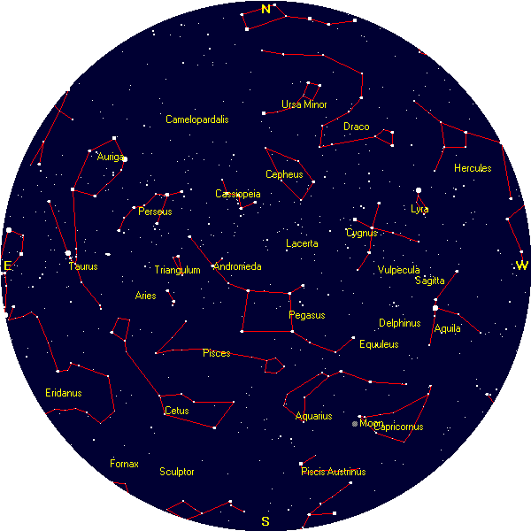
Tonight’s Sky
at 8:00 p.m.
Courtesy, Heavens-Above (www.heavens-above.com)

Slide 10
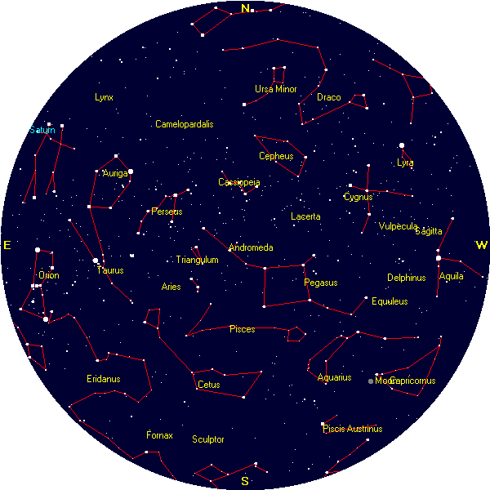
Tonight’s Sky
at 9:00 p.m.
Courtesy, Heavens-Above (www.heavens-above.com)

Slide 11
The MOON…
Luna…
So near, and yet so far.
So common, yet so extraordinary!

Slide 12
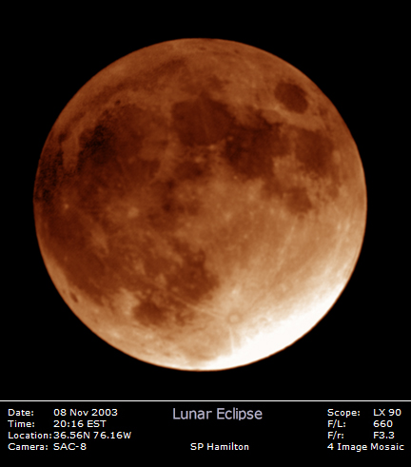
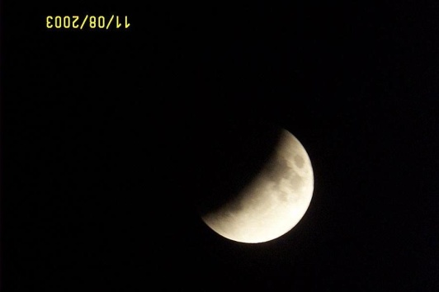
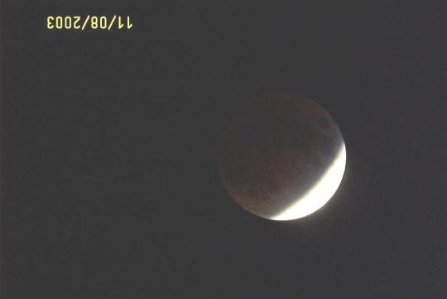
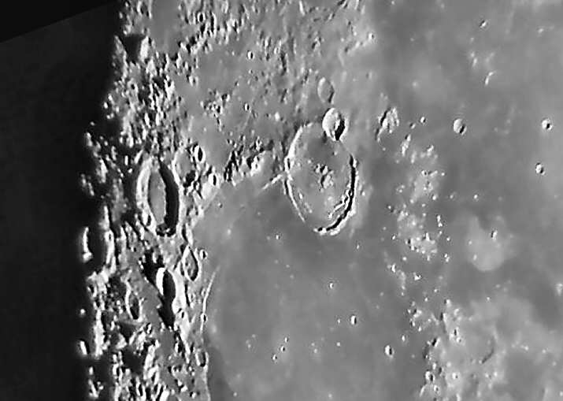
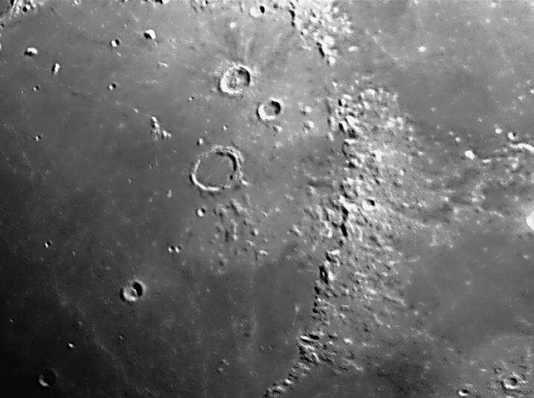
The Moon
Phases
Lunar Eclipse
Craters
Mountains

Slide 13
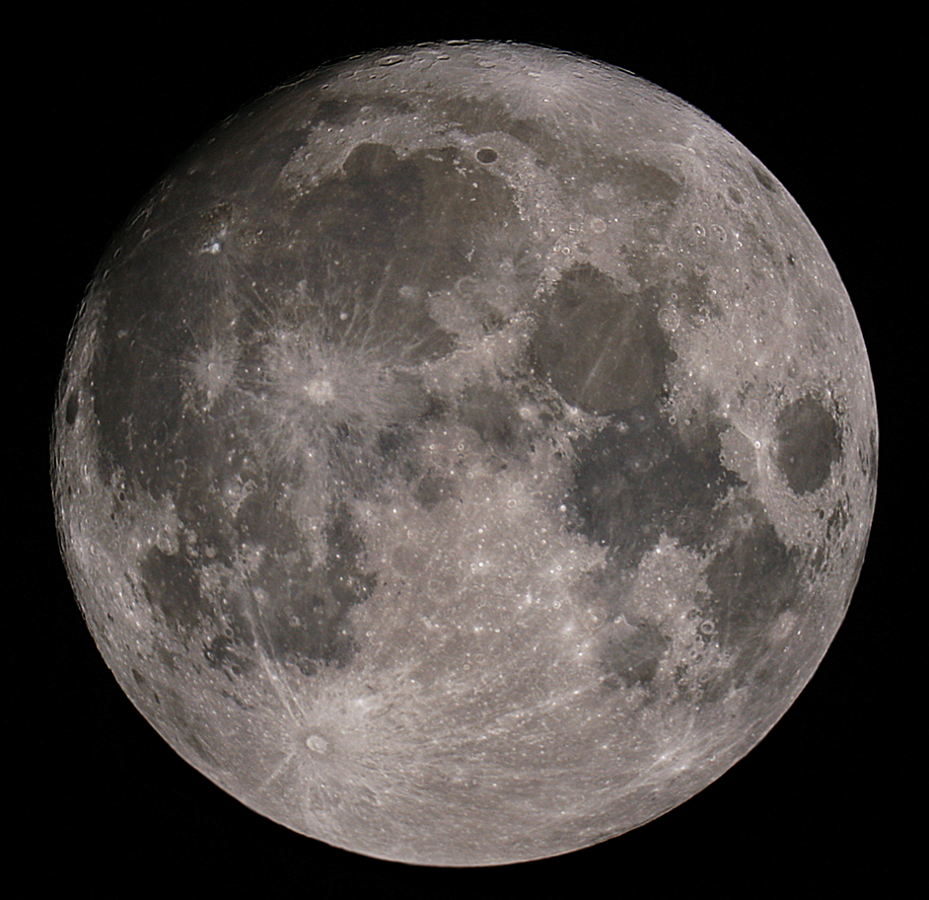
The Moon – The Whole Thing!
Can you see…
The Man in the Moon?
The Woman in the Moon?
The Rabbit in the Moon?
The cow jumping over the Moon?

Slide 14
Greenbrier Middle School Lunar Festival 2004
Besides the Moon, what can I expect to see?
In the city, not a whole lot!

Slide 15
Why can’t I see many stars?

Slide 16
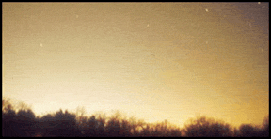
Sky Glow!
Another term for
Light Pollution!

Slide 17
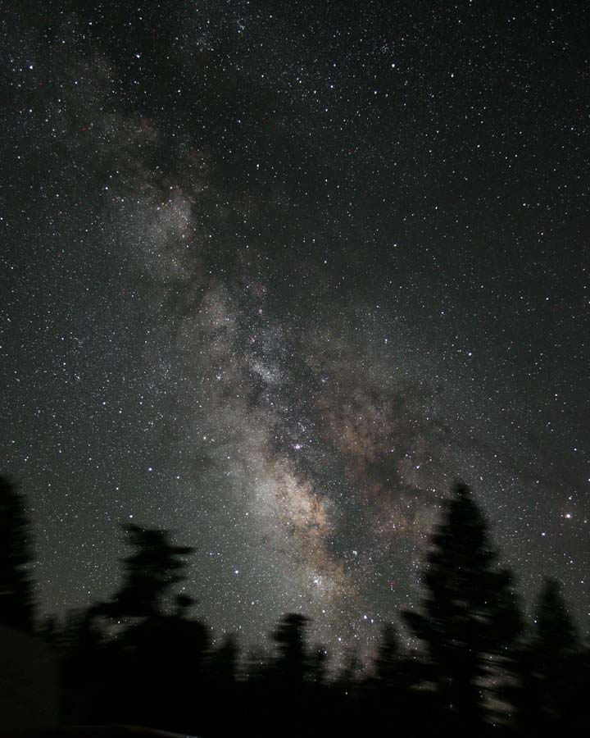
James Jacobson
Here’s what it SHOULD look like!

Slide 18
Greenbrier Middle School Lunar Festival 2004
Besides the Moon, what can I expect to see?
Planets (must know when and where to look for them)
To see more, you need to get out away from the city lights, away from the skyglow.

Slide 19
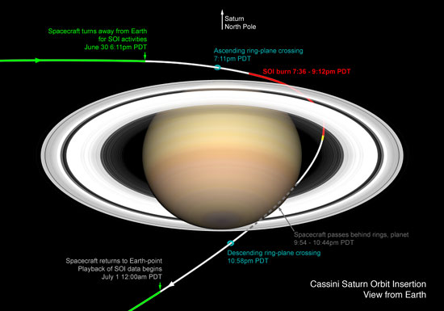
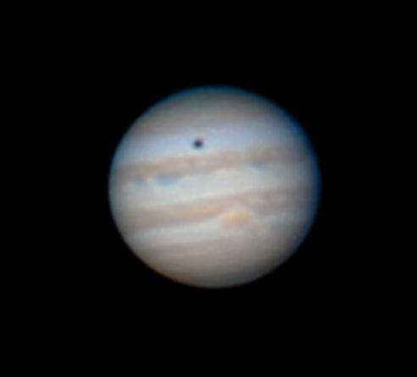
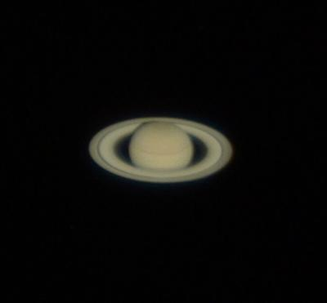
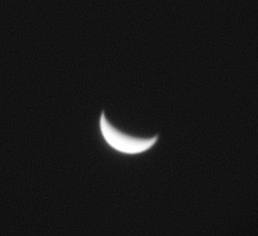
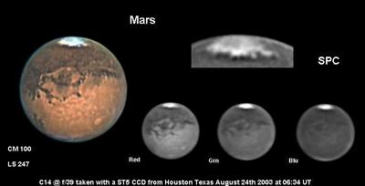
Planets and their Rise Timnes
Saturn
9:10 PM
Jupiter
3:05 AM
Venus
4:10 AM
Mars
5:10 AM
All these photos were taken through amateur astronomers’ telescopes.
Notes:
PLANETS: Saturn rises tonight at 9:10PM, will be high in the sky after midnight, and will set tomorrow 11:20AM.
JUPITER rises at 3AM, VENUS at 4AM, and MARS at 5AM. If you get up before dawn (0645) and look SE, you may see them, with Saturn more to the SW.
NEPTUNE rises at 12 Noon and set at 10:30PM, URANUS rises at 1PM and sets at Midnight. You need a powerful telescope and a good sky map to find them. PLUTO is up during the daylight hours, so it cannot be seen now.

Slide 20
What can I see in a dark sky?
Stars
Constellations
Planets
Comets
Star Clusters
Nebulas (Nebulae) & Galaxies
Satellites (and Space Junk!)
Here’s a sneak preview of some things the 6th grade will see tomorrow:
Notes:
THREE comets are currently visible in the sky, if you know where to look and have a good telescope.
(Comet C/2002 T& LINEAR, C/2001 Q4 NEAT, and brand-new (newly discovered) Comet Machholz.)

Slide 21
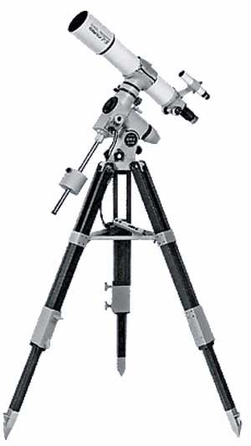
HOW can I see in a dark sky?
The unaided eye (“Naked eye”)
Binoculars
Telescopes
Hubble Space Telescope
  Always in a dark sky -- in Space, in orbit around Earth
  Above the atmosphere and its pollution
  No humidity, clouds, or rain
Telescopes
Here are some photos taken by amateur astronomers . . .

Slide 22
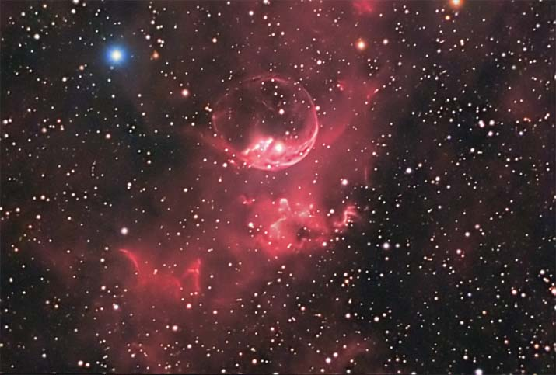
The Bubble Nebula (NGC 7635)
Image courtesy Don Waid, Waid Observatory
Notes:
The energetic starlight then ionizes the shell, causing it to glow. The Bubble Nebula (NGC 7635) is about 10 light-years across and visible with a small telescope towards the constellation of Cassiopeia.

Slide 23
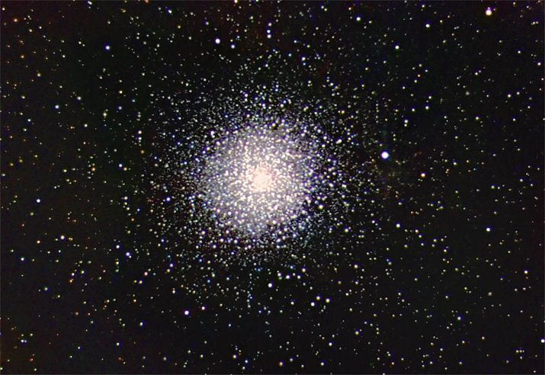
A Globular Star Cluster – a massive ball of hundreds of thousands of stars. This is “M15”.
Image courtesy Don Waid, Waid Observatory
Notes:
M15 lies at a distance of about 33,600 light years from the Earth. Its linear extension is about 175 light years across. It is postulated a massive black hole may lie at the center of M15's core.

Slide 24
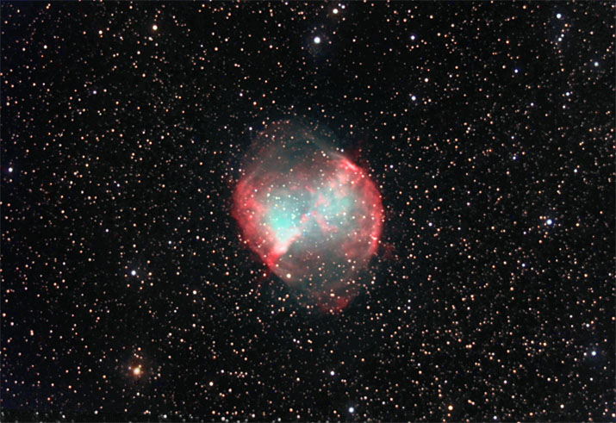
The “Dumbbell Nebula” -- what’s left of a star that exploded thousands of years ago.
Image courtesy Don Waid, Waid Observatory
Notes:
Messier 27 or NGC 6853 - is a typical planetary nebula and is located in the constellation Vulpecula (The Fox). The distance is rather uncertain, but is believed to be around 1200 light-years.

Slide 25
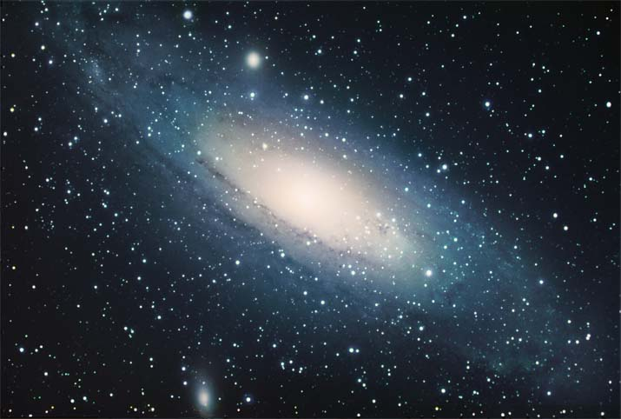

The Andromeda Galaxy – our “neighbor” in space, 2.3 million light years away.
Image courtesy Don Waid, Waid Observatory
Notes:
M31, a galaxy similar in size and shape to our own Milky Way Galaxy, but even larger, with more stars. Located in Andromeda, M31 is one of the three large galaxies (Milky Way, M33 and M31) in the Local Group and is approximately 2.35 million light years distant. With a mass of about 1.5 times that of the Milky Way, it is the dominant galaxy of the Local Group.
The stars and star clusters we see in the night sky are in our own Milky Way Galaxy. When we look beyond our galaxy, we see thousands of other galaxies, farther and farther away.

Slide 26
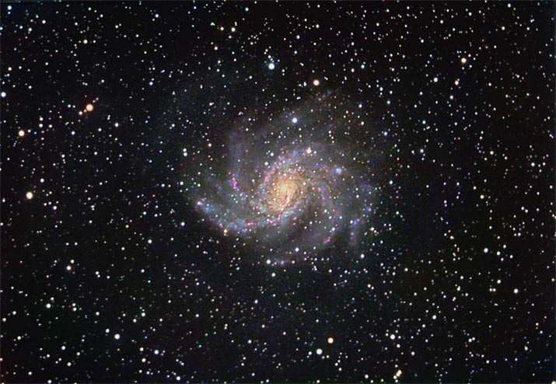
A Spiral Galaxy -- on a vast background of stars, 10 million light-years distant.
Image courtesy Don Waid, Waid Observatory
Notes:
NGC 6946, Approx. 10 million LY away, in the direction of the constellation Cepheus, the King. This is a galaxy out beyond our own Milky Way Galaxy, 4 times as far as the Andromeda Galaxy, on the previous slide. Still, as astronomical distances go, This impressive face on spiral galaxy
is relatively close to our own Milky Way Galaxy.

Slide 27
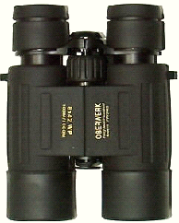
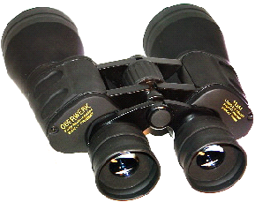
Binoculars
A great way to see the stars . . .
And learn the constellations
“A cheap pair of binoculars is better than a cheap telescope any day!”

Slide 28
Telescope
Telescope ads and department store scopes hype
“magnification”
But the most important feature of a telescope is its
“aperture”,
Or its “light-gathering” power.
A 4.5-inch (114mm) scope gathers 250% MORE light than a 2.4-inch (60mm) scope.

Slide 29
Different Types of Telescopes?
There are three basic types of telescopes.
Refractors use lenses to focus light
(when light passes through glass, it refracts).
Reflectors use mirrors to focus light
(light reflects off of mirrors).
Catadioptric (combination) telescopes use some combination of lenses as well as mirrors (to fold the light path).

Slide 30
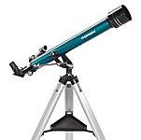
Refractor

Slide 31
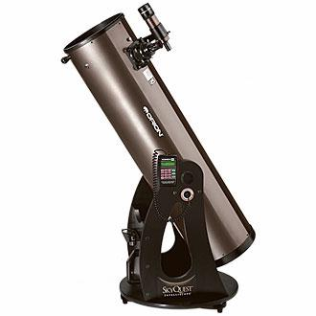
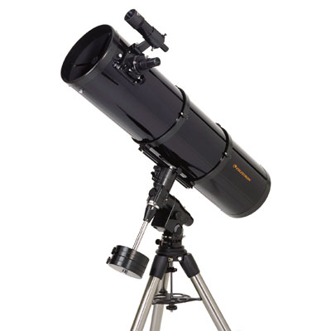
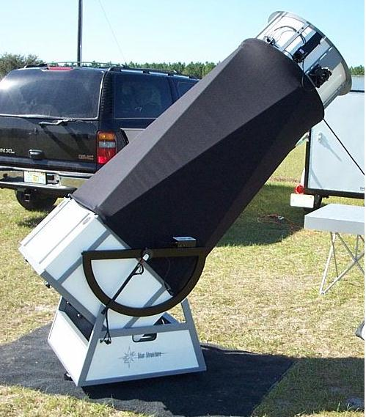
Reflector

Slide 32
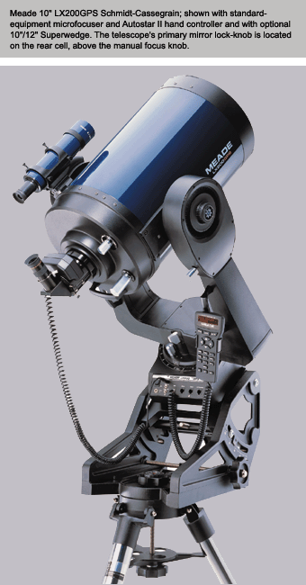
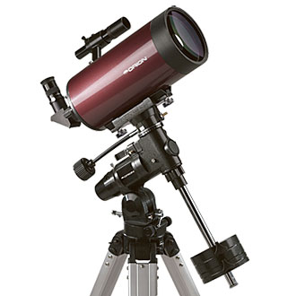
Catadioptric

Slide 33
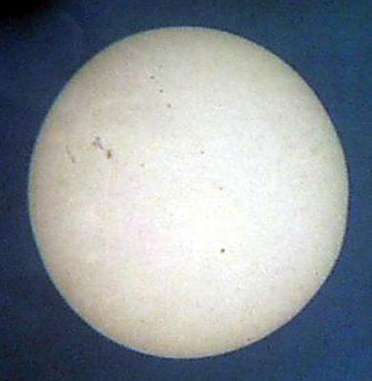
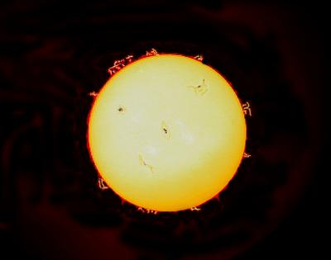
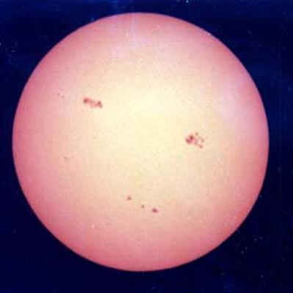
The Sun
CAUTION! NEVER look at the Sun directly without a proper filter!
Sunspots
Solar Flares
More Sunspots

Slide 34
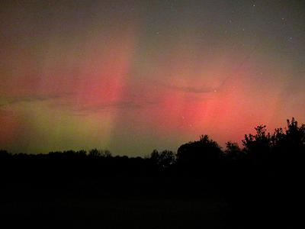
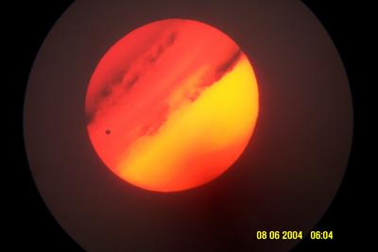
Auroras and other Events
Aurora Borealis
Transit of Venus

Slide 35
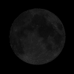
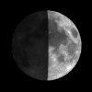
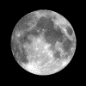
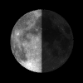
The Inconstant Moon
Phases of the Moon – about 7 days
  New moon ------
  1st Quarter
  Full Moon ---------
  Last Quarter
Waxing and Waning Moon
  Waxing – increasing; “Daring”
  Waning – decreasing; “Cautious”
Moon Calendar – QuickPhase Pro software
Notes:
PRIOR to presentation, SET UP PC with USB Memory stick. CHANGE this slide to link to that external memory on mouseover or mouse click.

Slide 36
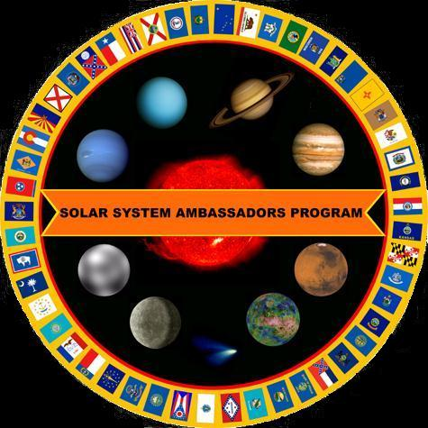
Your “Solar System Ambassador”
George Reynolds
Thank You!

Slide 37
GO out and look
for the Moon!
Greenbrier Middle School Lunar Festival 2004

Slide 38
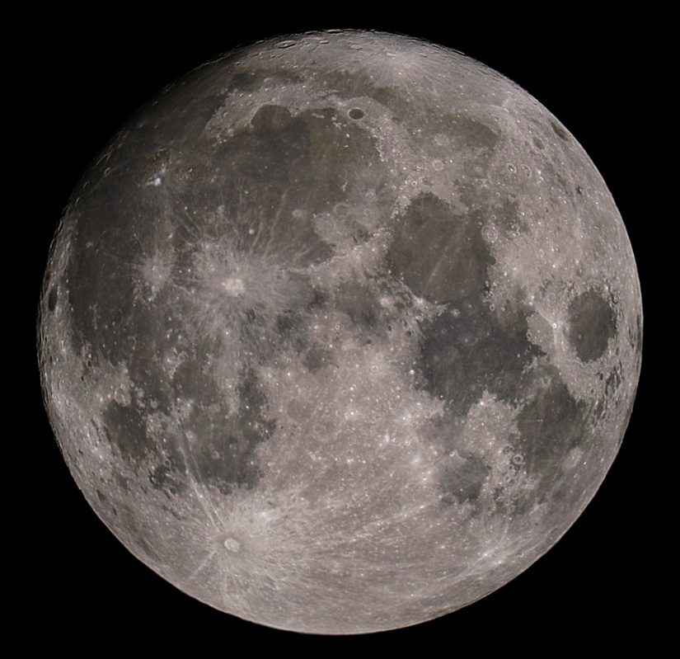
GO out and look
for the Moon!
Greenbrier Middle School Lunar Festival 2004

