Slide 2

“Seeing Stars” – February 15, 2007
Welcome to “Seeing Stars”
An Evening With the Astronomers
Presented by
The Back Bay Amateur Astronomers
for Azalea Gardens Middle School
Thursday, February 15, 2007

Slide 3


The Back Bay Amateur Astronomers
Bringing Astronomy to the People of Hampton Roads
The Back Bay Amateur Astronomers
PO Box 9877
Virginia Beach, VA 23450

Slide 4
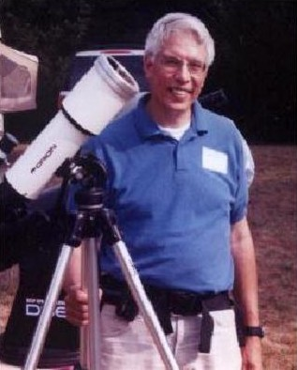
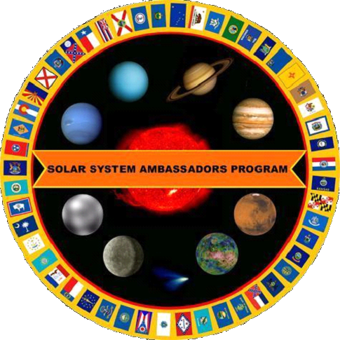
Your “Solar System Ambassador”
George Reynolds

Slide 5
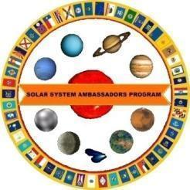
Introductions
Back Bay Amateur Astronomers
  George Reynolds
  Kevin Weiner
Bringing Astronomy to the people of Hampton Roads since 1978

Slide 6
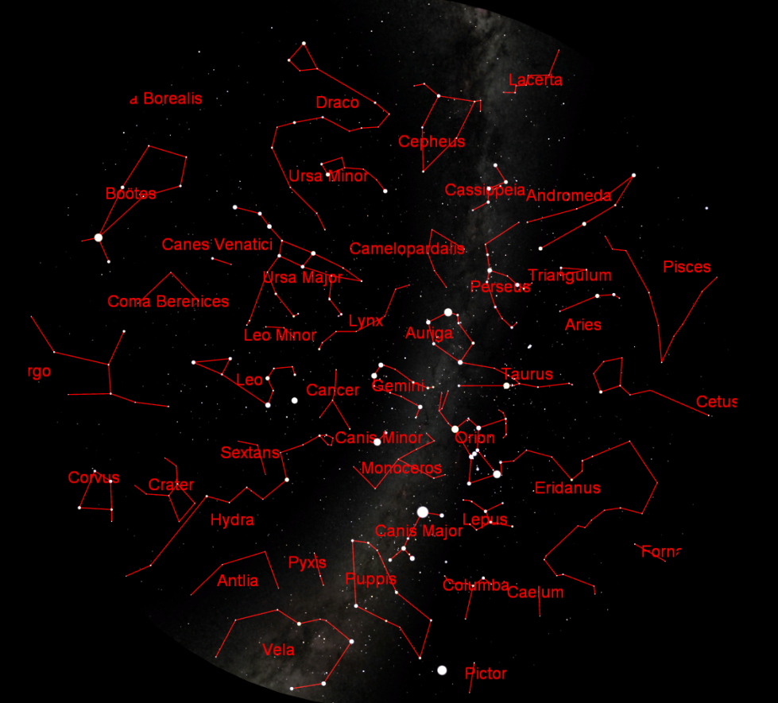
Star lore...
Notes:
Amateur Astronomers – Who are they . . . What are they?
Well, some people stereotype astronomers as nerdy individuals with pocket protectors and taped-up glasses.
I will admit to wearing glasses, but I don’t own a pocket protector. ;-)

Slide 7
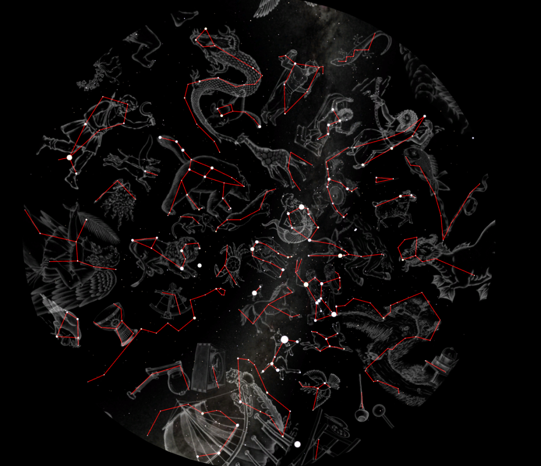
Star lore...
Notes:
Amateur Astronomers – Who are they . . . What are they?
Well, some people stereotype astronomers as nerdy individuals with pocket protectors and taped-up glasses.
I will admit to wearing glasses, but I don’t own a pocket protector. ;-)

Slide 8
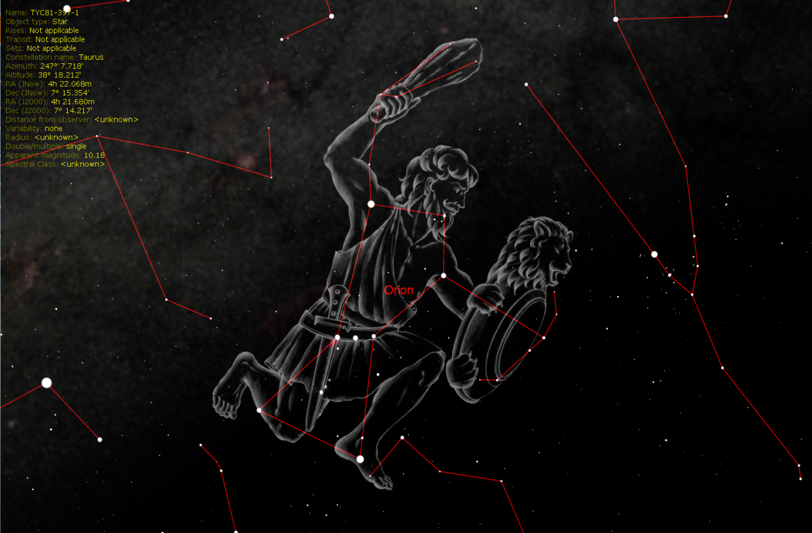
Star lore...
Notes:
Amateur Astronomers – Who are they . . . What are they?
Well, some people stereotype astronomers as nerdy individuals with pocket protectors and taped-up glasses.
I will admit to wearing glasses, but I don’t own a pocket protector. ;-)

Slide 9
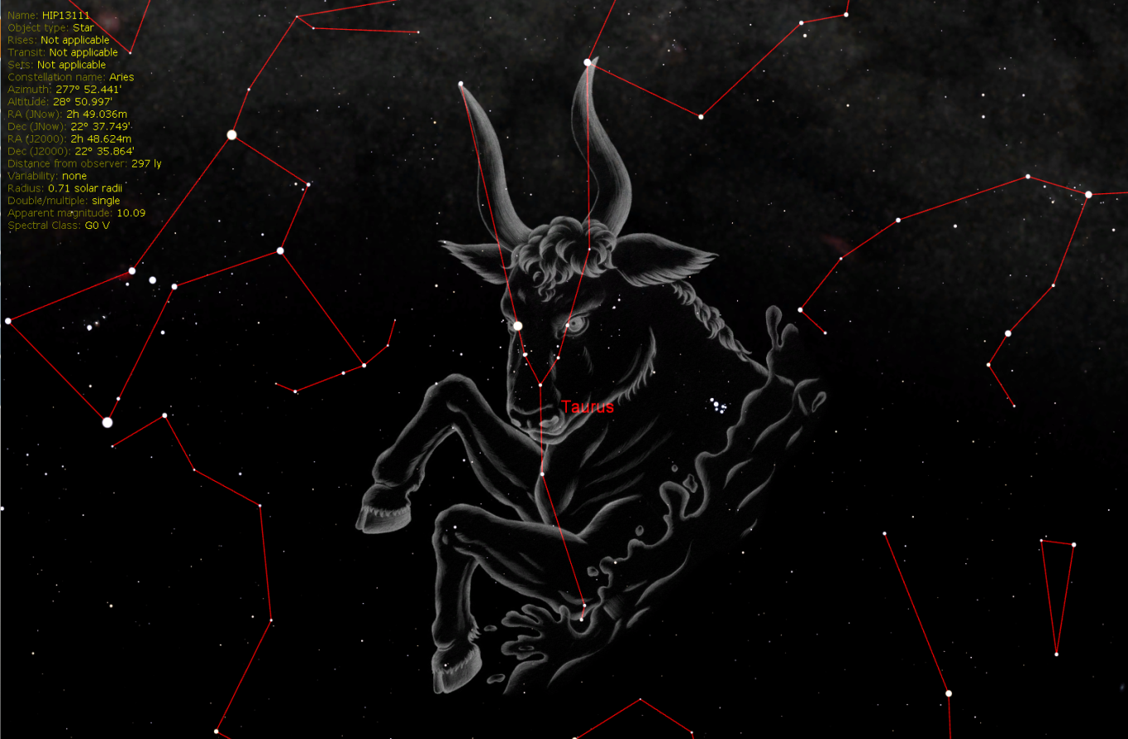
Star lore...
Notes:
Amateur Astronomers – Who are they . . . What are they?
Well, some people stereotype astronomers as nerdy individuals with pocket protectors and taped-up glasses.
I will admit to wearing glasses, but I don’t own a pocket protector. ;-)

Slide 10
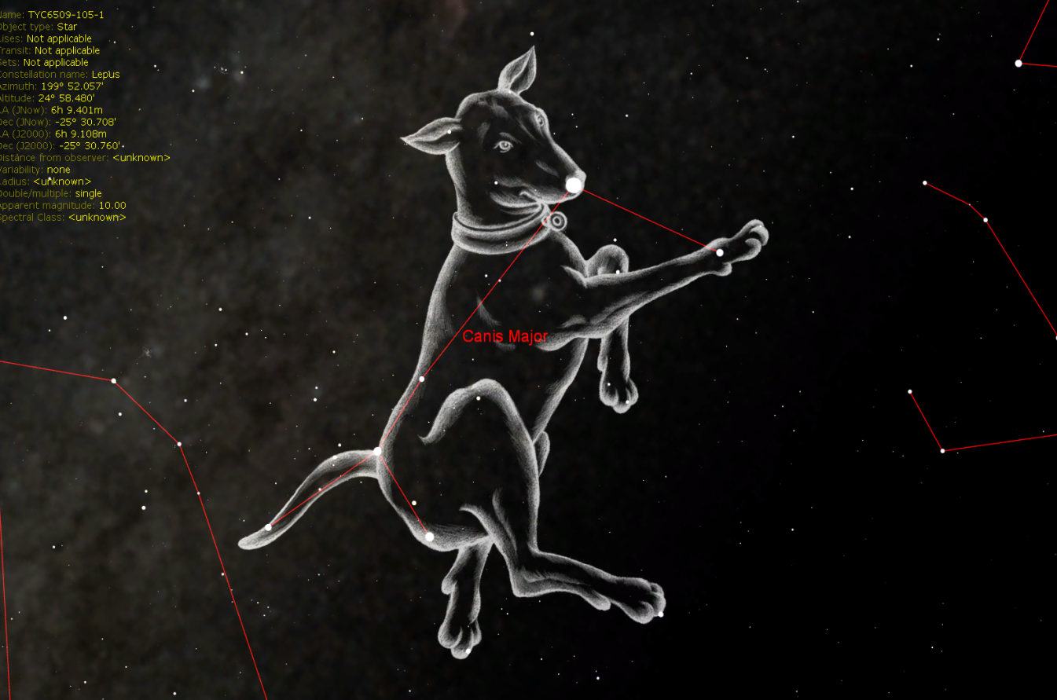
Star lore...
Notes:
Amateur Astronomers – Who are they . . . What are they?
Well, some people stereotype astronomers as nerdy individuals with pocket protectors and taped-up glasses.
I will admit to wearing glasses, but I don’t own a pocket protector. ;-)

Slide 11
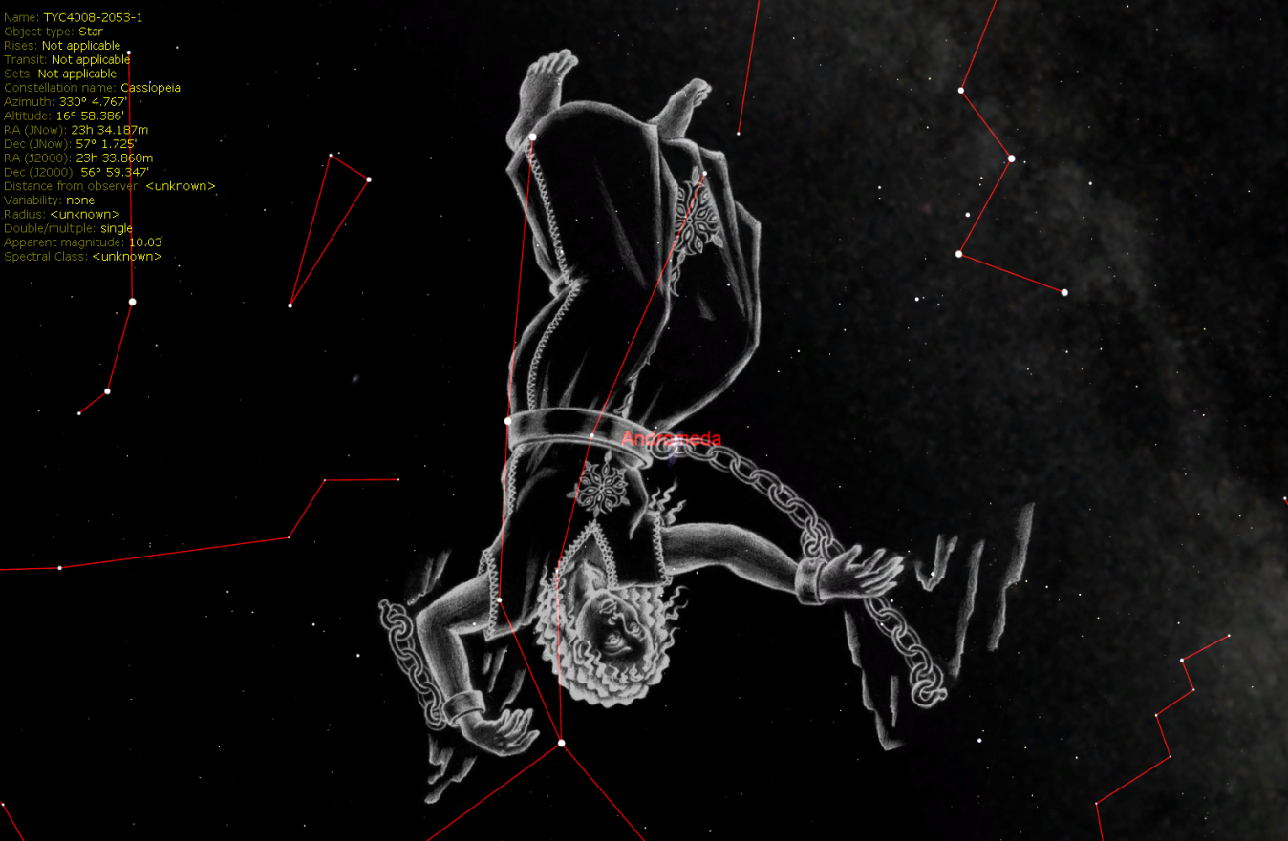
Star lore...
Notes:
Amateur Astronomers – Who are they . . . What are they?
Well, some people stereotype astronomers as nerdy individuals with pocket protectors and taped-up glasses.
I will admit to wearing glasses, but I don’t own a pocket protector. ;-)

Slide 12
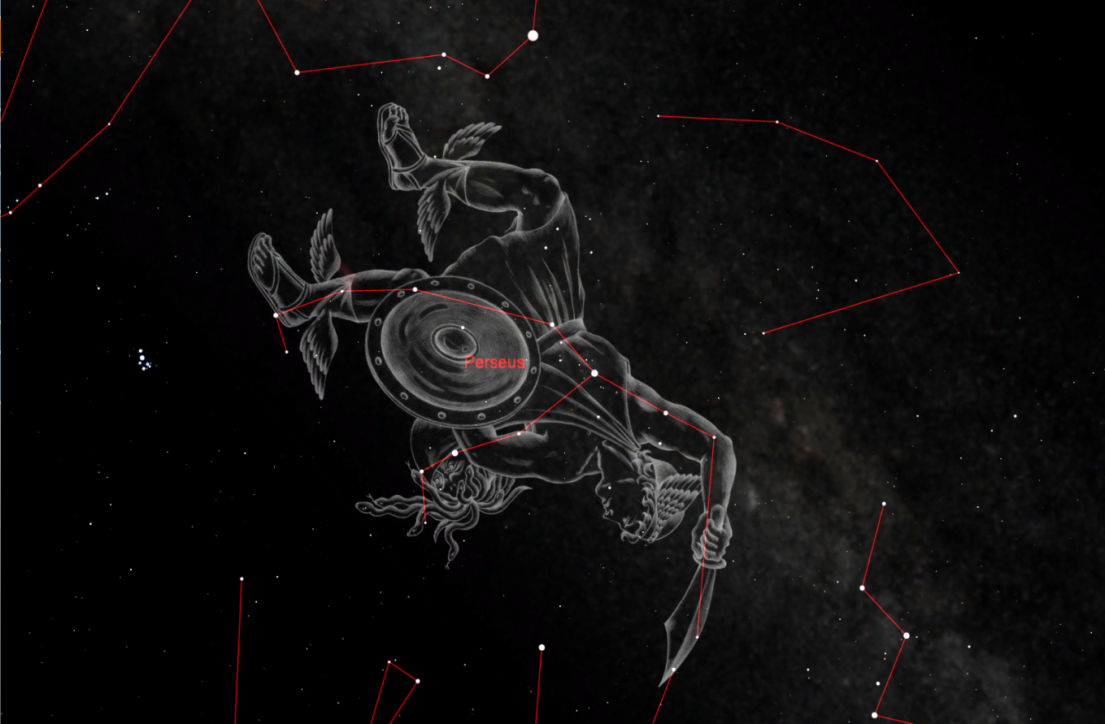
Star lore...
Notes:
Amateur Astronomers – Who are they . . . What are they?
Well, some people stereotype astronomers as nerdy individuals with pocket protectors and taped-up glasses.
I will admit to wearing glasses, but I don’t own a pocket protector. ;-)

Slide 13
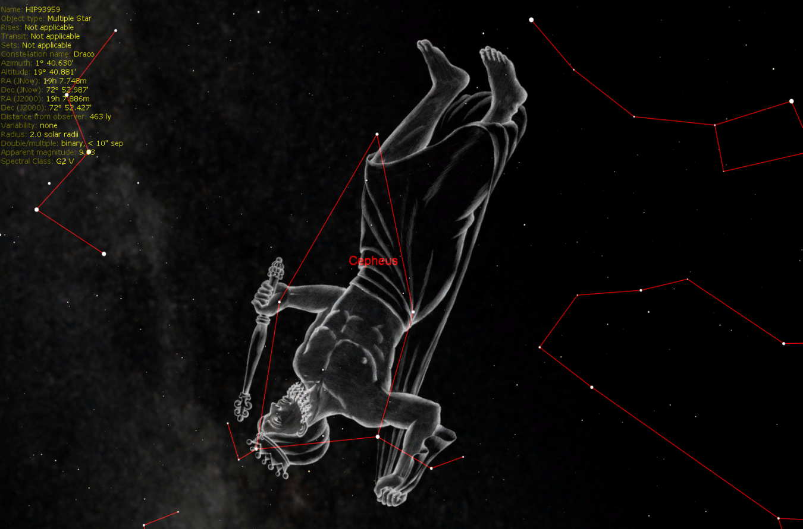
Star lore...
Notes:
Amateur Astronomers – Who are they . . . What are they?
Well, some people stereotype astronomers as nerdy individuals with pocket protectors and taped-up glasses.
I will admit to wearing glasses, but I don’t own a pocket protector. ;-)

Slide 14
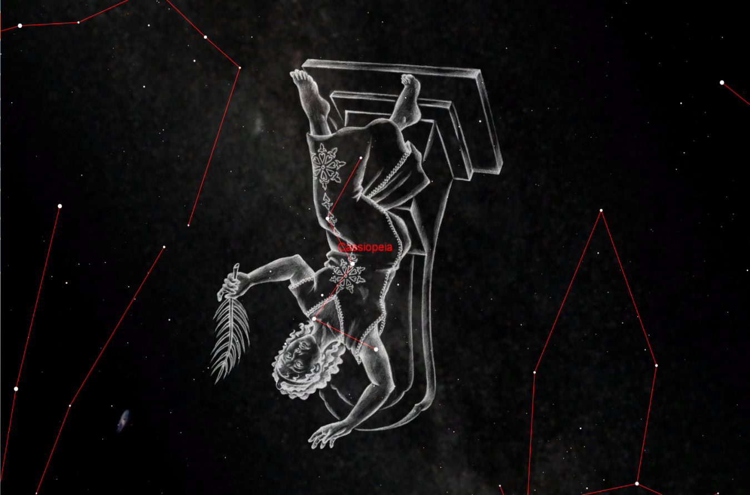
Star lore...
Notes:
Amateur Astronomers – Who are they . . . What are they?
Well, some people stereotype astronomers as nerdy individuals with pocket protectors and taped-up glasses.
I will admit to wearing glasses, but I don’t own a pocket protector. ;-)

Slide 15
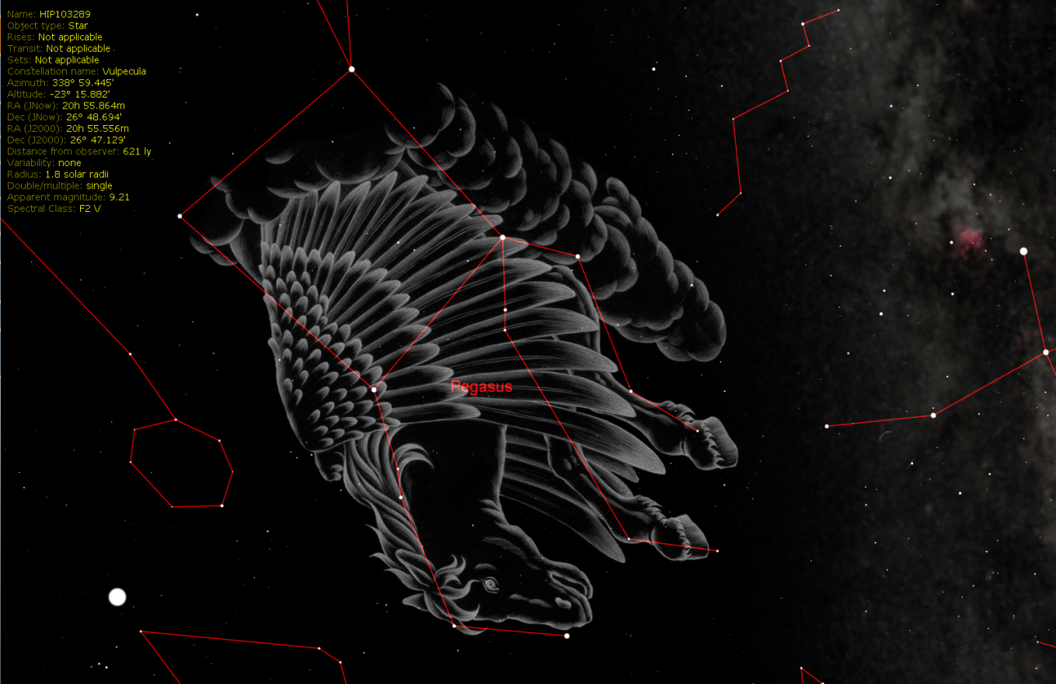
Star lore...
Notes:
Amateur Astronomers – Who are they . . . What are they?
Well, some people stereotype astronomers as nerdy individuals with pocket protectors and taped-up glasses.
I will admit to wearing glasses, but I don’t own a pocket protector. ;-)

Slide 16
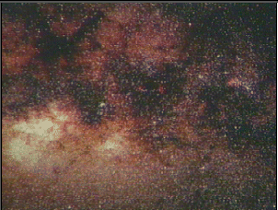
Amateur Astronomers...
We are ordinary people with a love of the heavens. We contribute to science thru discovery, study and by sharing information with others.
Notes:
As the slide says, we are ordinary folks . . . With an interest in science, nature, Creation, you name it.
Some of us are computer geeks, some work in offices or schools, some are students, and some are retired. We have some ladies in the club, and a lot of guys. We have a few teenagers, some old men, and a lot of in-between folks.
I know some people think that science is BORING . . . ➔

Slide 17


Science is BORING!
Notes:
.. . . But I say that science is FUN! ➔

Slide 18
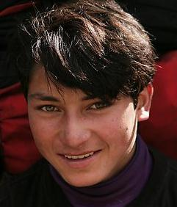
Science is FUN!!
Notes:
There are many Web sites kids can go to for fun and infromation about science and astronomy.
Here are just a couple of examples . . . ➔

Slide 19
Out of this World Fun for Kids
A kid-friendly (and parent-friendly) Web site by NASA
FUN learning about Space and Exploration!
http://www.nasa.gov/audience/forkids/kidsclub/flash/index.html
http://spaceplace.nasa.gov/en/kids/

Slide 20
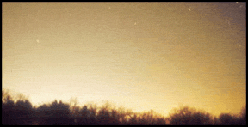
Why can’t I see any stars?
Sky Glow!
Another term for
Light Pollution!
Notes:
You may ask, “what is there to see up in the night sky? When I look up, I don’t see much of anything.”
LIGHT POLLUTION: streetlights, car lots, shopping centers, illuminated buildings, “security” lights, decorative lighting, etc., etc.

Slide 21
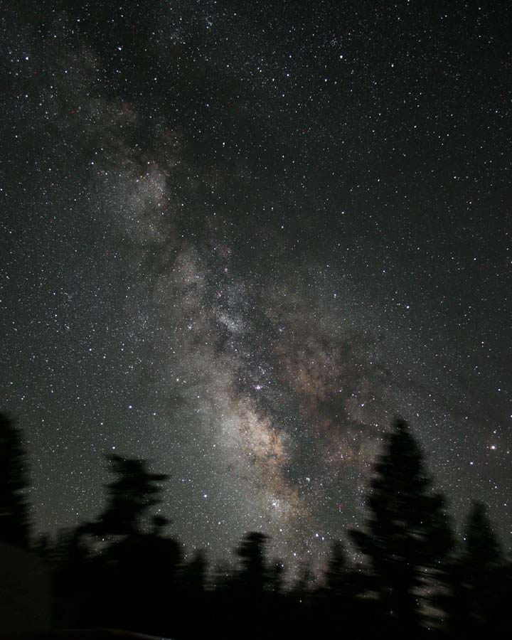
James Jacobson
Here’s what it SHOULD look like!
Notes:
The Milky Way – looking toward the center of our home galaxy in the summertime.
In the winter we are looking toward the outer edge of the galaxy, so it is not quite as bright.
In order to see the Milky Way and more stars, we find it necessary to get out of town, away from the skyglow and light pollution. We need to drive an hour away to get a decent dark sky.

Slide 22



HOW can I see in a dark sky?
The unaided eye (“Naked eye”)
Binoculars
Telescopes
Notes:
HOW can I see . . .

Slide 23
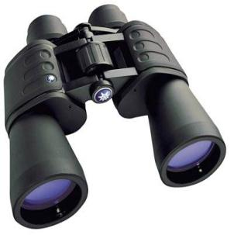
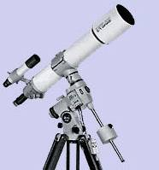
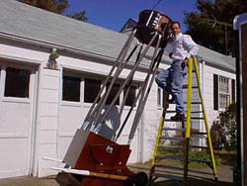
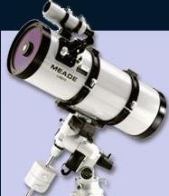
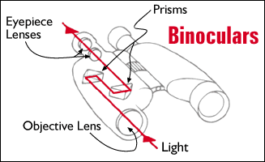
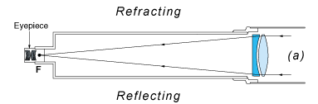
Telescopes – Types
Eyes, Binoculars, Refractors, Reflectors, Catadioptric
Notes:
These are some devices you can use to enhance your eyes’ ability to see faraway objects in the night sky: Binoculars, and Telescopes of various types and sizes.
Your next question may well be, “WHAT can I expect to see in a dark sky?”
Well, there are PLANETS, MOONS, COMETS, and ASTEROIDS in our SOLAR SYSTEM, and STARS, STAR Clusters, and NEBULAS in our GALAXY . . . And outside our own galaxy, there are countless billions of other galaxies in the far reaches of outer space.

Slide 24
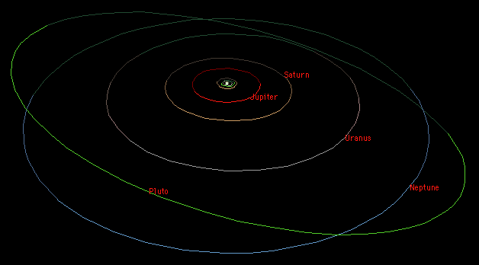
Our Solar System
Overview
The Sun
8 Major Planets
4 Dwarf Planets
Many “minor planets”
Comets
Asteroids
Notes:
Our SOLAR SYSTEM is the system of planets, moons, asteroids, comets, and other objects that trabvel in orbits around our SUN. Our Sun has a name, and it is “SOL”. That’s why it is called the “SOLar system”. If we lived on a planet orbiting the star Rigel, we would be in the Rigelian System.
You may have heard that Pluto was recently demoted from full planet status to a “Dwarf Planet”. Many astronomers don’t agree with that decision, and it may change again in a few years. We’ll wait and see.
Let’s take a quick tour through our solar system. ➔

Slide 25
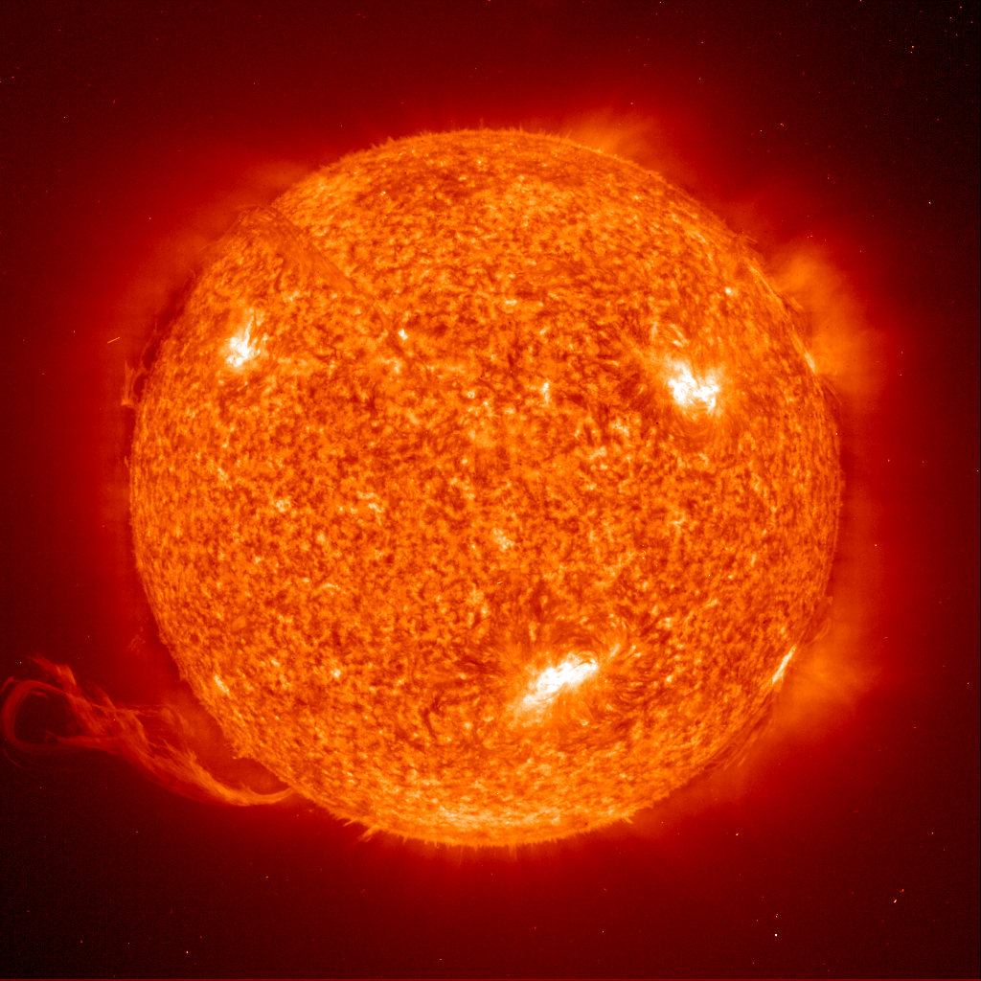
Our Solar System
1,391,000 km (864,400 mi) diameter
Apx 70% Hydrogen
Medium-small size star
The Sun
(Our Star)
“Sol”

Slide 26
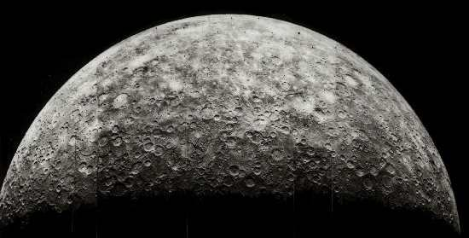
Our Solar System
4,480 km diameter
Average Temperature 167 C
Almost no Atmosphere
The Sun
(Our Star)
Mercury

Slide 27
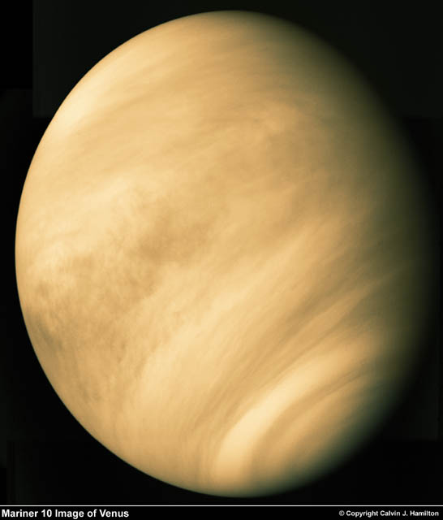
Our Solar System
12,103 km diameter
Our nearest neighbor
Sulphuric Atmosphere
The Sun
(Our Star)
Mercury
Venus

Slide 28
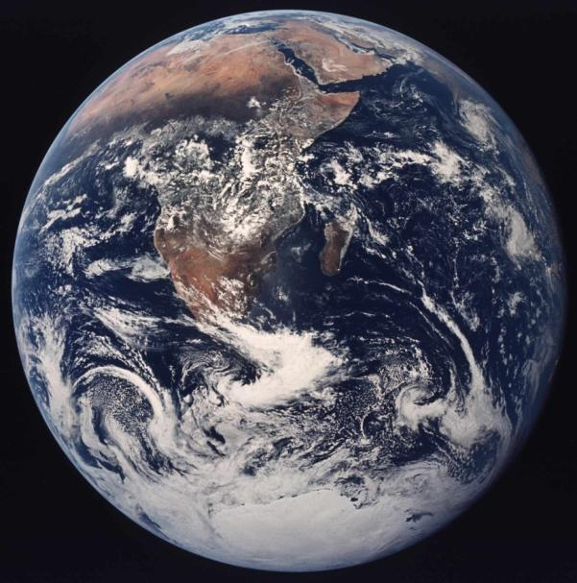
Our Solar System
12,756 km diameter
Our Home
Only Planet with life that we know of
The Sun
(Our Star)
Mercury
Venus
Earth

Slide 29
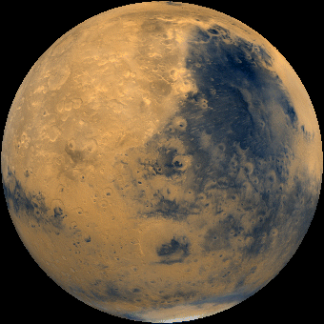
Our Solar System
6,794 km diameter
-133C – 80C Temperature
Possible water (frozen or beneath the surface)
The Sun
(Our Star)
Mercury
Venus
Earth
Mars

Slide 30
Our Solar System
142,984 km diameter
Gas Giant
63 + Moons
Great Red Spot
The Sun
(Our Star)
Mercury
Venus
Earth
Mars
Jupiter

Slide 31
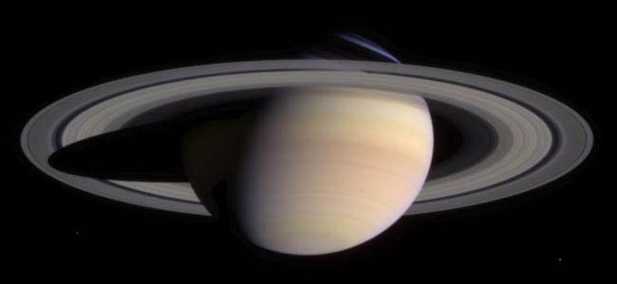
Our Solar System
120,536 km diameter
Gas Planet
Only planet with rings that can be easily seen from earth
The Sun
(Our Star)
Mercury
Venus
Earth
Mars
Jupiter
Saturn

Slide 32
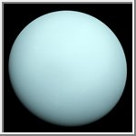
Our Solar System
51,118 km diameter
Gas Planet
Axis is sideways
The Sun
(Our Star)
Mercury
Venus
Earth
Mars
Jupiter
Saturn
Uranus

Slide 33
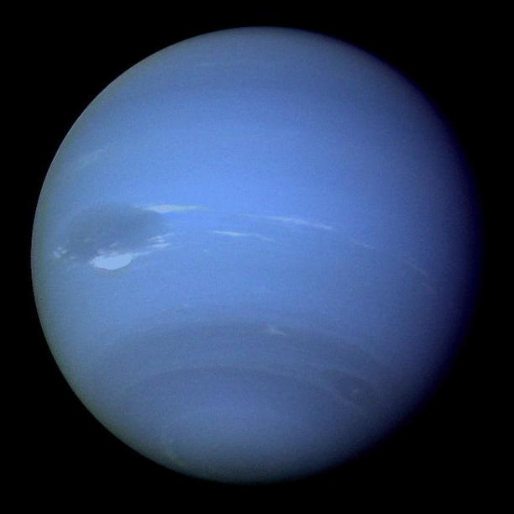
Our Solar System
49,532 km diameter
Gas Planet – Possible Core
Also has a “Blue Spot”
The Sun
(Our Star)
Mercury
Venus
Earth
Mars
Jupiter
Saturn
Uranus
Neptune

Slide 34
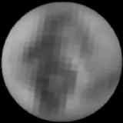
Our Solar System
2,274 km diameter
Dwarf Planet
Planet to Moon ratio similar to Earth
The Sun
(Our Star)
Mercury
Venus
Earth
Mars
Jupiter
Saturn
Uranus
Neptune
Pluto

Slide 35
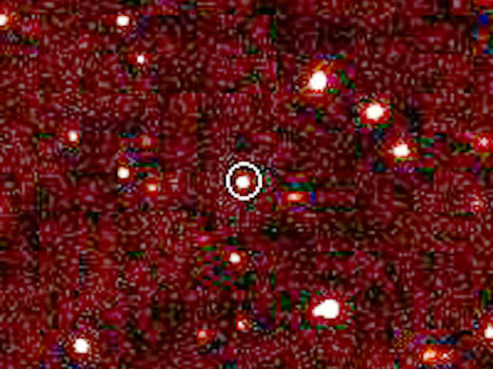
Our Solar System
Larger than Pluto
nearly 100 times the Earth-Sun distance -- over twice the average Pluto-Sun distance
The Sun
(Our Star)
Mercury
Venus
Earth
Mars
Jupiter
Saturn
Uranus
Neptune
Pluto
Eris
Eris

Slide 36
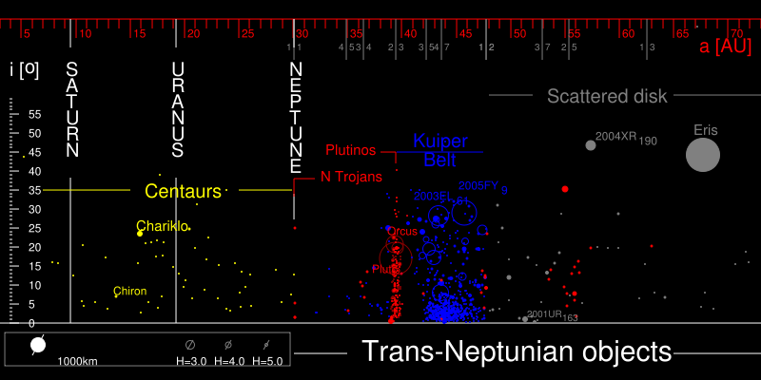
A trans-Neptunian object (TNO) is any object in the solar system that orbits the sun at a greater distance on average than Neptune. The Kuiper belt, Scattered disk, and Oort cloud are names for three divisions of this volume of space.
Notes:
This slide may be hard to read and understand. Simply put, it just shows that there are a whole lot of things out beyond the planets; comets, asteroids, “dwarf planets”, and a lot of things left to be discovered.

Slide 37
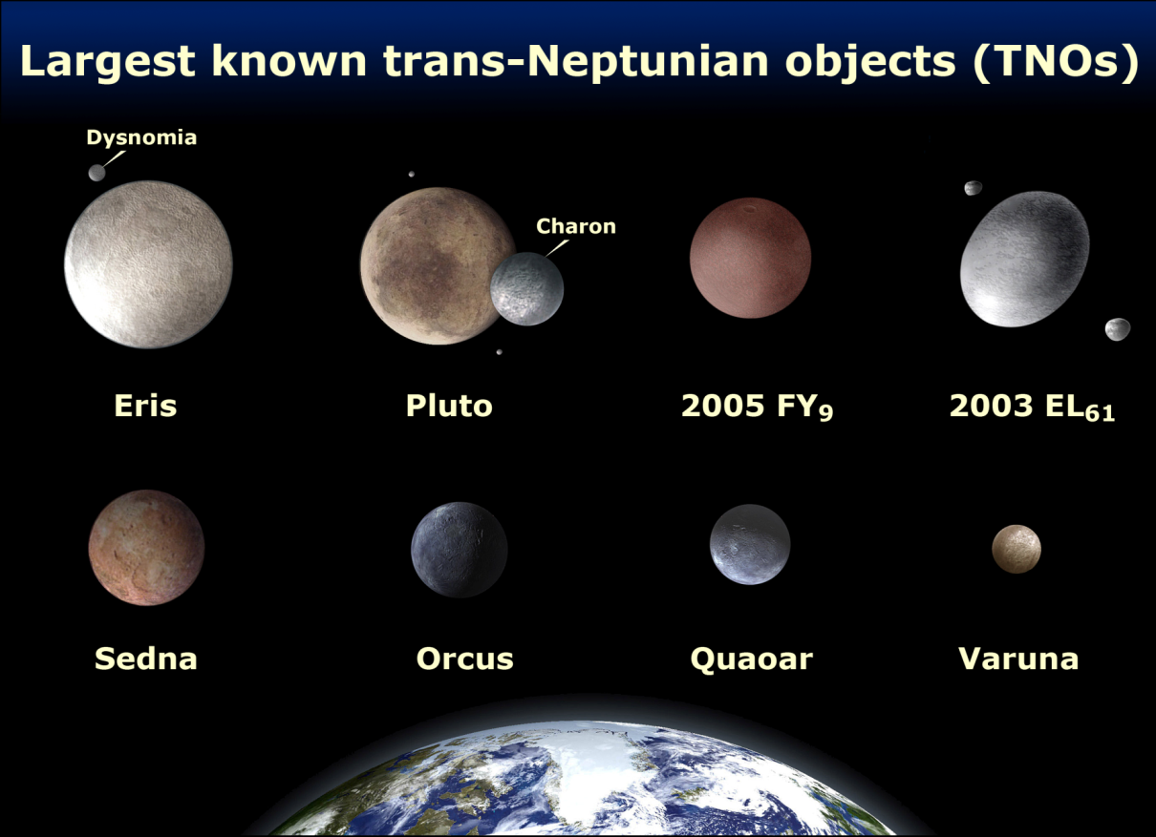
A trans-Neptunian object (TNO) is any object in the solar system that orbits the sun at a greater distance on average than Neptune. The Kuiper belt, Scattered disk, and Oort cloud are names for three divisions of this volume of space.
Notes:
Any fairly large solar system object that is not a planet, a moon, or a comet may be called a “minor planet”. Here are some examples, some of which fall into the new category of “dwarf planet”.

Slide 38
Space Exploration . . .
The Final Frontier

Slide 39
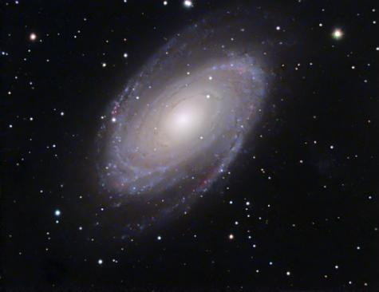
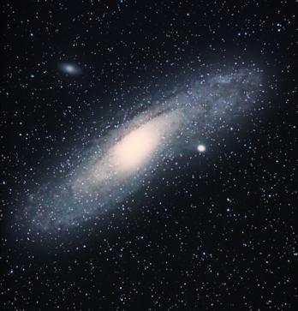
Deep Space
“Island Universes”
Billions of stars and possible Planets
Billions of Galaxies
Milky Way is Our Galaxy
Galaxies
Notes:
Out beyond our home galaxy, the Milky Way Galaxy, there are billions of other galaxies, of all shapes and sizes. Some are larger and some are smaller than our own galaxy. Ours in a spiral galaxy, as are these pictured here. The one on the right is the great Andromeda Galaxy, our nearest galactic “neighbor”, 2.5 million light-years away. On a clear night in a dark sky, you can see the glow of Andromeda without optical assistance.

Slide 40
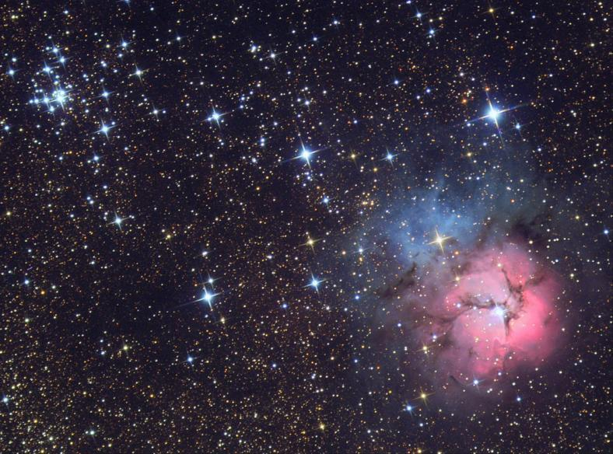
Deep Space
Galaxies
Gas Clouds
Emission, Reflection, Planetary
All we can see are within our Galaxy
Nebulae

Slide 41
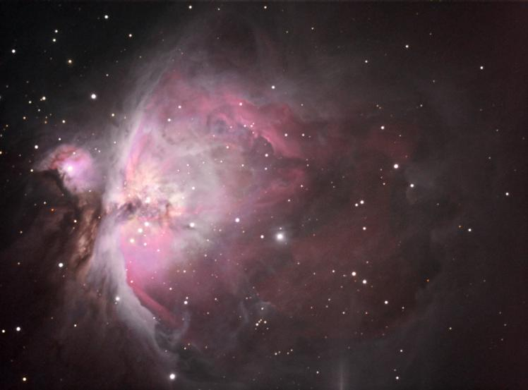
Deep Space
Galaxies
Gas Clouds
Star Nurseries
Light is emitted from within the cloud by new stars
Nebulae
  Emission

Slide 42
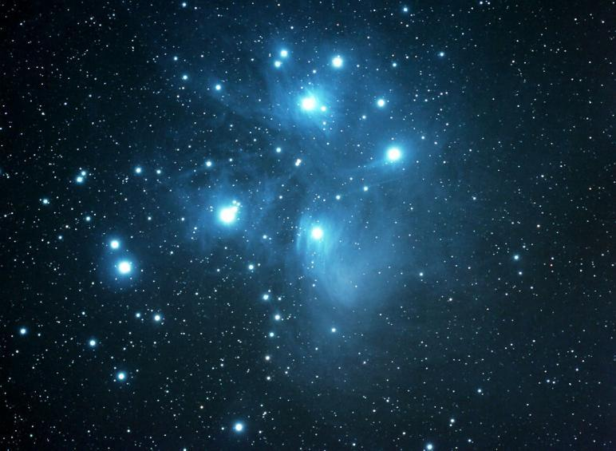
Deep Space
Galaxies
Light reflects from Nearby Stars
Gas is probably left over from previously formed stars or exploded stars
Nebulae
  Emission
  Reflection

Slide 43
Deep Space
Galaxies
Exploded Stars - Novas (Novae)
Gas forms a ring around the original Star
Not a planet, early astronomers thought the center was a planet
Nebulae
  Emission
  Reflection
  Planetary

Slide 44
Closer to Home . . .
Our own Moon, “Luna”, is a sight to see…
…when it is visible in the sky
Phases of the Moon
  New Moon, Waxing Crescent 1-7 days
  First Quarter Moon (“Half Moon”), Waxing Gibbous 8-15 days
  Full Moon to Waning Gibbous Moon 16-22 days
  Waning Crescent back to New Moon 23-29 days
Notes:
You cannot see the Moon every night in the sky, because it rises almost an hour later each day. The New Moon is dark, or a barely visible ultra-thin crescent, rising almost at sunrise and setting at sunset. Each day the Moon sets a little later, and grows in its area of illumination from a thin crescent to a “half-moon”, also called “First Quarter”. After First Quarter the Moon grows, or “waxes” through its waxing gibbous phase and is often visible in the afternoon skies. After two weeks from the New Moon, it is now at Full Moon phase. The Full Moon rises about sunset and sets about sunrise.
After Full Moon, Luna grows smaller, or “wanes” in its illuminated area, through the waning gibbous phases to “Last Quarter”, a “half-moon” lit on the left side instead of the right side. This moon rises later each night, until the last quarter moon rises around midnight or later.
As another week goes by the Moon goes from Last Quarter through its waning crescent stages, and is often visible in the morning skies after the sun comes up. Finally, after about a month (29 days) the cycle is complete, and the Moon once again goes to New, only to start the cycle all over again.

Slide 45
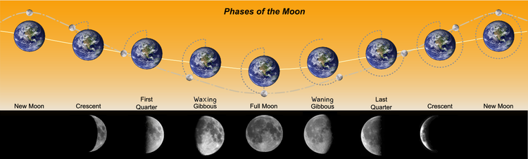
The phases of the Moon have been given the following names, which are listed in sequential order:
Dark Moon - Not visible
New Moon - Not visible, or traditionally, the first visible crescent of the Moon
Waxing Crescent Moon - Right 1-49% visible
First Quarter Moon - Right 50% visible
Waxing gibbous Moon - Right 51-99% visible
Full Moon - Fully visible
Waning gibbous Moon - Left 51-99% visible
Third Quarter Moon - Left 50% visible
Waning Crescent Moon - Left 1-49% visible
New Moon - Not visible
Notes:
Here is another slide to illustrate the phases of the Moon.

Slide 46
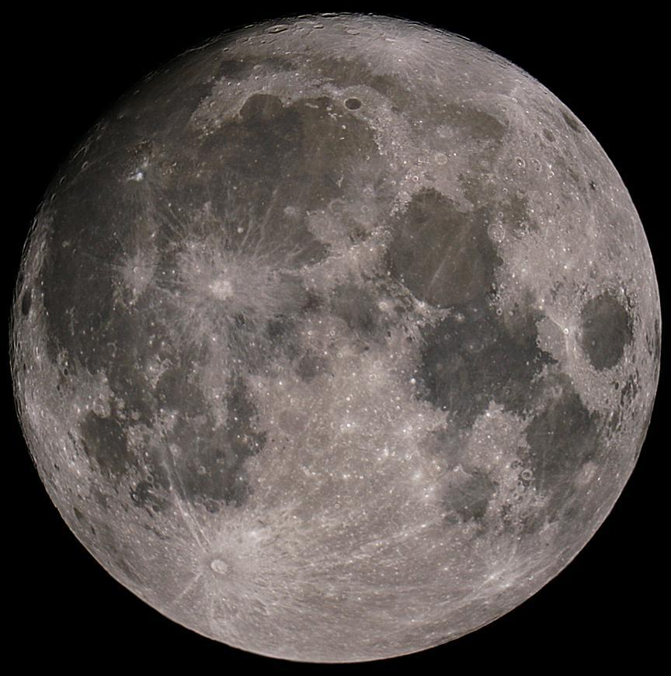
The Moon – The Whole Thing!
Can you see…
The Man in the Moon?
The Woman in the Moon?
The Rabbit in the Moon?
The cow jumping over the Moon?

Slide 47
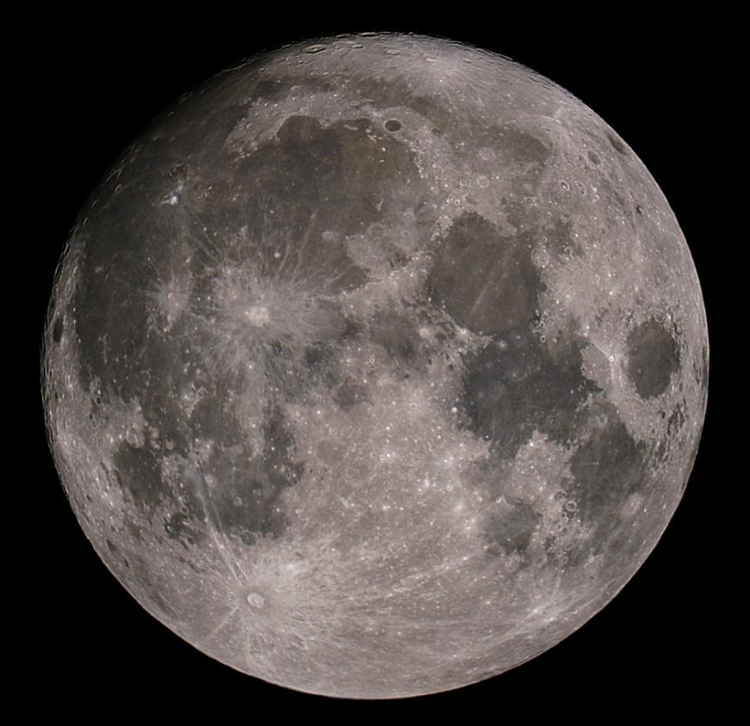
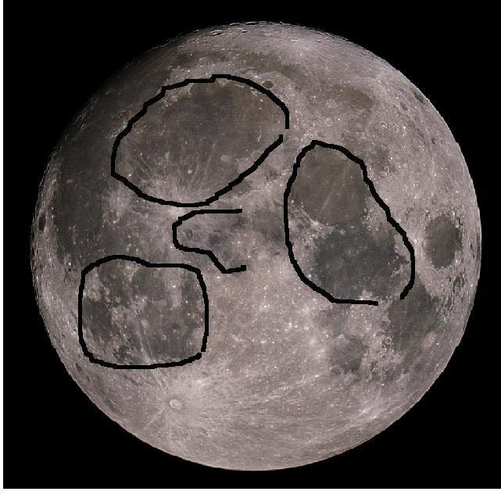
The Man in the Moon

Slide 48
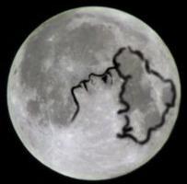
The Woman in the Moon

Slide 49
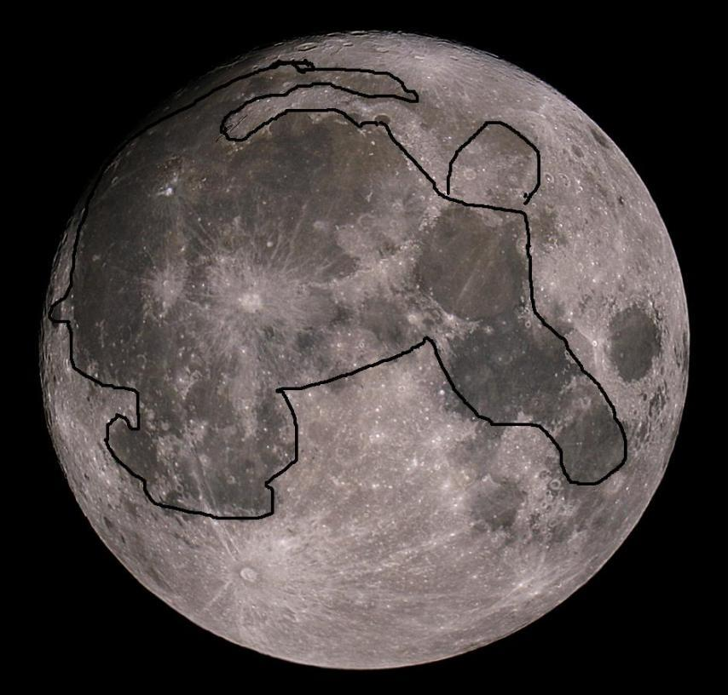
The Rabbit in the Moon

Slide 50
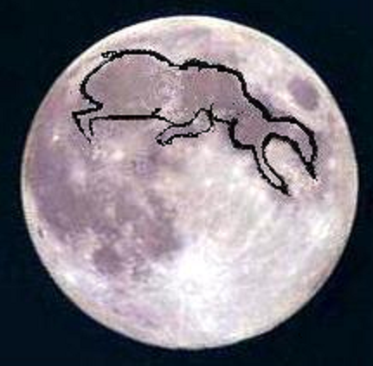
The Cow Jumping Over the Moon

Slide 51
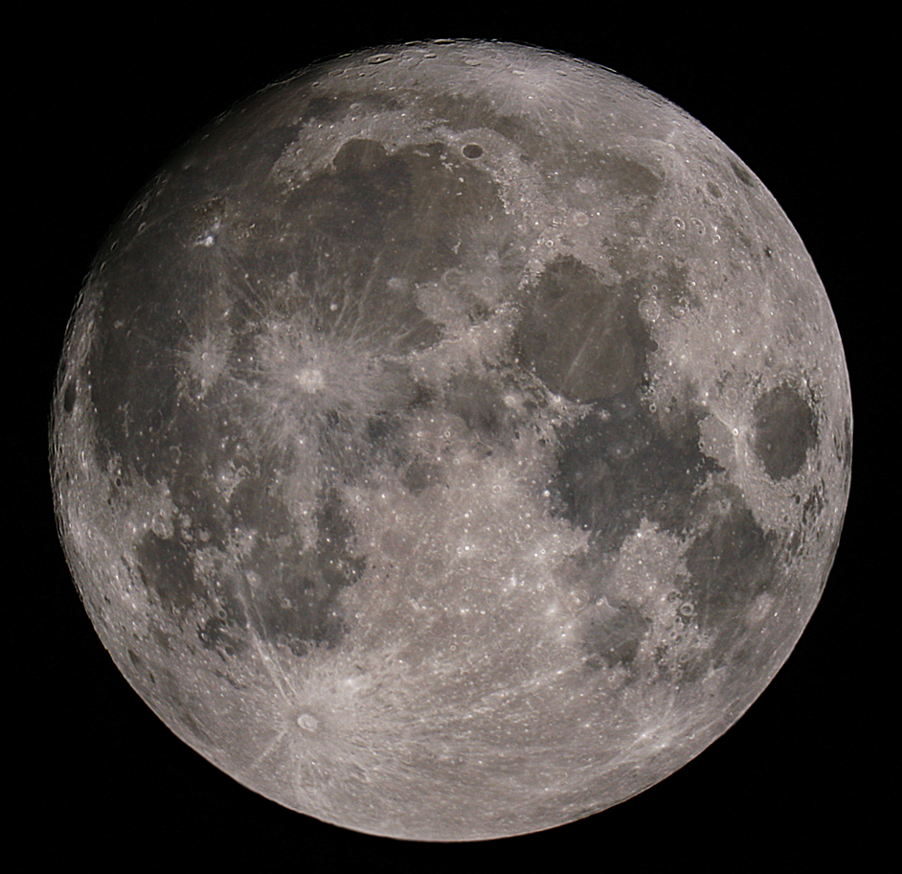
The Moon – The Whole Thing!
The Big Craters with Bright “Rays” are
Copernicus
and
Tycho

Slide 52
The Moon – Dry “Seas”,
Or “Maria”
Oceanus Procellarum
Mare Imbrium
Mare Nubium
Mare Serenitatus
Mare Tranquillitatus
Mare Crisium, “Sea of Crises”

Slide 53
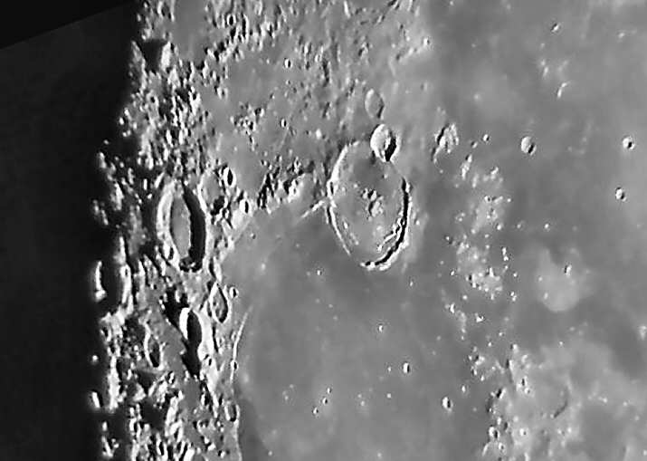

More “Moon Shots”
Craters on the Far Side of the Moon
Gassendi Crater

Slide 54


More “Moon Shots”
Craters and Rilles, Peaks and Valleys

Slide 55
Current Events in Astronomy
TONIGHT . . .
PLANETS – Most of them now are up in the DAYTIME!
Mars & Pluto*; Mars rose 5:15 a.m., set 2:15 p.m.
Pluto rose 3 a.m., set 1 p.m.
Mercury, Uranus, & Venus rose after sunrise, set just after sunset; Mercury 6:05 p.m., Venus 7:10 p.m.
Moon – rose just before sunrise, set about 3 p.m.
Saturn – Rises around sunset, sets about sunrise, in the constellation Leo the Lion
Open Cluster M45 “The Pleiades” - In Taurus the Bull
Double Cluster in Perseus – Almost straight up
Open cluster Hyades & star Aldebaran overhead in Taurus
M31 Andromeda Galaxy – Sinking in the west
Constellation Orion the Hunter, Great Orion Nebula
Castor & Pollux, stars in Gemini the Twins
Bright winter stars: Sirius, Capella, Rigel
Notes:
These are a few of the celestial objects it is possible to see in tonight’s sky. We probably won’t see them all, depending on their position in the sky and our location with regard to obstacles such as trees, buildings, and perhaps some cloud cover.

Slide 56


TONIGHT’S SKY
Saturn in Leo
Andromeda
Venus setting
Taurus
Orion
7:30 p.m.
Notes:
If we had low horizons all around, like out on the ocean, here is what you could see tonight. This sky chart shows the major constellations, groupings of stars that men have named over the centuries, to help us be more familiar with our starry tapestry above.
If conditions outside permit, we will point out some of these constellations to you.

Slide 57
The scientific method
The scientific method is the best way to discovered for the truth from non-truth. The simple version looks something like this:
Observe some aspect of the universe.
Invent a tentative description, called a hypothesis, that is consistent with what you have observed.
Use the hypothesis to make predictions.
Test those predictions by experiments or further observations and modify the hypothesis in the light of your results.
Repeat steps 3 and 4 until there are no discrepancies between theory and experiment and/or observation.
When consistency is obtained the hypothesis becomes a theory and provides a coherent set of propositions which explain a class of phenomena. A theory is then a framework within which observations are explained and predictions are made.

Slide 58
Questions
Questions
?
http://www.BackBayAstro.org

Slide 59

Your “Solar System Ambassador”
George Reynolds
and Kevin Weiner, VP, BBAA
Thank You!

Slide 60
And now, we urge you . . .

Slide 61
Boldly GO!

